Slide 1
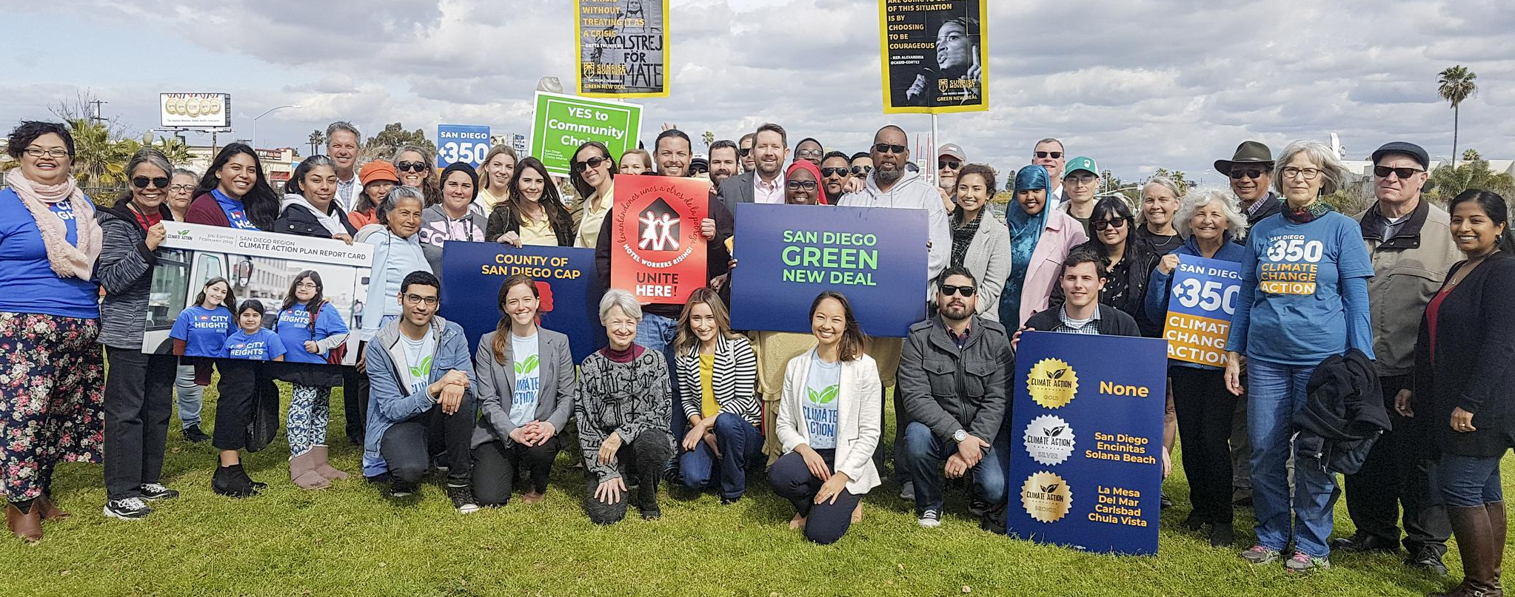
CLIMATE ACTION CAMPAIGN
Notes:
NC

Slide 2
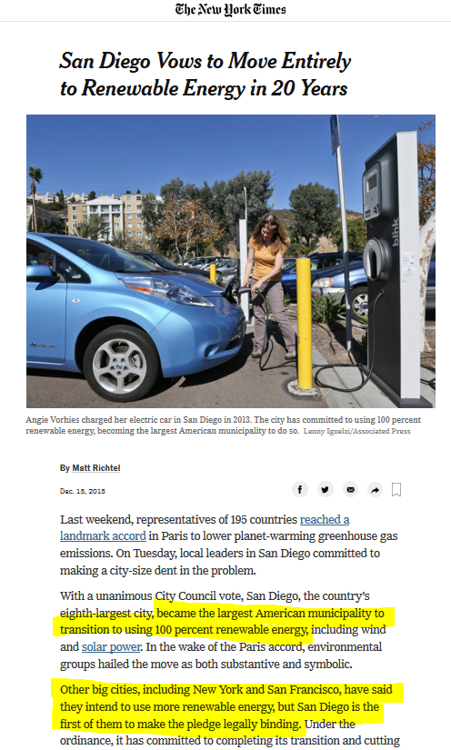
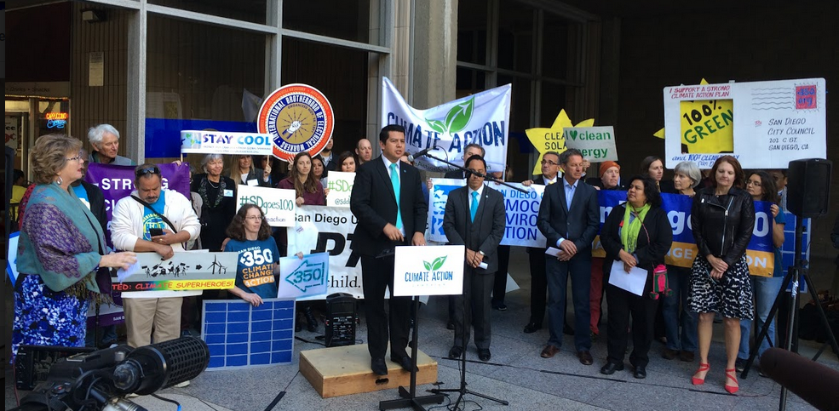
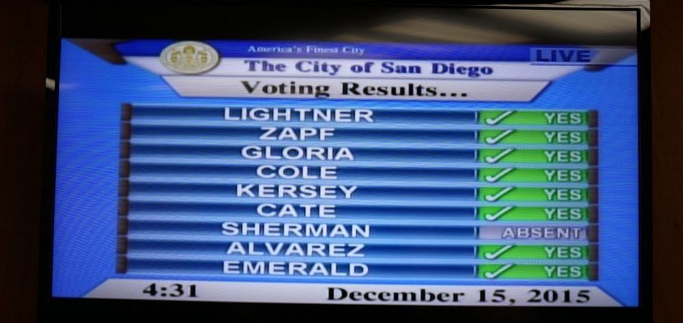
Notes:
Derived from emissions inventory

Slide 3
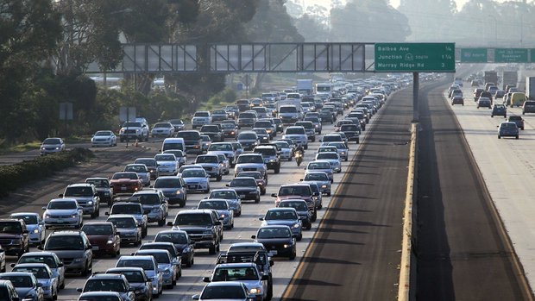
Notes:
Derived from emissions inventory

Slide 4
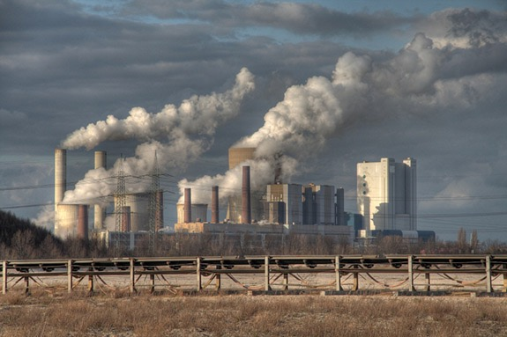
Notes:
Derived from emissions inventory

Slide 5
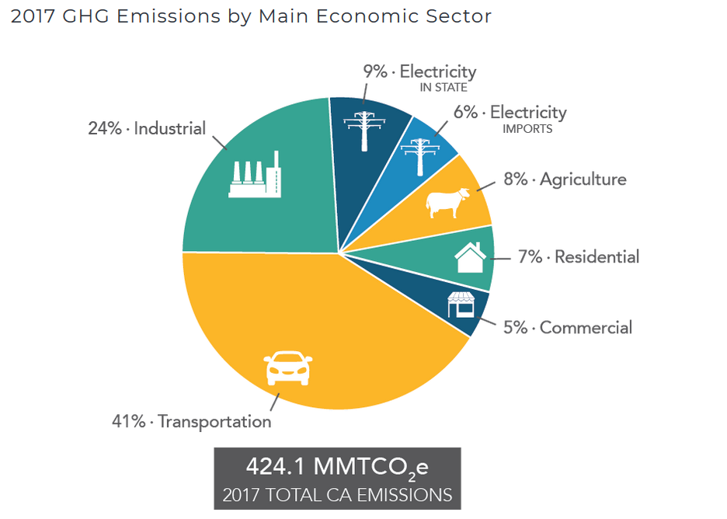
Statewide Emissions
Notes:
Derived from emissions inventory

Slide 6
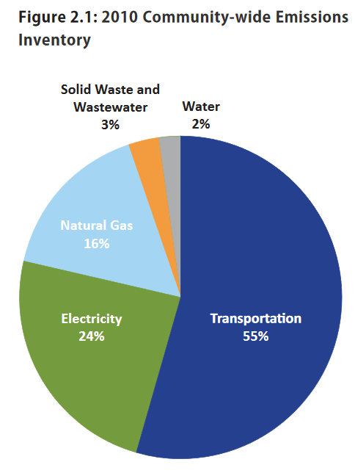
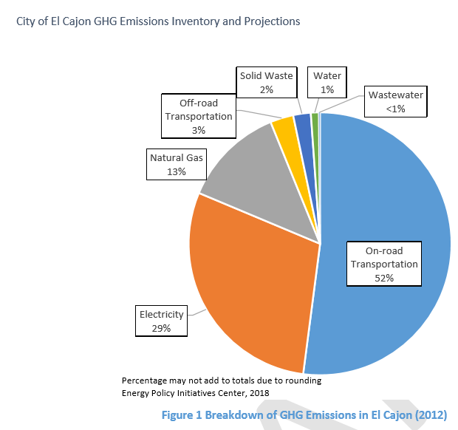
City of San Diego Emissions
Notes:
Derived from emissions inventory

Slide 7
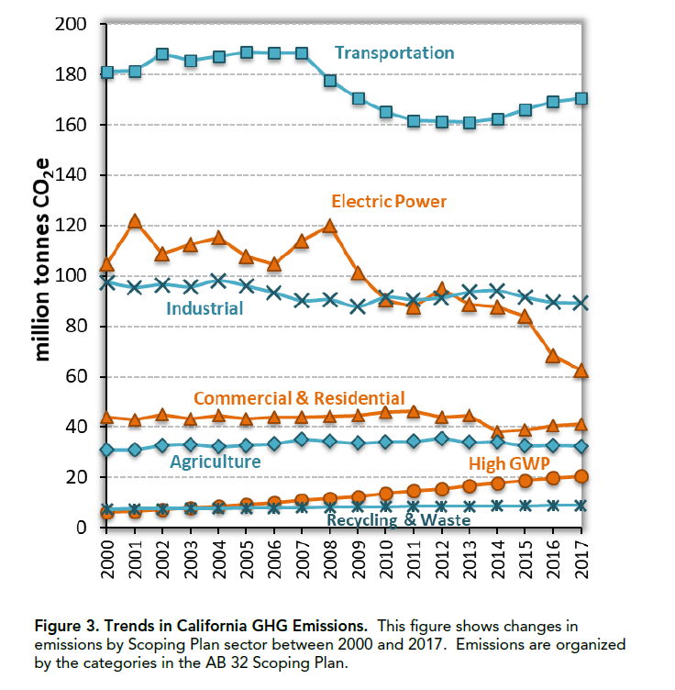
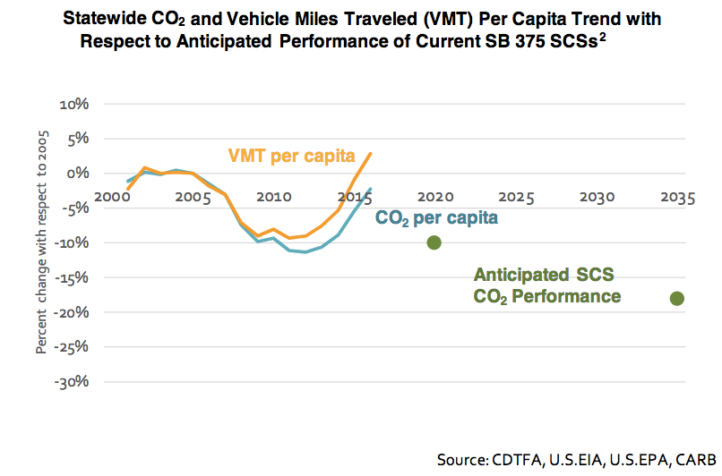
Emissions Trends
Notes:
Derived from emissions inventory

Slide 8
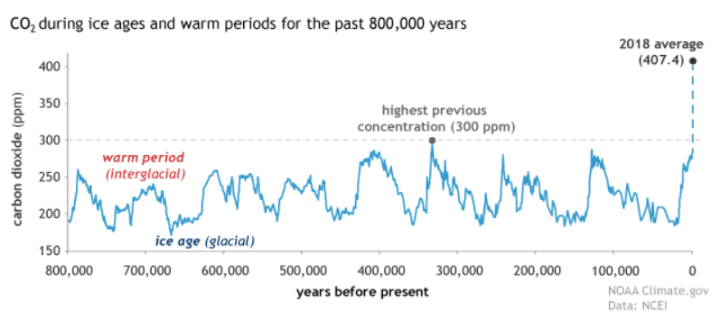
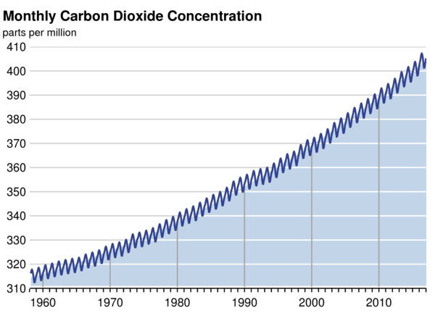
Atmospheric CO₂ on the Rise
Notes:
Derived from emissions inventory

Slide 9
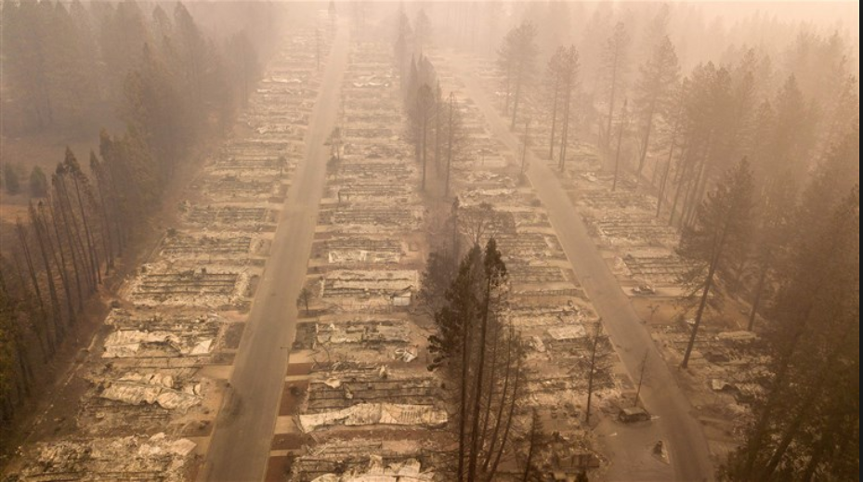
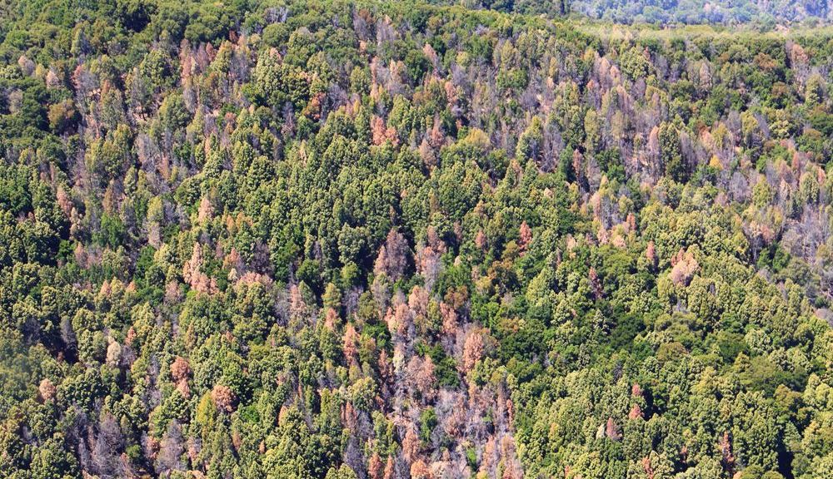
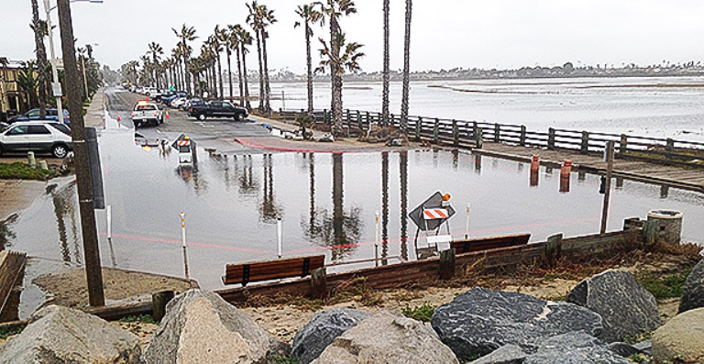
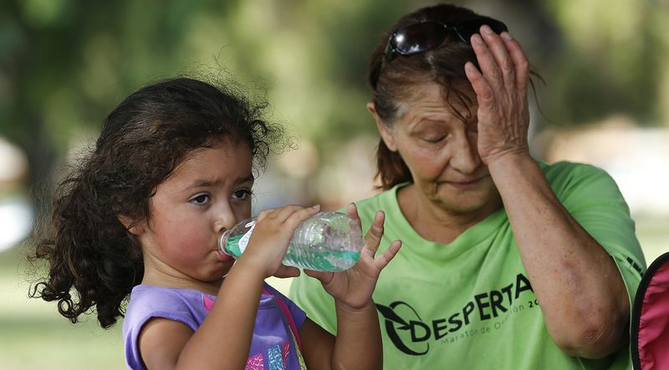
Impacts
Notes:
Derived from emissions inventory

Slide 10
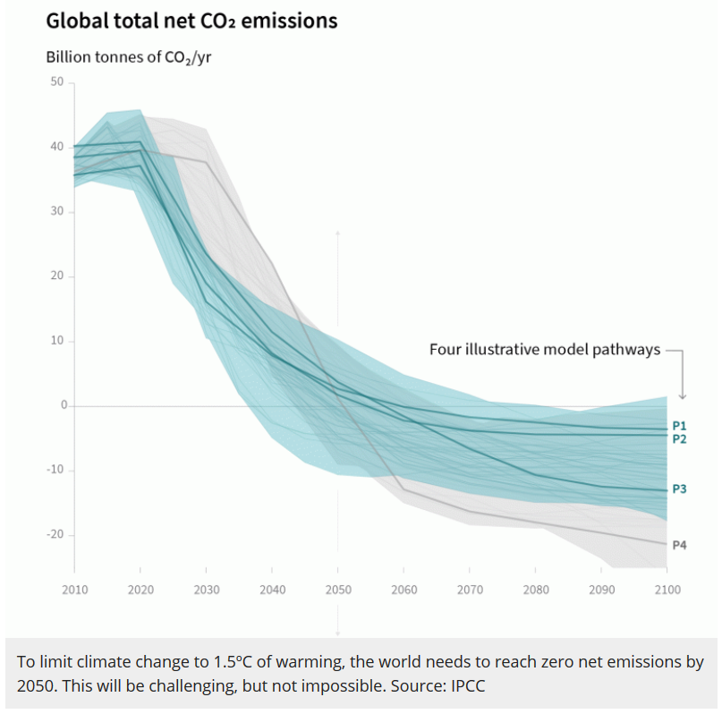
IPCC Global Warming of 1.5℃
50/50 Chance
Carbon Budget: 580 Gt CO2
2030: 45% reduction
2050: Carbon Neutral
2/3 Chance
Carbon Budget: 420 Gt CO2
2040: Carbon Neutral
Notes:
Derived from emissions inventory

Slide 11
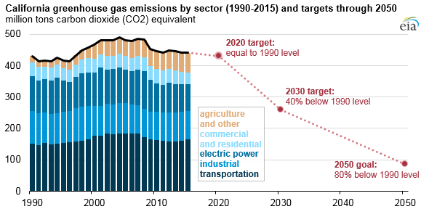
CA Climate Law
AB 32 (2006): 1990 levels by 2020
SB 32 (2016): 40% below 1990 levels by 2030
EO S-3-05: 80% below 1990 levels by 2050
EO B-55-18: Carbon neutrality by 2045
Notes:
Derived from emissions inventory

Slide 12
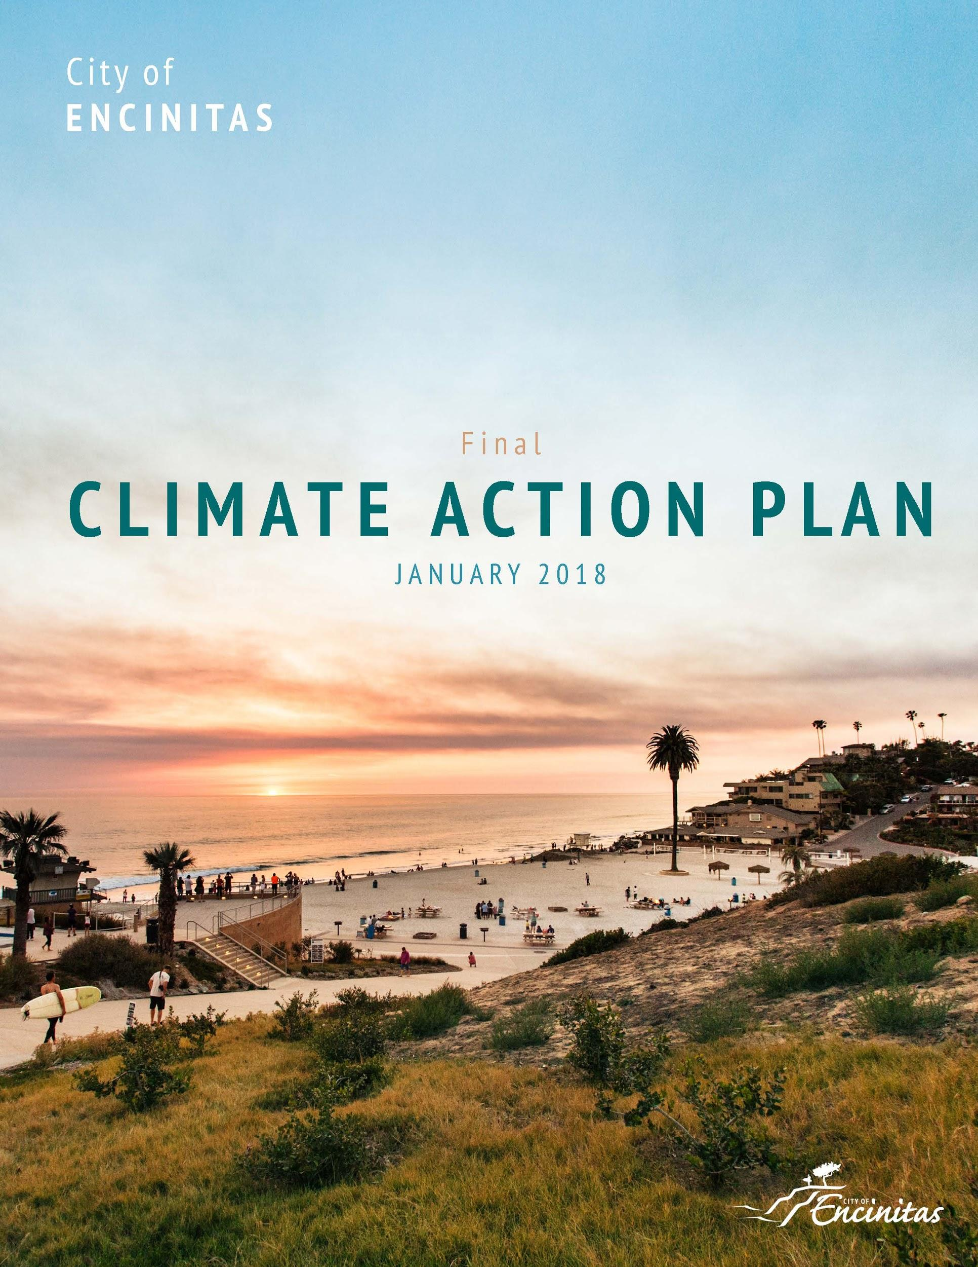
CLIMATE ACTION PLANS
-
Notes:
Mention Solana Beach

Slide 13
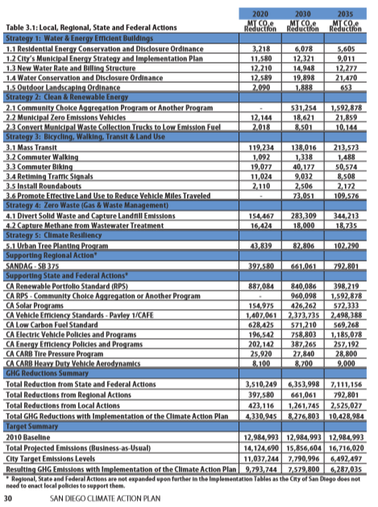
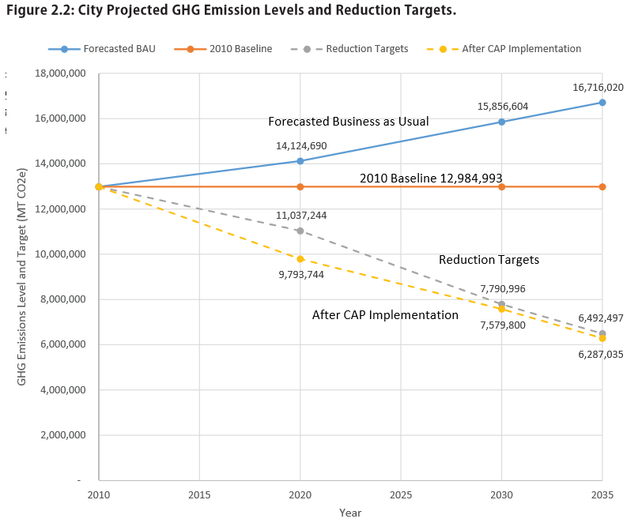
CLIMATE ACTION PLANS
Notes:
Mention Solana Beach

Slide 14
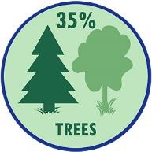
KEY STRATEGIES: 100% CLEAN ENERGY
Notes:
Derived from emissions inventory

Slide 15
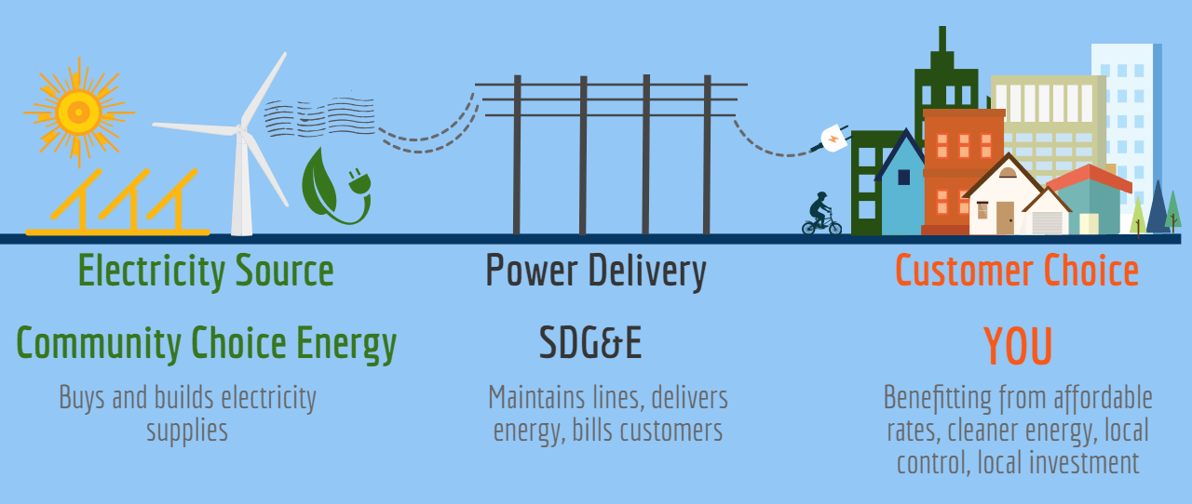
COMMUNITY CHOICE ENERGY
Notes:
Mention Solana Beach

Slide 16
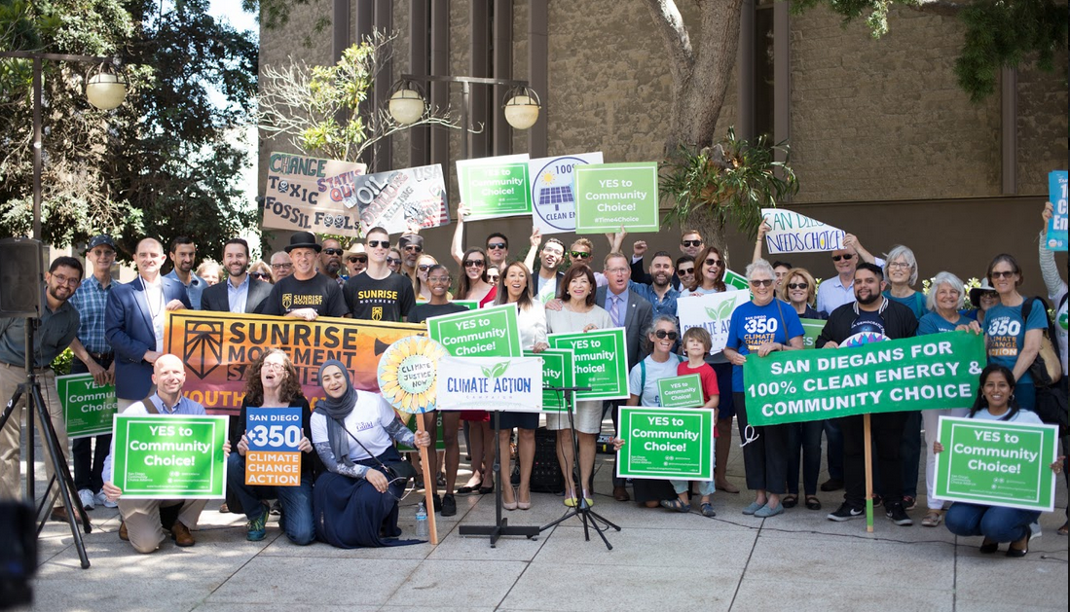
COMMUNITY CHOICE ENERGY
San Diego Regional JPA
San Diego
Chula Vista
La Mesa
Encinitas
Imperial Beach
In Negotiations
Carlsbad
San Diego County
Santee
Del Mar
Solana Beach
Notes:
Mention Solana Beach

Slide 17
KEY STRATEGIES: GREEN INFRASTRUCTURE & TREE CANOPY
Notes:
Derived from emissions inventory

Slide 18
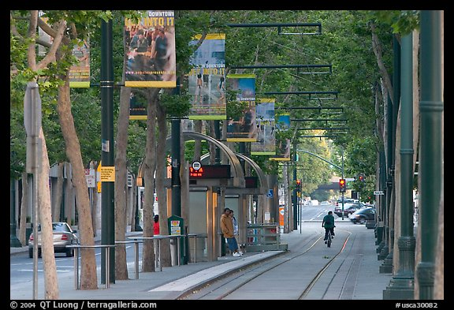
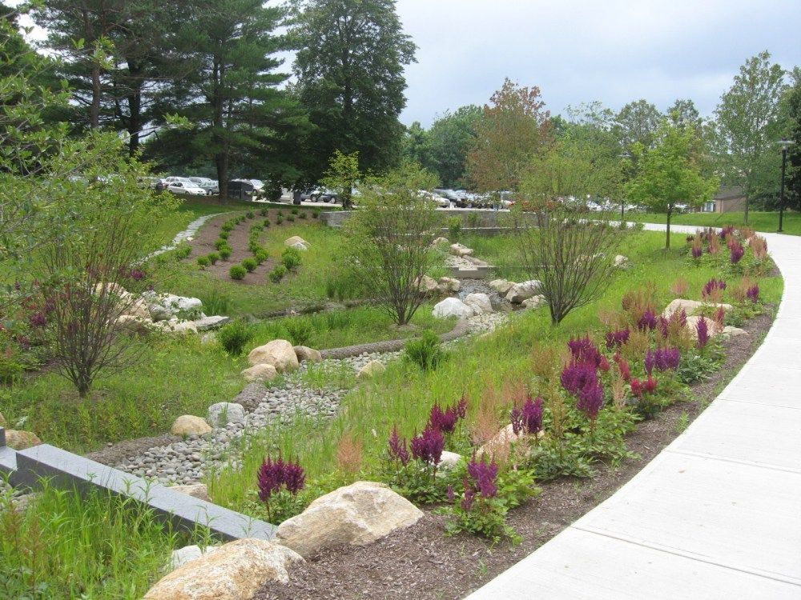
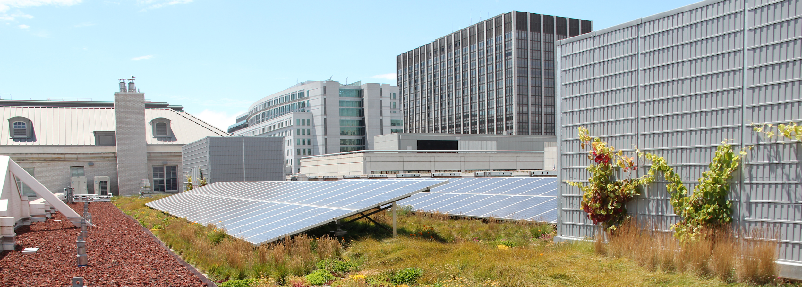
KEY STRATEGIES: GREEN INFRASTRUCTURE & TREE CANOPY
Notes:
Derived from emissions inventory

Slide 19
KEY STRATEGIES: TRANSIT, WALKING, & BIKING
Notes:
Derived from emissions inventory

Slide 20
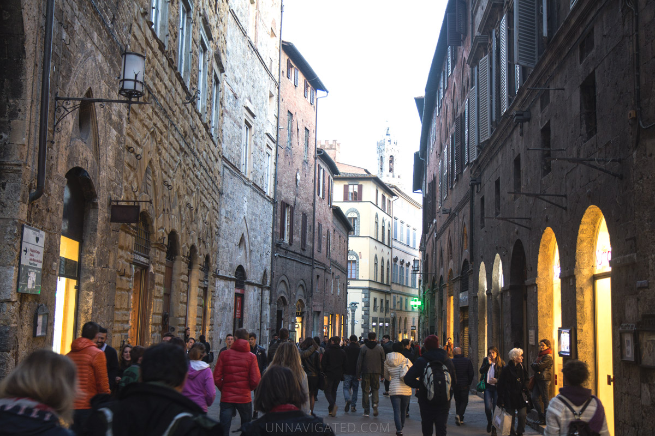
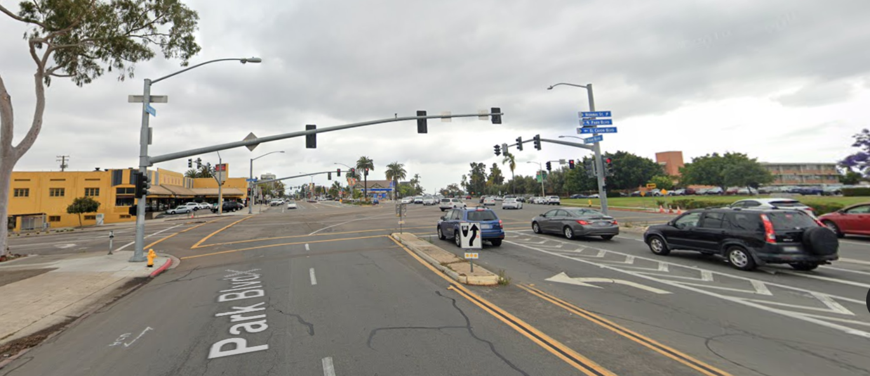
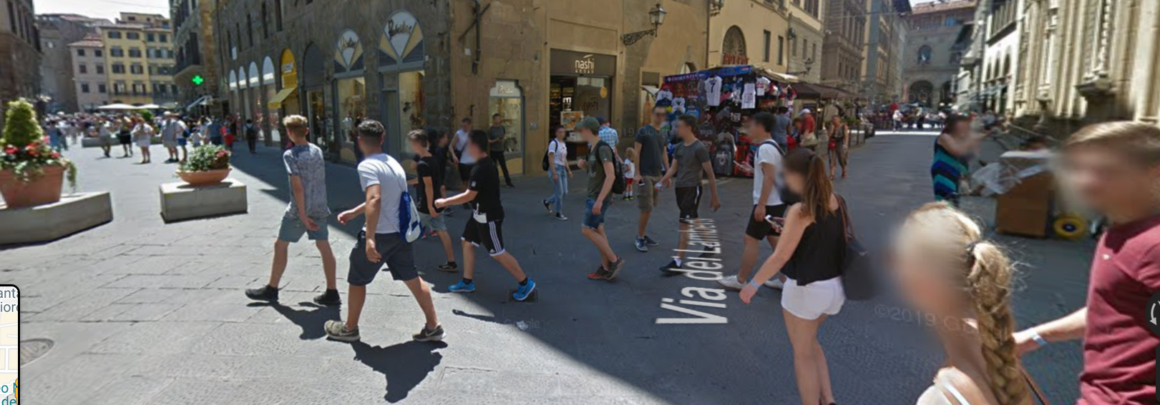
Walking
Notes:
Walking should be the city’s top transportation priority. Walking is the cheapest and most space-efficient form of transportation, it allows for social interaction, it’s built-in exercise, and it’s good for business. The most successful commercial streets tend to have high volume of pedestrians.

Slide 21
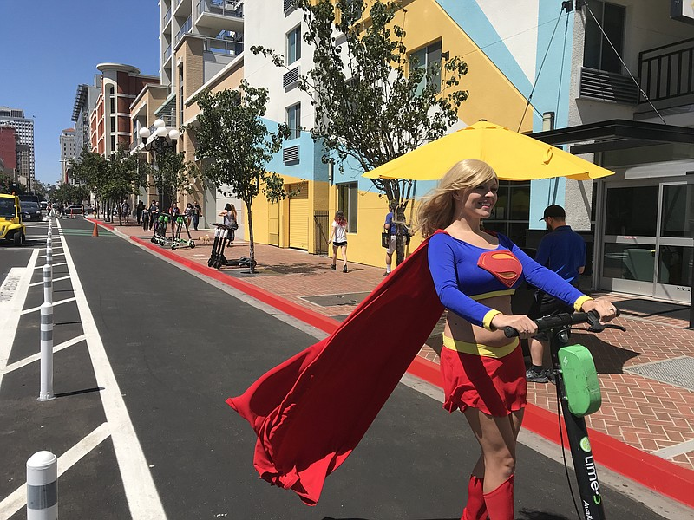
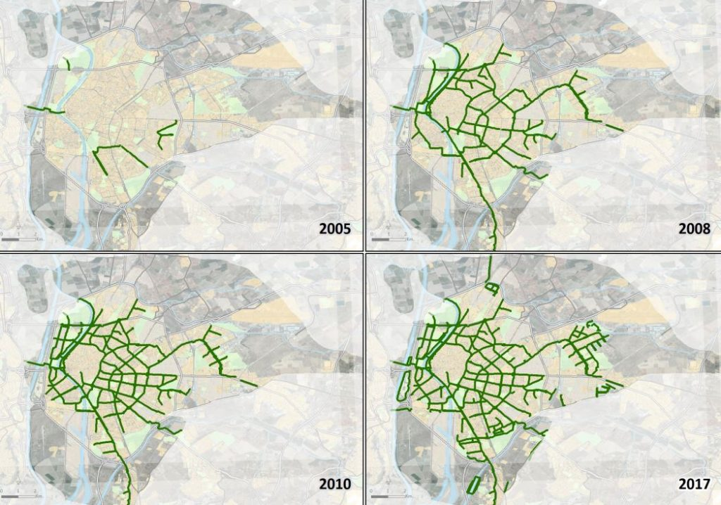
Biking
Notes:
Connec

Slide 22
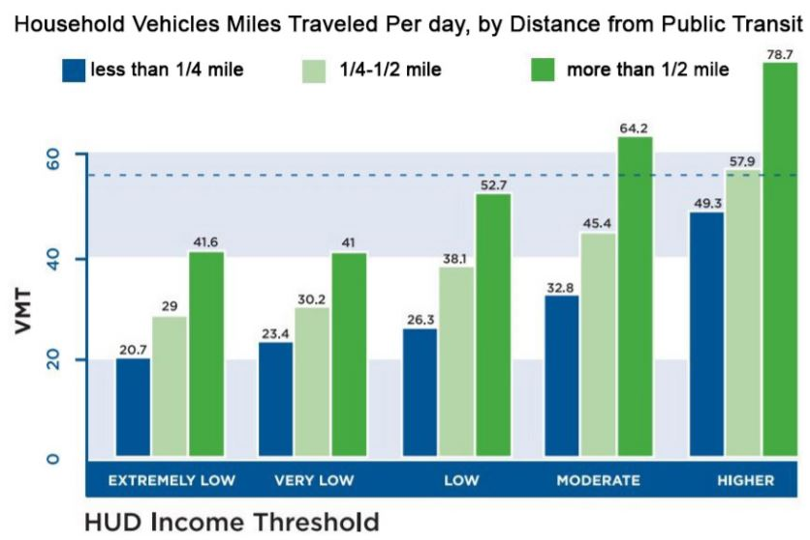
Transit
Notes:
Connec

Slide 23
KEY STRATEGIES: ZERO WASTE
Notes:
Derived from emissions inventory

Slide 24
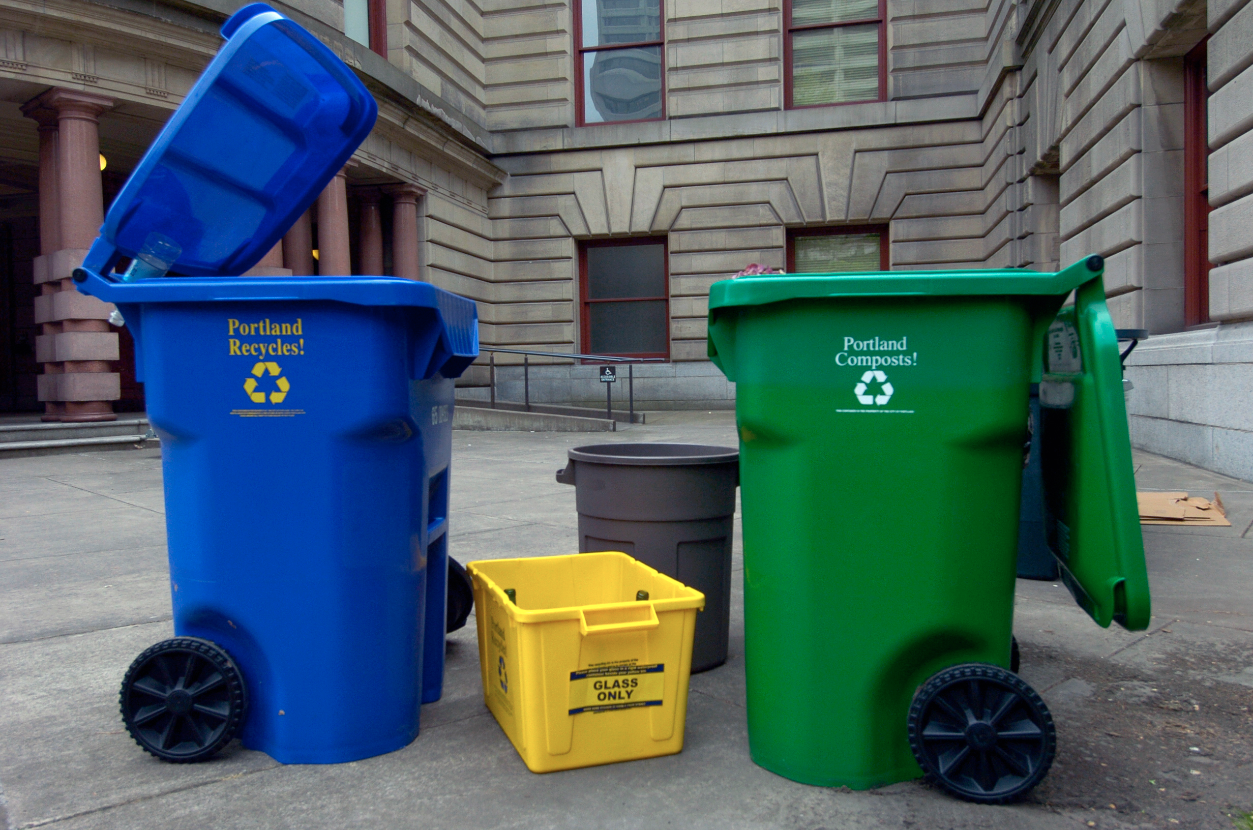
KEY STRATEGIES: ZERO WASTE
Notes:
Weekly composting and recycling and every other week trash pickup, since 2011 (spot the trash can)

Slide 25
KEY CONCEPT
Notes:
Derived from emissions inventory

Slide 26
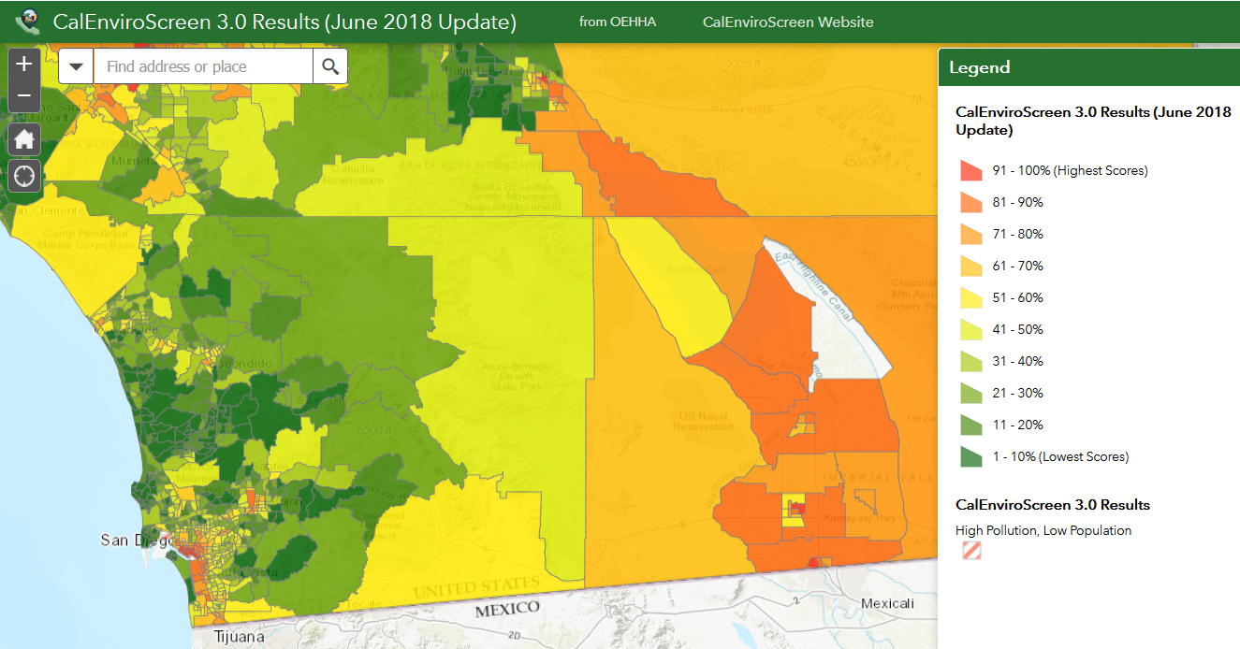
Social Equity & Environmental Justice
Notes:
Derived from emissions inventory

Slide 27
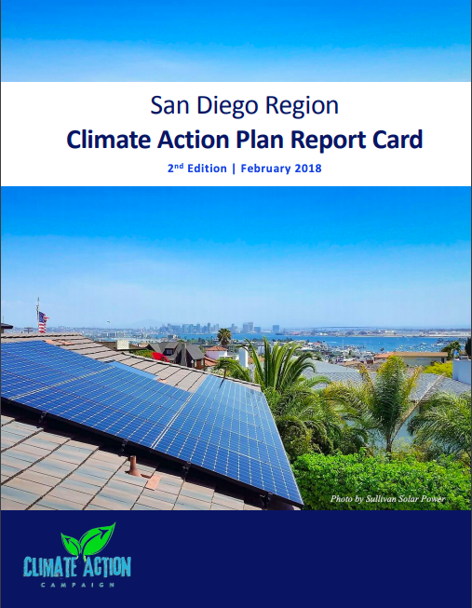
ANNUAL REGIONAL CAP REPORT CARDS
https://www.climateactioncampaign.org/2018-climate-action-plan-report-card-2/

Slide 28
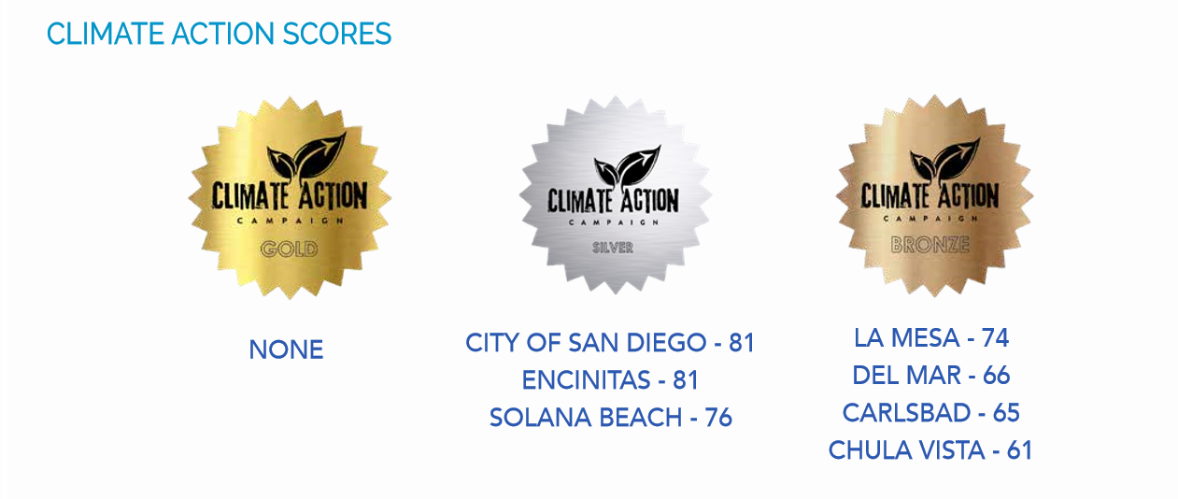
REPORT CARD RESULTS
Notes:
MM -- latest report card good, but not great

Slide 29
REPORT CARD RESULTS
THE GOOD:
Genuine effort by cities
Progress on energy
Record number of climate-friendly electeds
THE BAD:
Climate still not a top priority
Still lack real transportation choices
Failing to center communities of concern
THE UGLY:
We are not on track to meet targets
The County CAP jeopardizes regional progress.
Notes:
MM

Slide 30
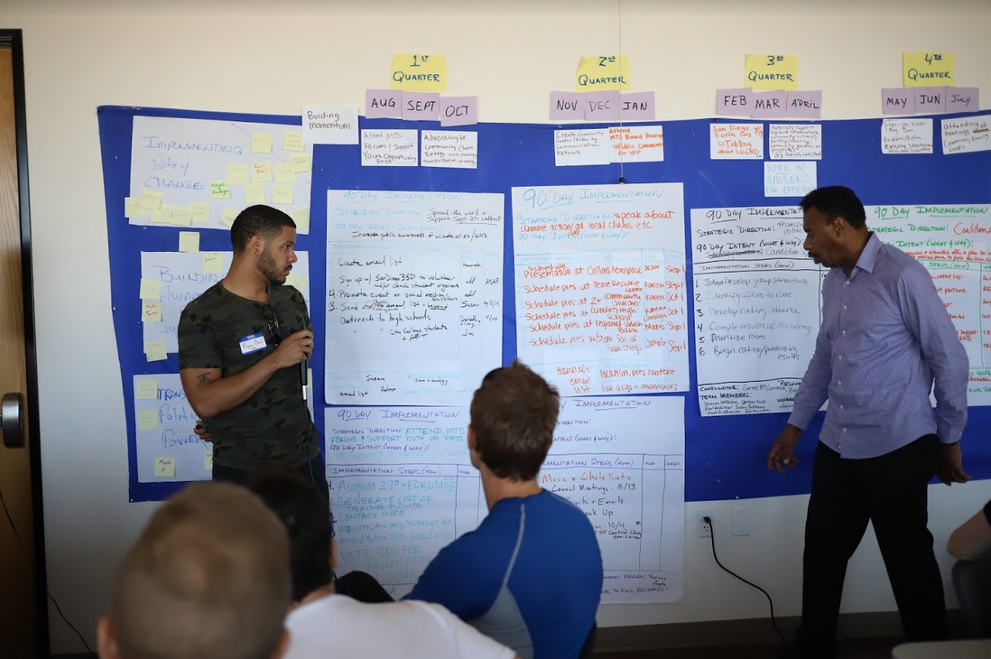
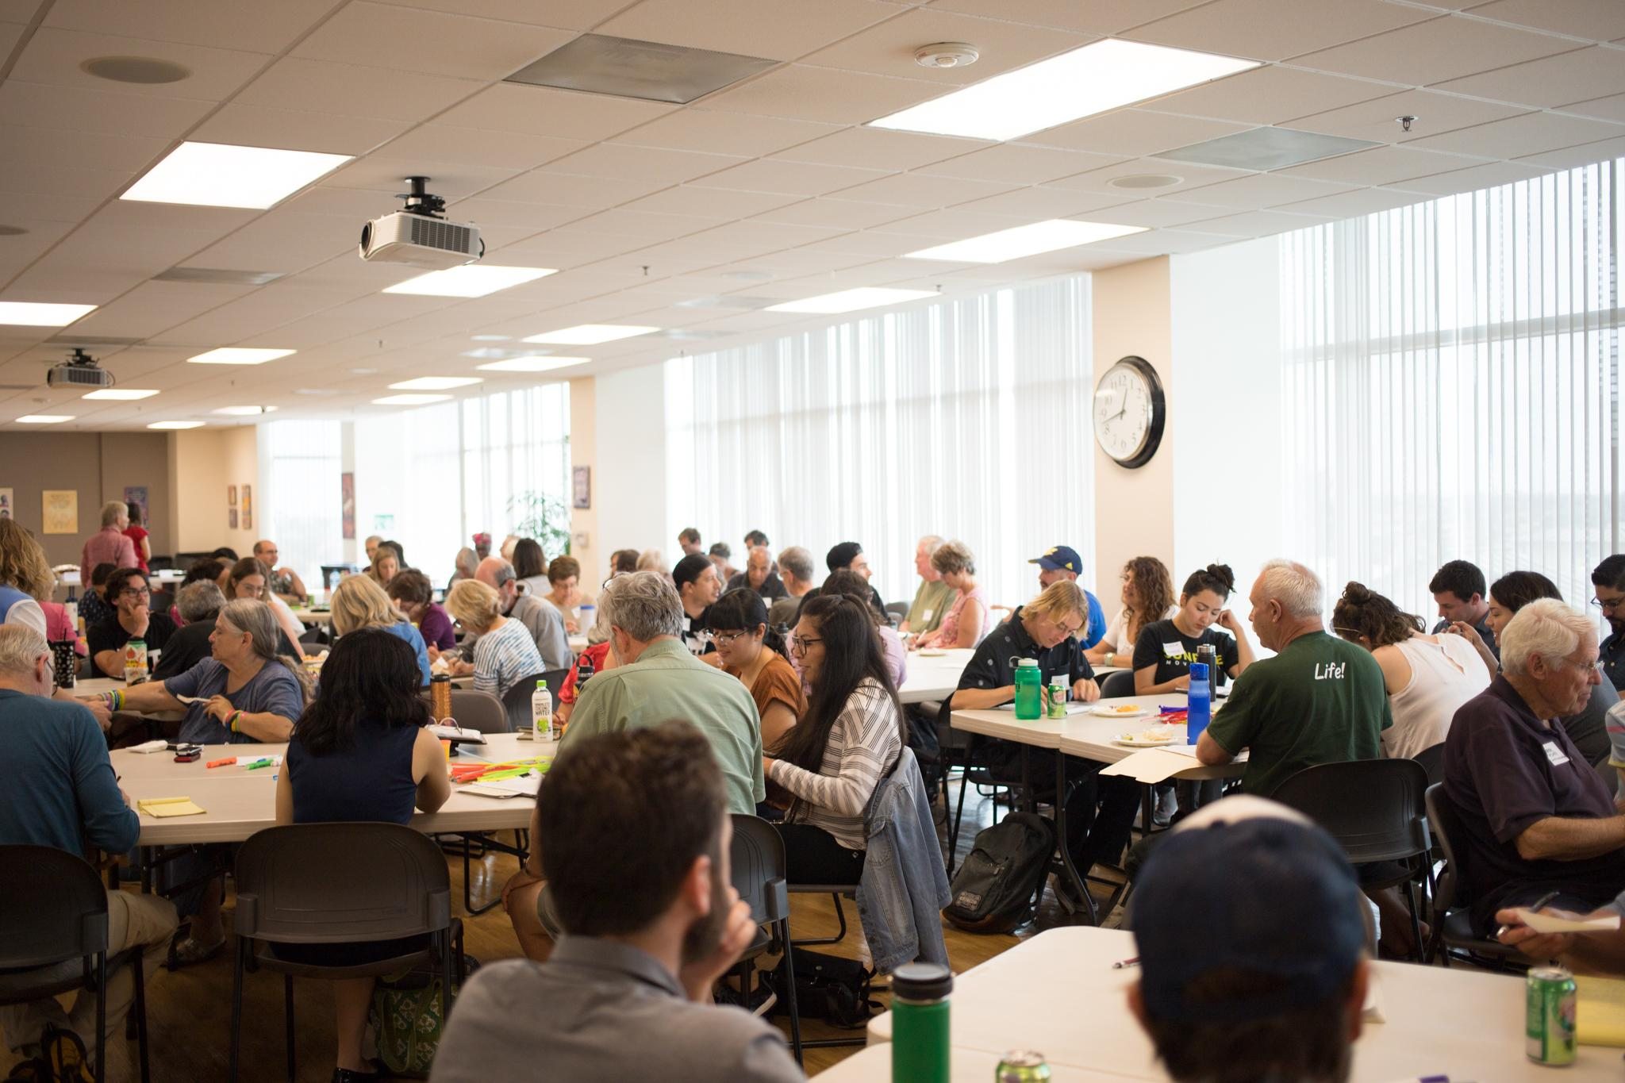
SAN DIEGO GREEN NEW DEAL
Similar to the national Green New Deal Resolution, our initiative would model how to create catalytic change here in our own backyard through investments in infrastructure and industry to fight the climate crisis, center front-line communities, and build a just society with an economy works for all.
Notes:
MM

Slide 31
Stay in Touch!
Website: ClimateActionCampaign.org
Facebook: @ClimateActionCampaign
Twitter: @sdclimateaction
Instagram: sdclimateaction
Volunteer: info@climateactioncampaign.org
Notes:
MM

