Slide 1
Integrating water management in san diego
Matt O’Malley
San Diego Coastkeeper

Slide 2
Watersheds and development

Slide 3
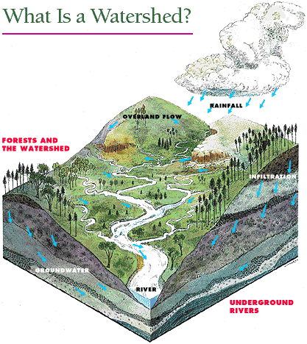
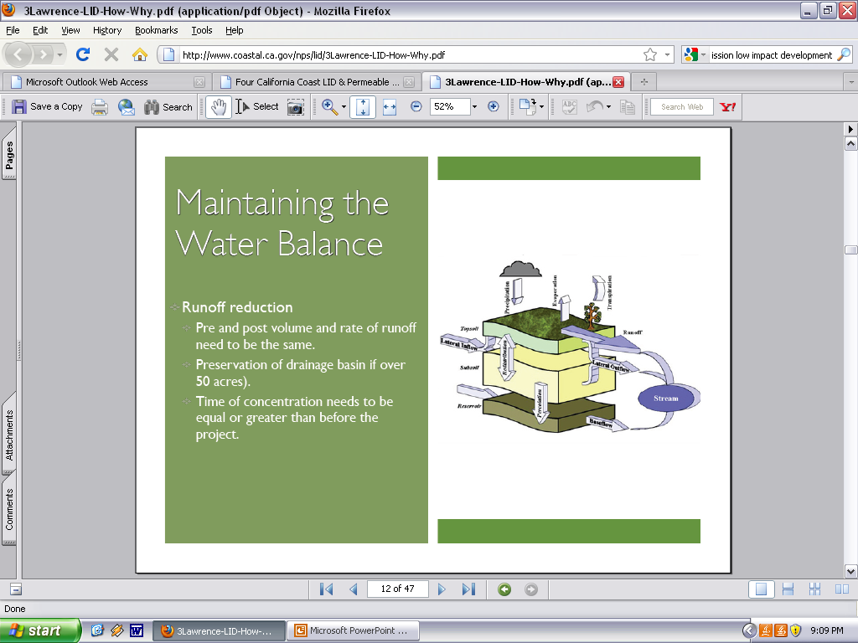

Slide 4
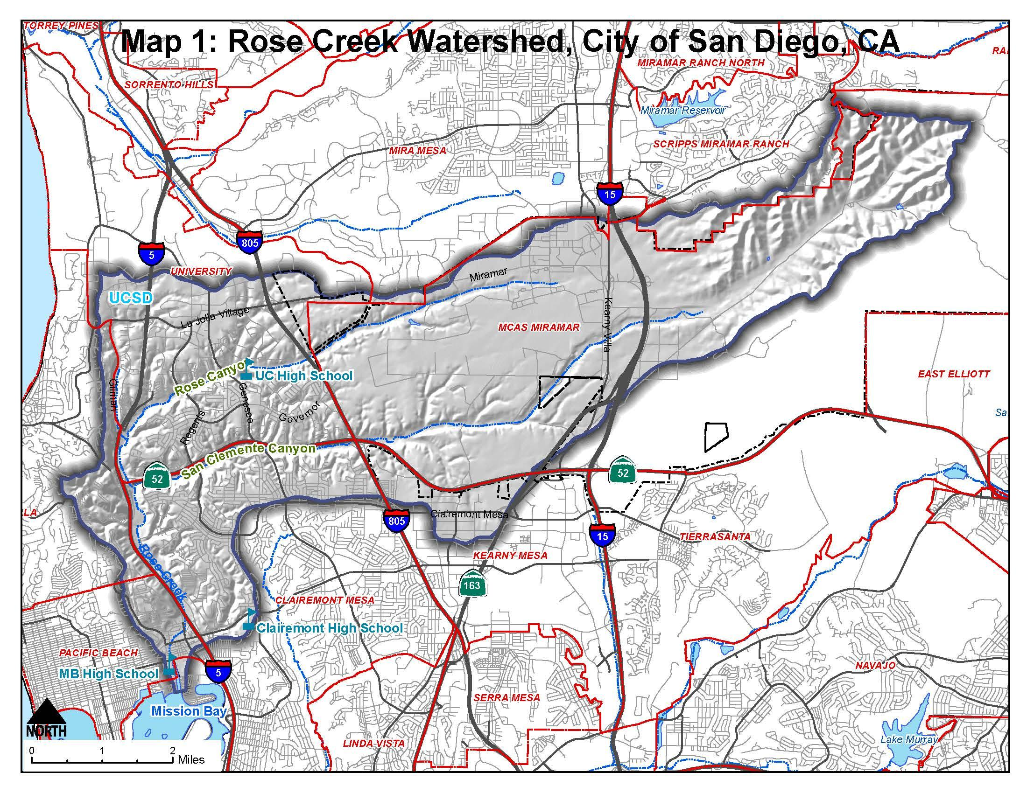
What is a Watershed?

Slide 5
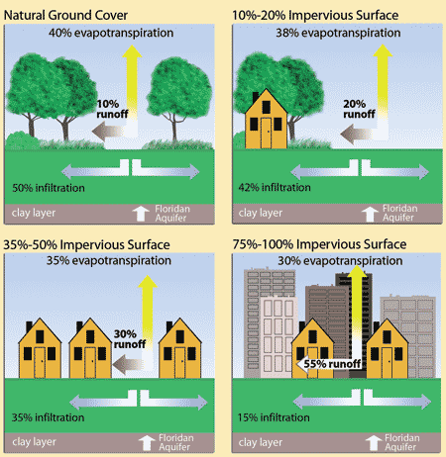
The Impact of Urbanization
Hard surfaces disrupt the normal water cycle
Notes:
Imperviousness increases stormwater volume, changes timing of peak flows, and increases the amount of pollutants loaded to watersheds
Increase in peak flow rate
Increase runoff volume
Increase in streambed erosion
Change in creek morphology
Increase in pollutant loading
Lead to changes in vegetation in stream and riparian areas
Decrease biodiversity of receiving waters

Slide 6
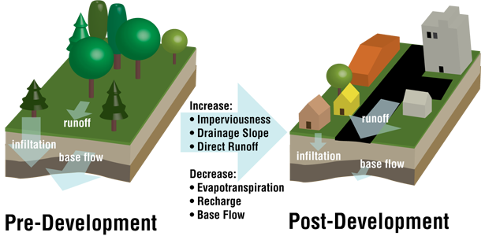
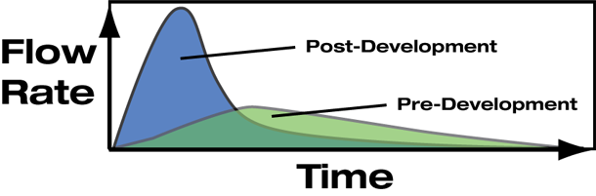
The Impact of Urbanization
Notes:
Imperviousness increases stormwater volume, changes timing of peak flows, and increases the amount of pollutants loaded to watersheds
Increase in peak flow rate
Increase runoff volume
Increase in streambed erosion
Change in creek morphology
Increase in pollutant loading
Lead to changes in vegetation in stream and riparian areas
Decrease biodiversity of receiving waters

Slide 7
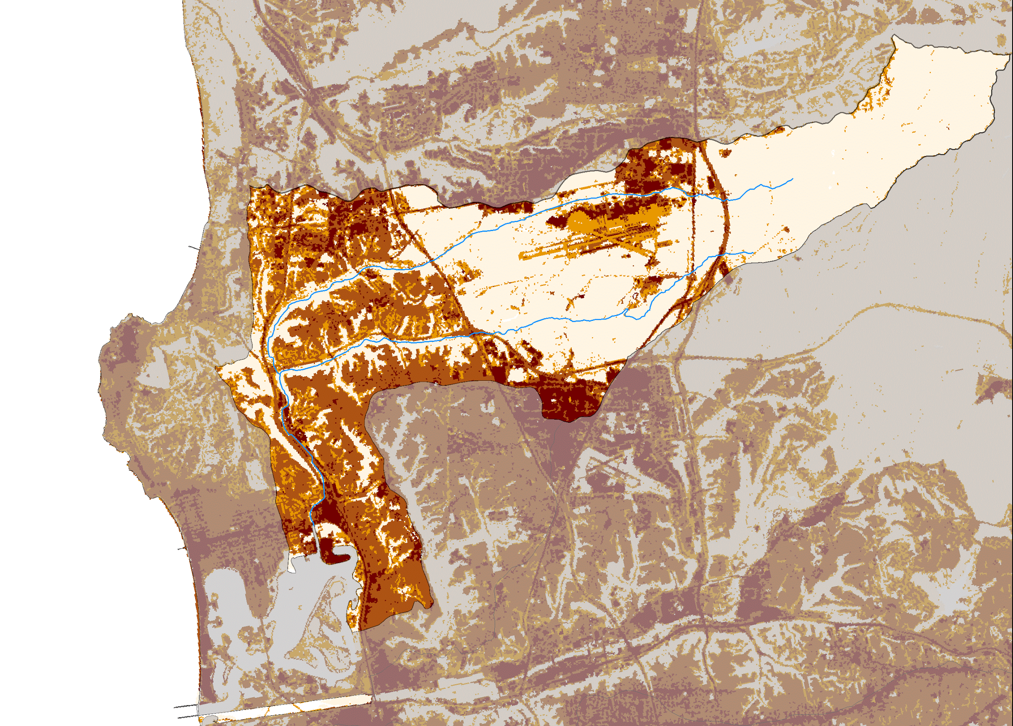
Development Intensity:
>20% impervious
20-50% impervious
50-80% impervious
>80% impervious
Data source: NOAA Office for Coastal Management

Slide 8
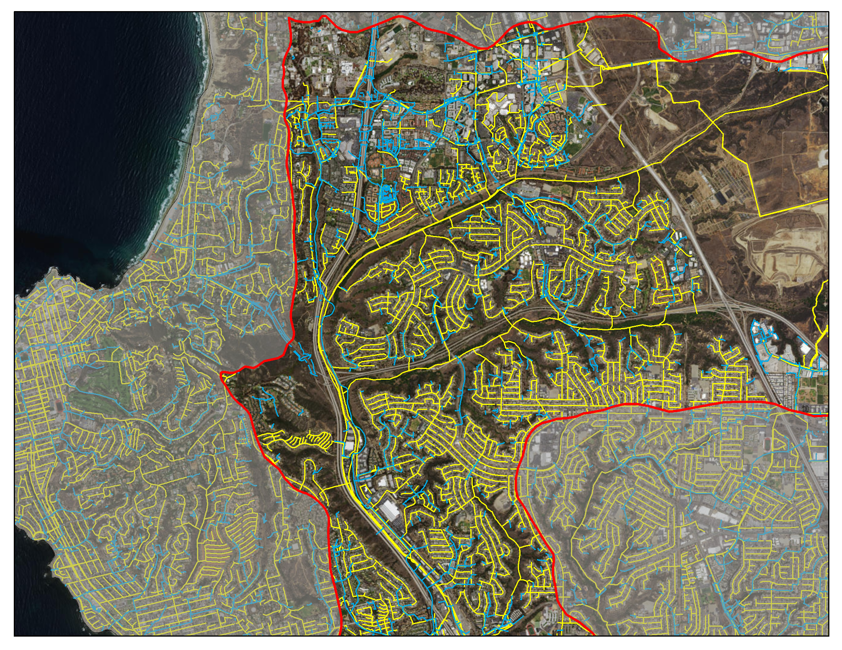
Stormwater Conveyance
Sewer Main

Slide 9
Water management in san diego

Slide 10
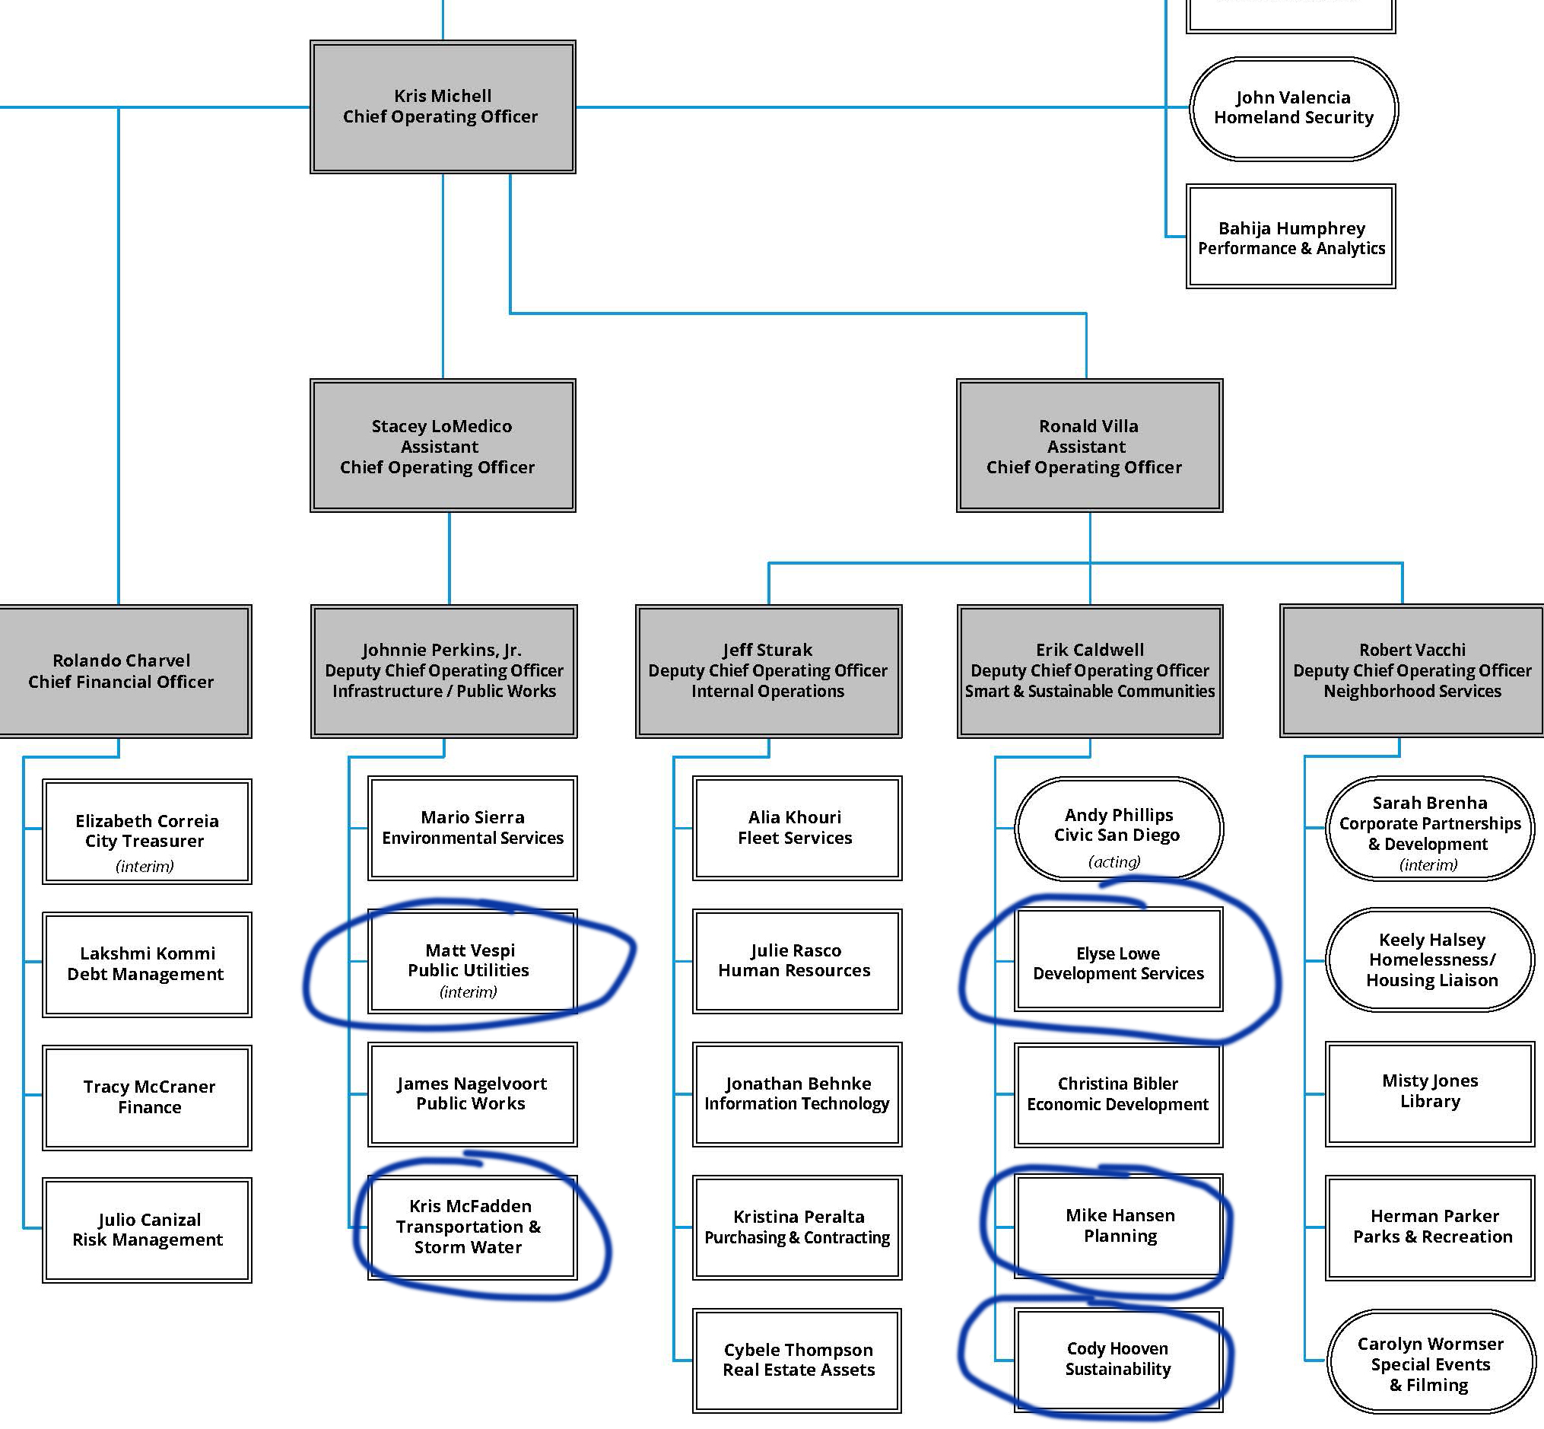
Water Management currently

Slide 11
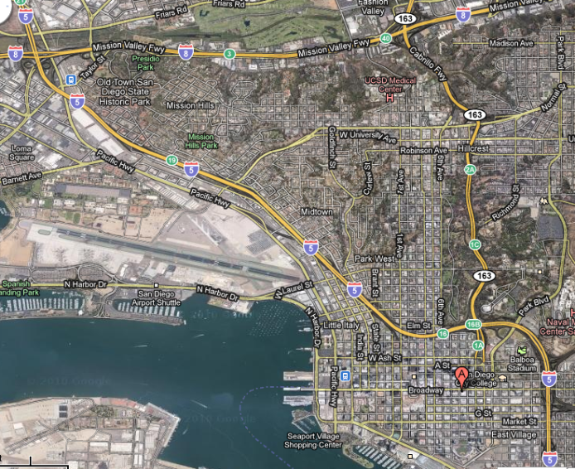
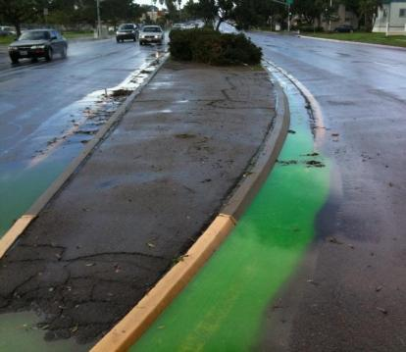
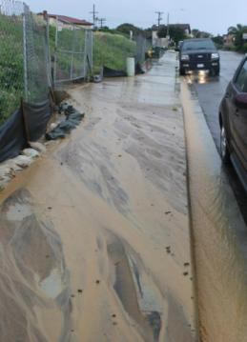
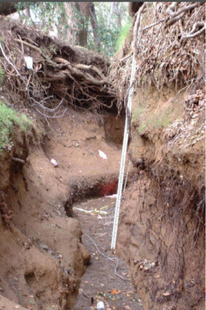
The Impact of Urbanization
Notes:
On average it only takes 10% of watershed being impervious to start seeing measurable impacts
In SD that number is lower – 3% because our streams are very vulnerable.

Slide 12
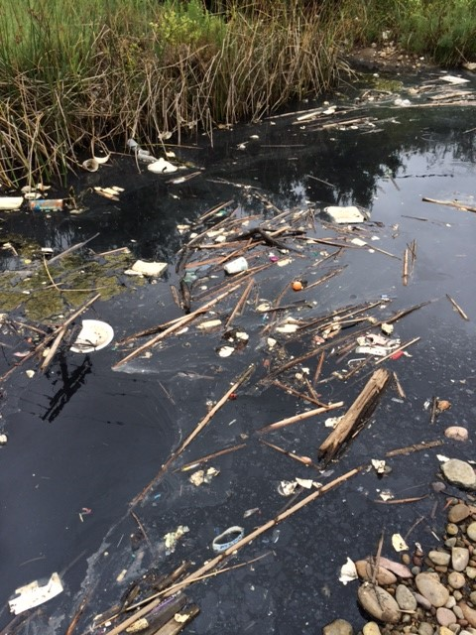
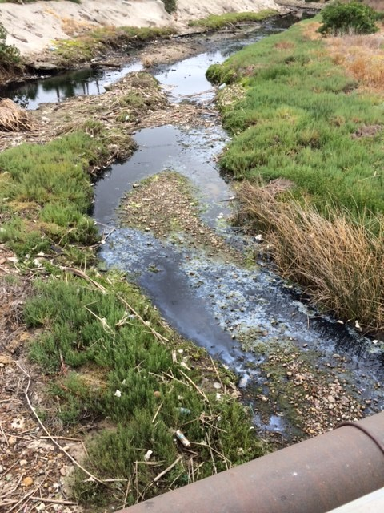

Slide 13
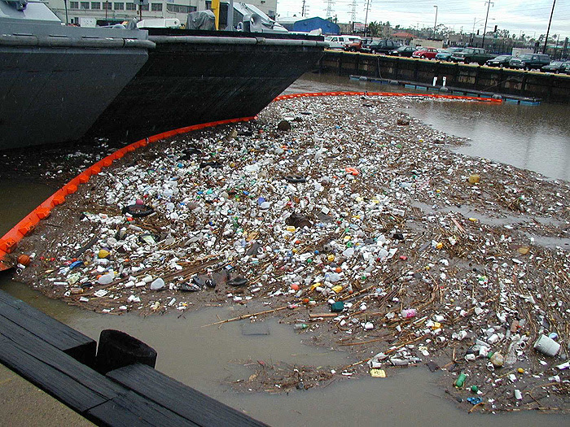
Municipal
Pollution

Slide 14
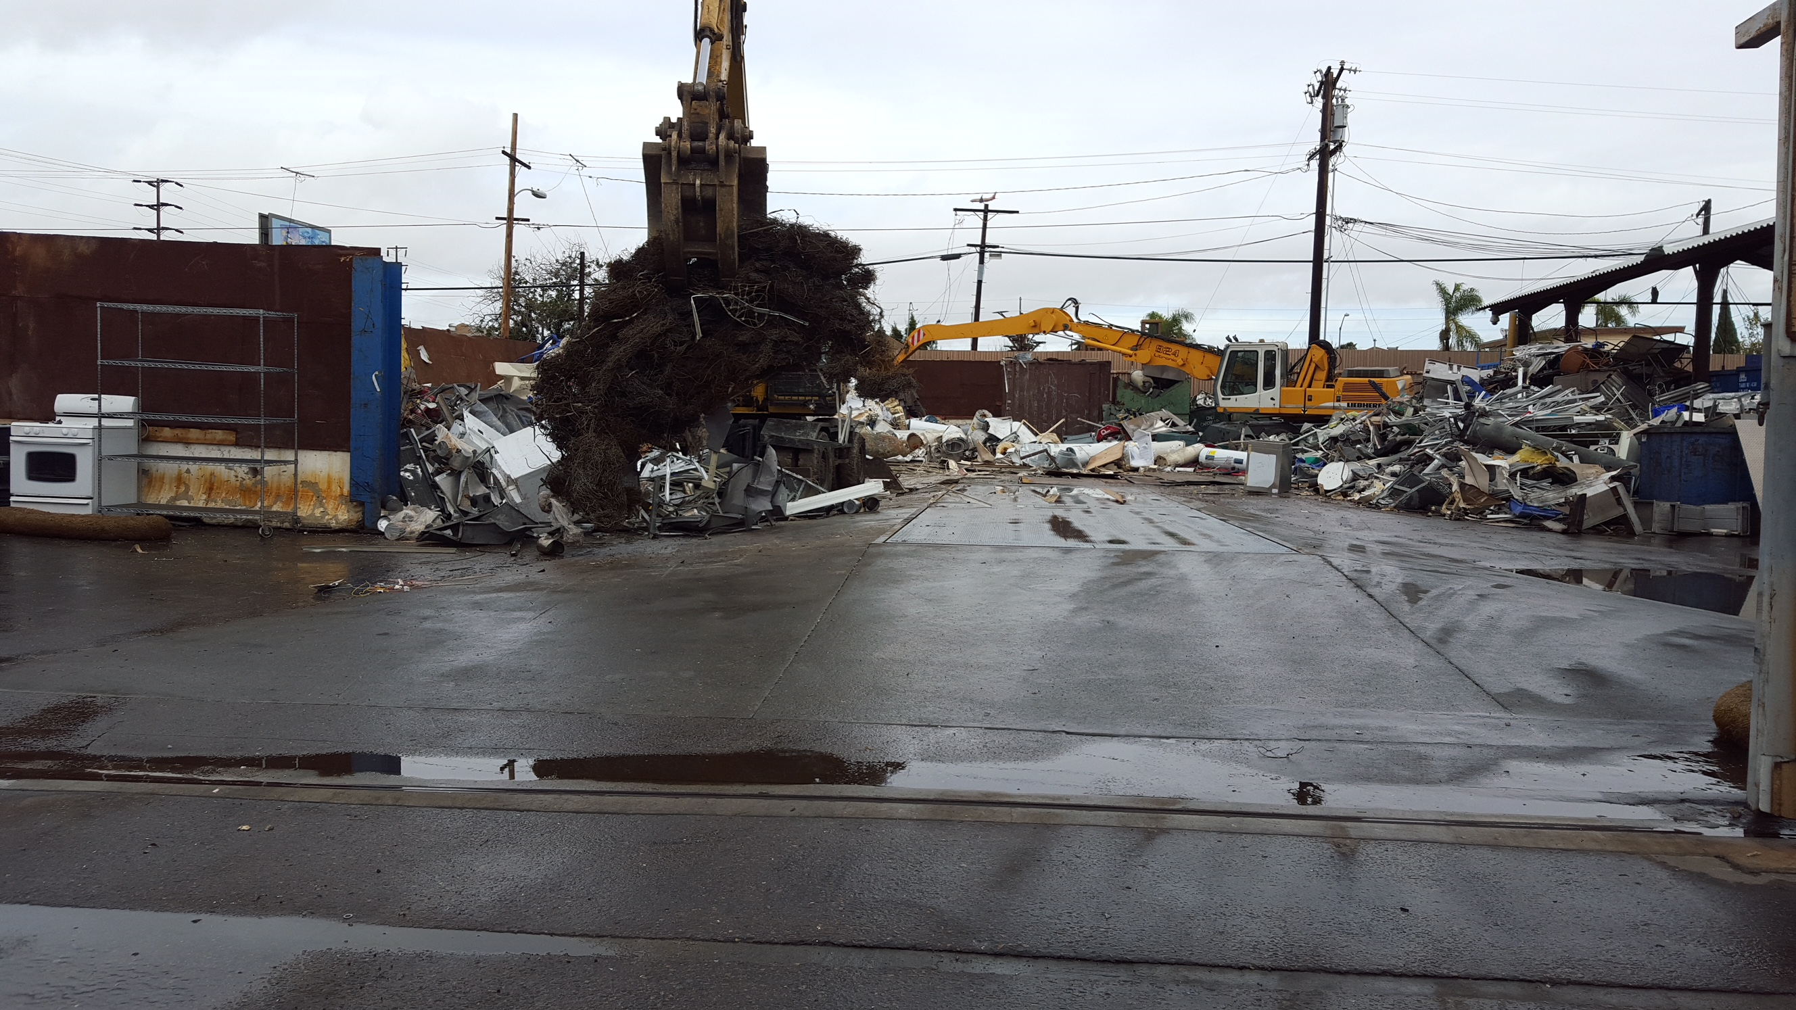
Industrial
Pollution

Slide 15
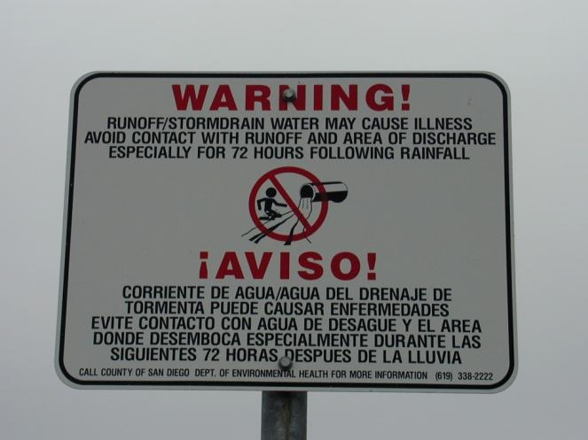
Regular beach closures
and advisories issued by County DEH

Slide 16
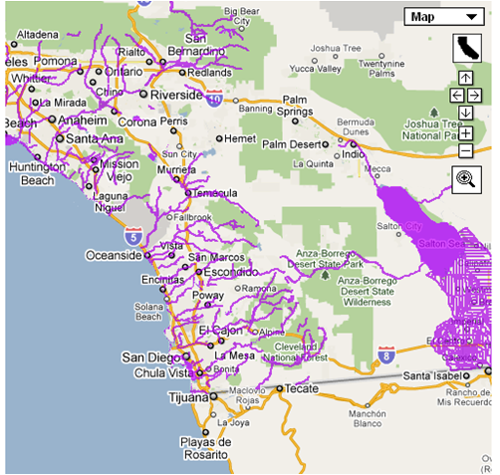
Many waters listed as “impaired”
Only a few clean up plans completed

Slide 17
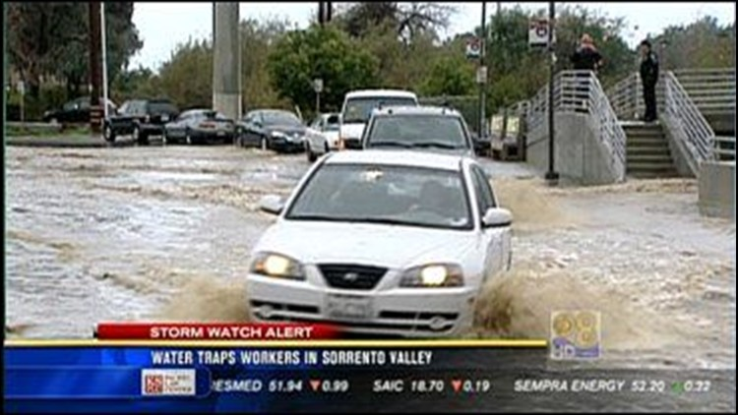
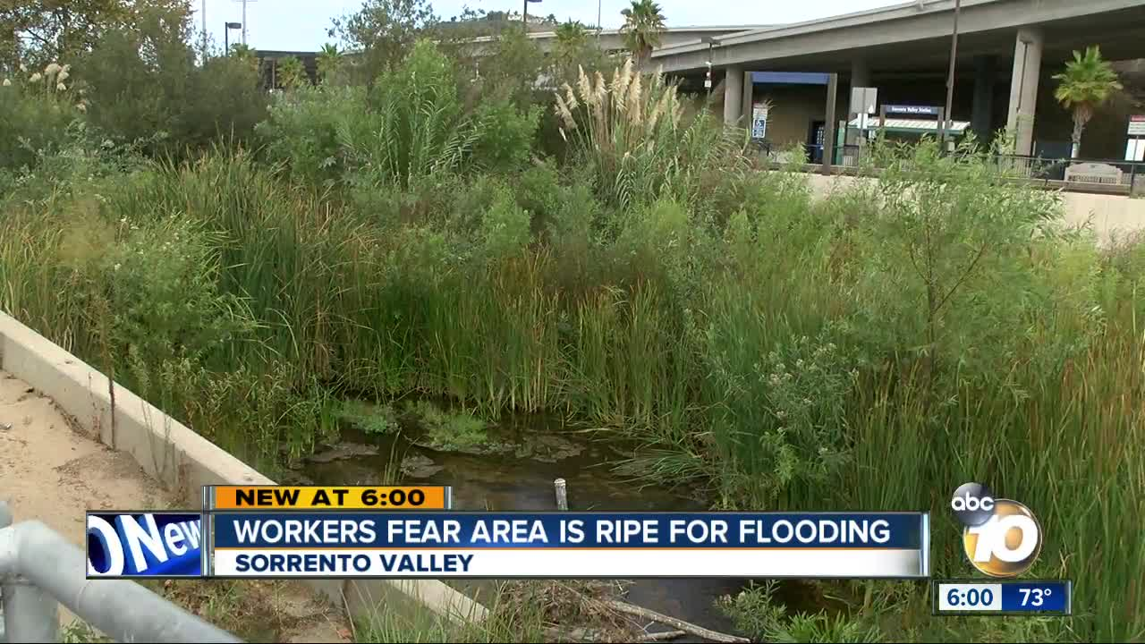

Slide 18
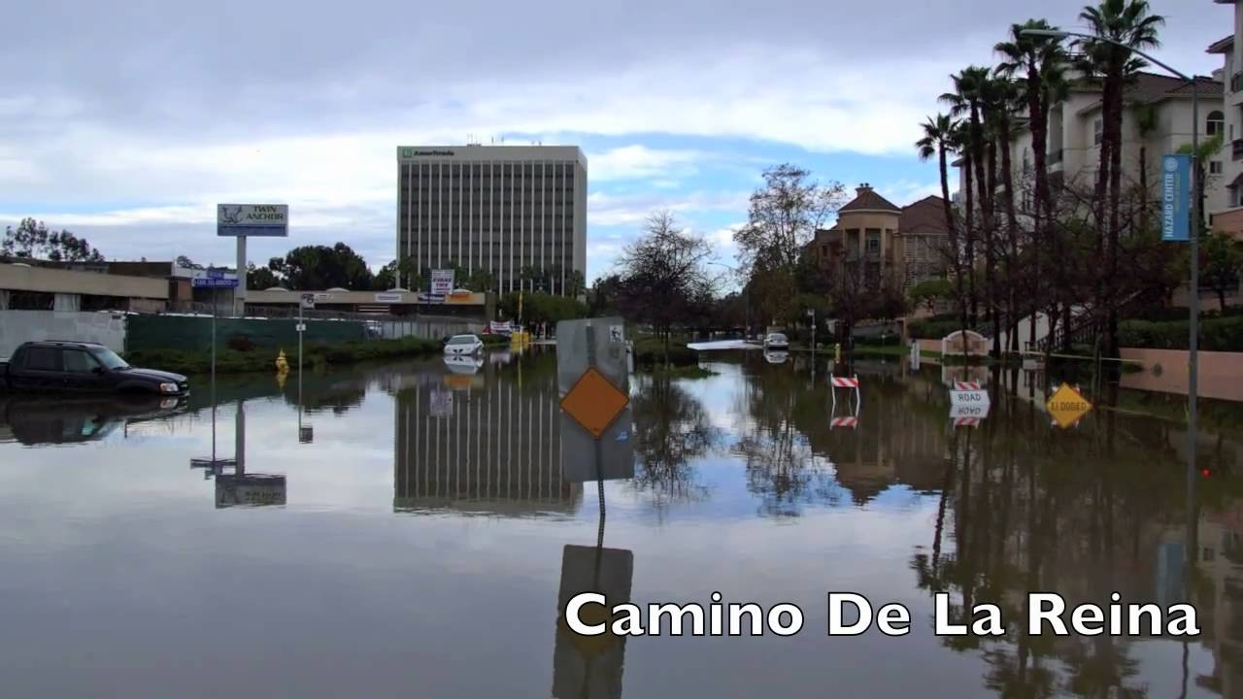

Slide 19
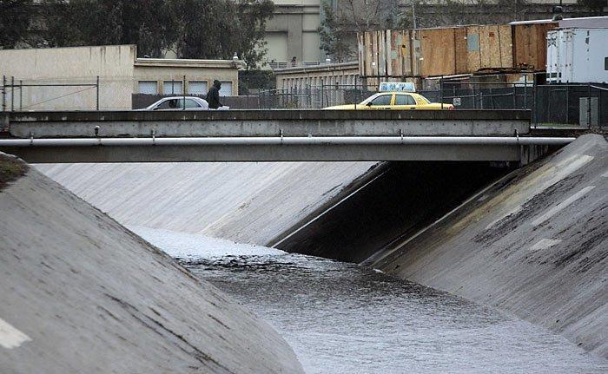
Escondido
“Creek”

Slide 20
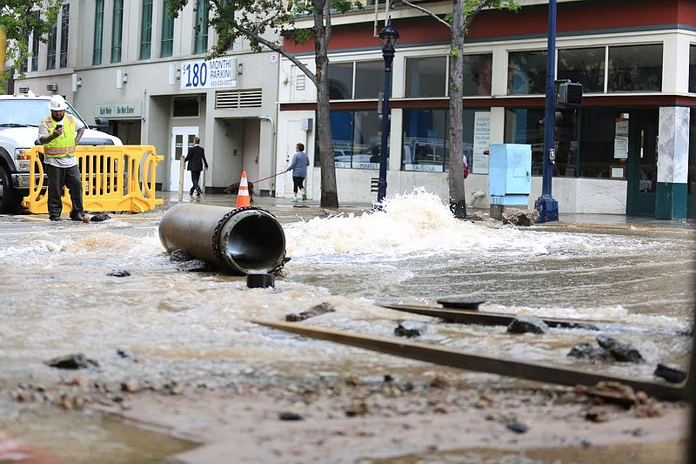

Slide 21
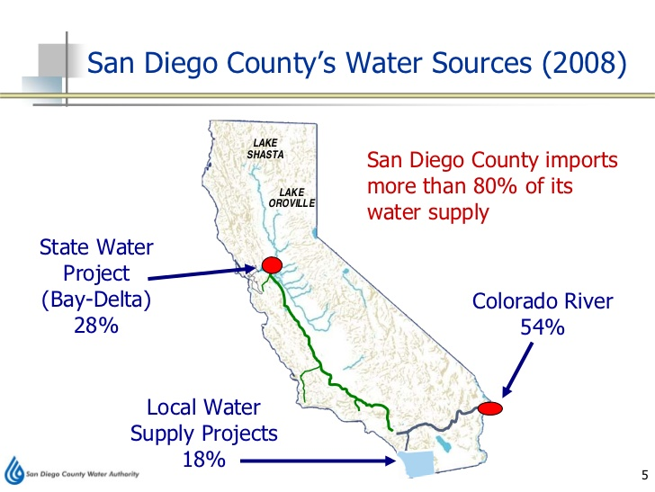
Existing Water Supply for San Diego
Notes:
Some measure of vulnerability without local control/sourcing

Slide 22
Solutions

Slide 23
Multi-Benefit, nature-based Solutions
Solutions that address pollution, water quality, and public health issues while simultaneously addressing other community needs like flooding, recycled water supply, parks, green spaces, and climate resilience.

Slide 24
COMMUNITY BENEFITS
Reduction in capital costs overall
Significant additional locally controlled water supply
Reduction/elimination of flooding
Clean beaches, bays, lagoons, rivers, streams, creeks, and watersheds
Improved public health
Green jobs
Climate resilience and adaptation
Increase in green and recreational spaces
Habitat improvement and connectivity
Improved air quality
Increased property values

Slide 25
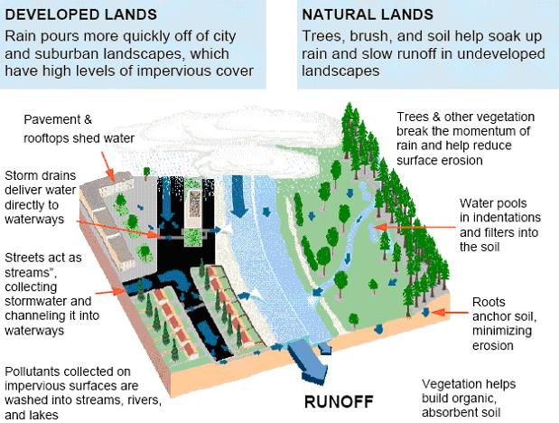
Mimicking the natural hydrologic cycle

Slide 26
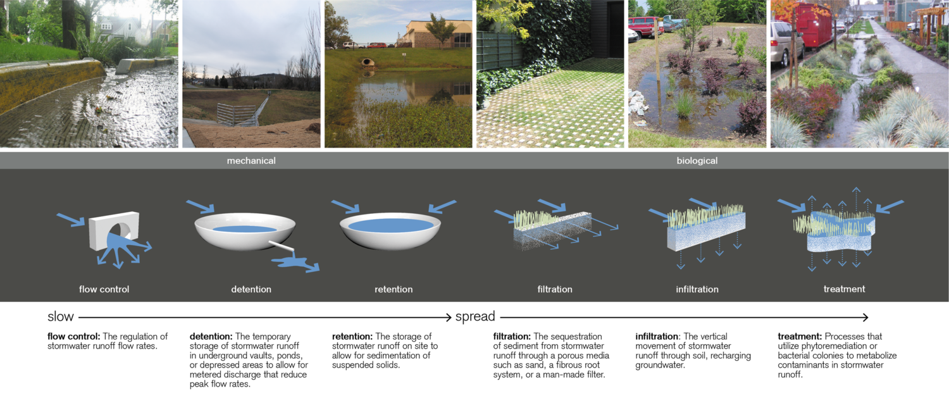

Slide 27
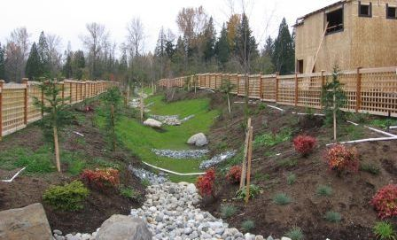
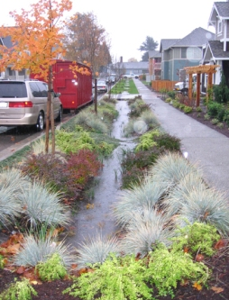
Nature-based solutions

Slide 28
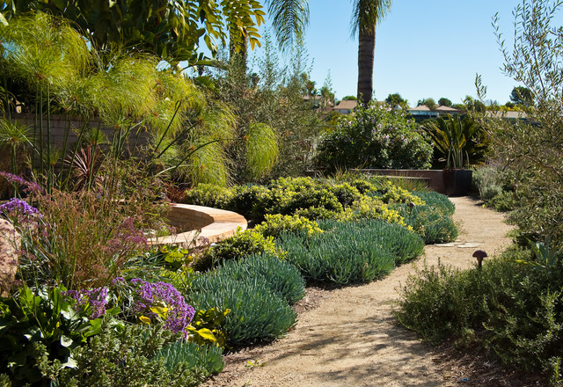
Re-landscaping
To Reduce
Pollution and
Over Watering
Runoff

Slide 29
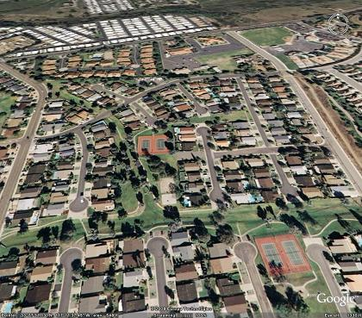
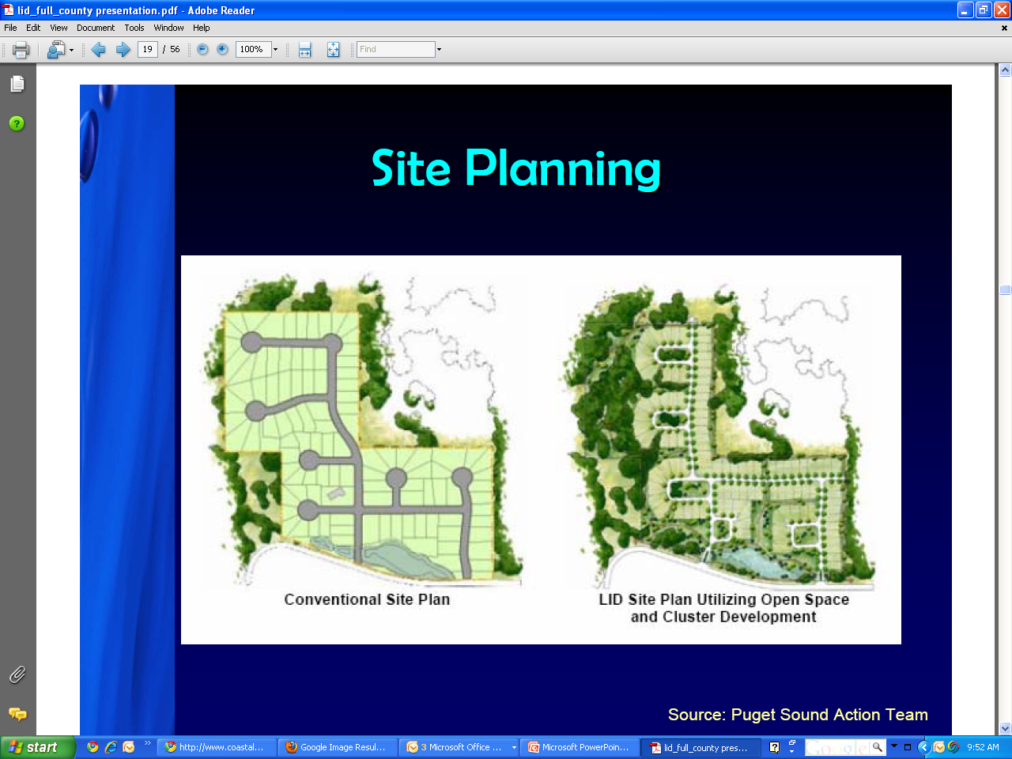
Housing development near
Lake San Marcos (North County)

Slide 30
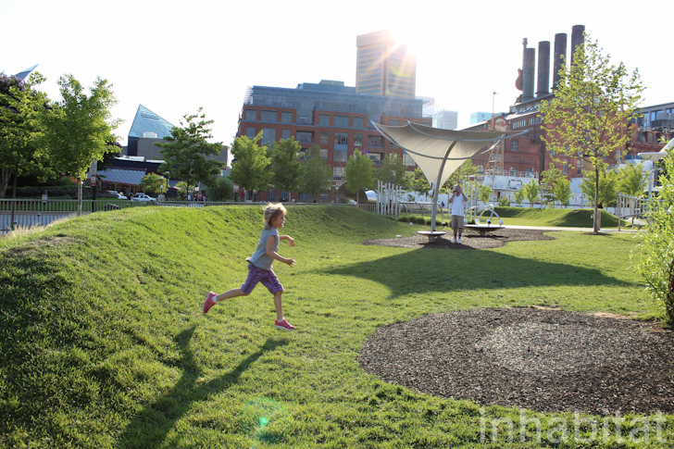
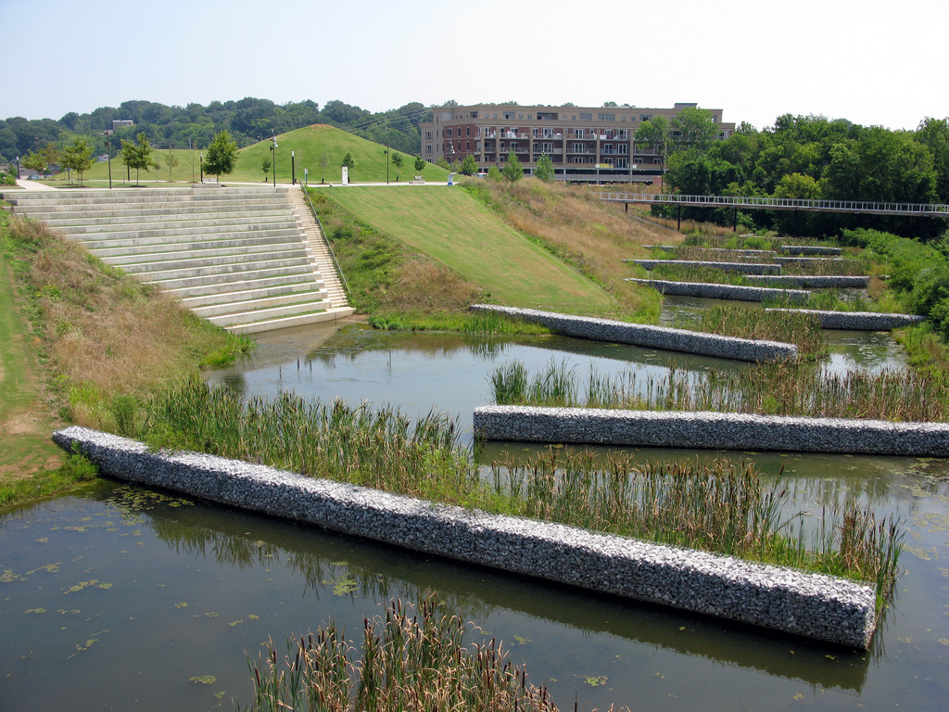
Constructed Wetlands to Filter
and capture
Regional Parks to Capture Runoff and
Stormwater

Slide 31
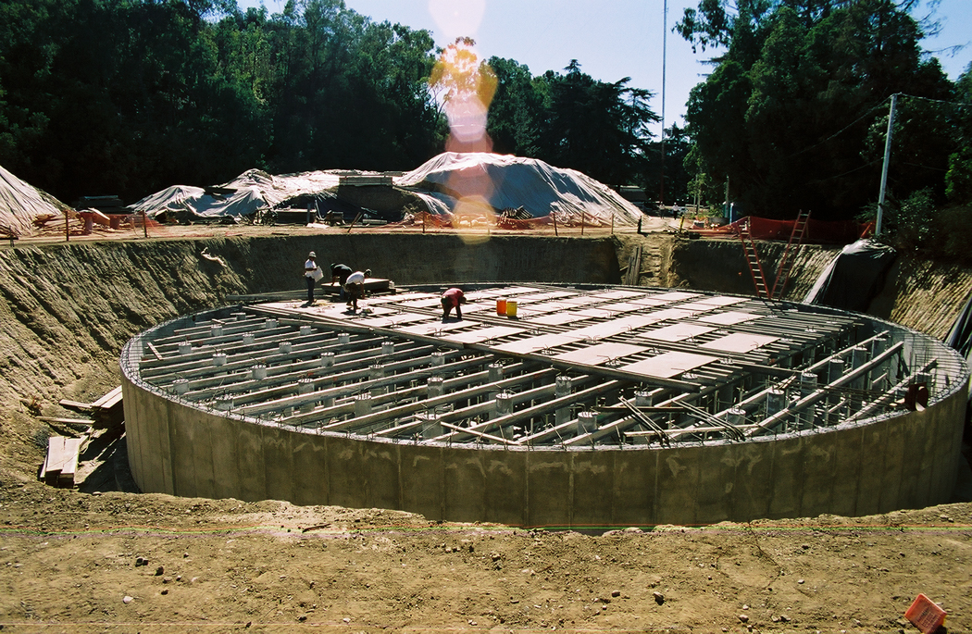
Large
Underground
Cisterns to Hold
Water, Meter out
Recycled water
Plant

Slide 32
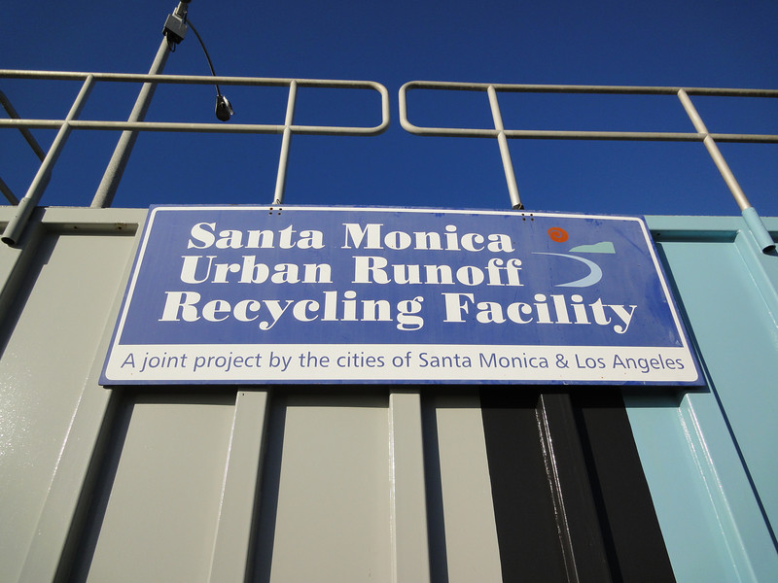
Large
Scale
Capture
and
Harvesting

Slide 33
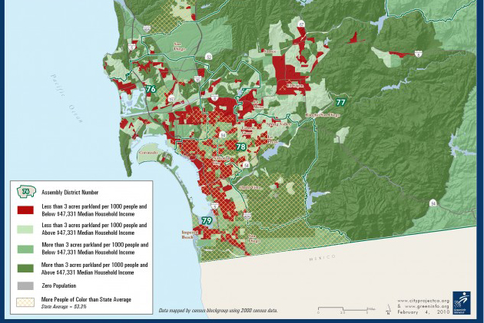

Slide 34
City-commissioned Tetra Tech 2016 Report:
  Stormwater capture could potentially provide 22% of City’s water supply.
  Integrated water management could save City $750 million over 20 years

Slide 35
Ball fields, green spaces, and parks act as vaults for runoff and stormwater, water metered out over time

Slide 37
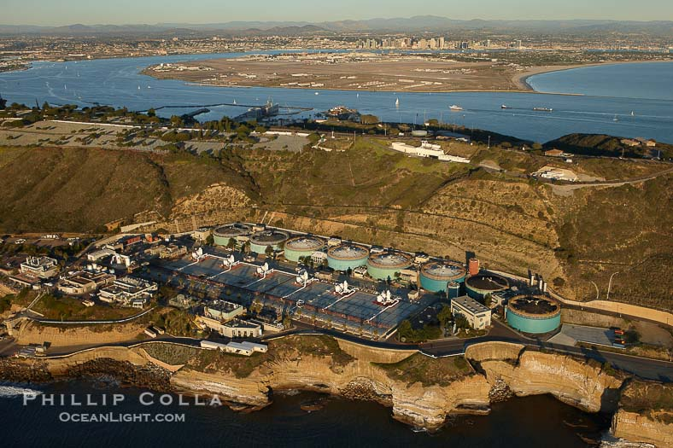
Large
Scale
Wastewater
Recycling

Slide 38
Regulatory compliance

Slide 39
Clean Water Act
Regulates water health and water infrastructure.
1972 Act passed to “restore and maintain the chemical, physical and biological integrity of the Nation’s waters.” 33 USC §1251(a).
The discharge of “any pollutant by any person” is unlawful unless in compliance with a permit. 33 USC § 1311, 1342.
Citizens can sue dischargers for violations of their permits or to stop unpermitted discharges. 33 USC § 1365(a)(1).
Notes:
Strict liability law that requires strict compliance

Slide 40
LID on-site design Storm Standards
MS4: “Each Priority Development Project must be required to implement LID BMPs that are designed to retain (i.e. intercept, store, infiltrate, evaporate, and evapotranspire) onsite the pollutants contained in the volume of storm water runoff produced from a 24-hour 85th percentile storm event (design capture volume)”
IGP BMPs: “The Discharger, at a minimum, shall calculate…The volume of runoff produced from an 85th percentile 24-hour storm event, as determined from local, historical rainfall records”

Slide 41
Alternative compliance (off-site) options
Industrial General Permit
  “The Discharger may enter into a local agreement with the local jurisdiction(s) to participate in the development, implementation, and operation of an off-site storm water capture and/or infiltration BMP(s)”
Municipal Permit
  “At the discretion of each Copermittee, Priority Development Projects may be allowed to participate in an alternative compliance program in lieu of implementing the onsite structural BMP performance requirements of Provisions E.3.c.(1) and E.3.c.(2)(a)…The alternative compliance program is available to a Priority Development Project only if the Priority Development Project applicant enters into a voluntary agreement with the Copermittee authorizing this arrangement.”
Notes:
For the copermittee to engage in these types of projects, it’ll take money, and that takes a ballot measure.

Slide 42
To date, although an alternative compliance option has existed since 2013 in the San Diego Regional MS4 permit, no project has been developed, identified, and/or approved.
Partly due to regulatory uncertainty and risk, partly due to funding and capital investment

Slide 43
Funding and investment

Slide 44
2018 City Audit Committee
“Storm Water Funding is Insufficient to Fund Current and Future Storm Water Needs and the City Has Not Taken Action to Develop and Pursue a Long-Term Funding Strategy.”
Stormwater shortfall and obligations are currently the City’s largest liability.

Slide 45
Stormwater Infrastructure Funding
IBA Report: Stormwater is “…largest funding gap of any of the City’s other capital assets…”
Jan 2019 IBA Report: over $750 million+ backlog from 2019-2024
Funding at only 7% of needs for next 5 years (and growing)
Compliance with regs likely to cost several billion dollars, much of that infrastructure

Slide 46
City of SD current fee = $0.95
IBA Report 2015: City of SD stormwater fees “are extremely low compared to other major California cities and cities in the western United States”
“City officials have been informed for the need to increase storm water revenues yet they have not taken action to develop and pursue a long-term funding mechanism.” City Audit 2018
“Without a communications plan to educate stakeholders knowledge of storm water funding issues, City officials are effectively making the decision to underfund storm water needs unilaterally.” City Audit 2018

Slide 47
Proposition 218 constraints
  Need for public vote for some/significant portion of funding
  Measure W in Los Angeles, November 2018
If successful, result would be 20-40 years of green and multi-benefit infrastructure projects, stormwater capture/use, and potential for public-private partnership approaches
Notes:
Better funded ms4 program creates better incentives for private investment/partnerships. Perhaps through tax breaks or incentives on private property projects

Slide 48
Measure W: Passed Nov 2018 LA County
Los Angeles Region’s Public Health and Safe, Clean Water Program
“Shall an ordinance improving/protecting water quality; capturing rain/stormwater to increase safe drinking water supplies and prepare for future drought; protecting public health and marine life by reducing pollution, trash, toxins/plastics entering Los Angeles County waterways/bays/beaches; establishing a parcel tax of 2.5¢ per square foot of impermeable area, exempting low-income seniors, raising approximately $300,000,000 annually until ended by voters, requiring independent audits, oversight and local control be adopted?”

Slide 49
Up to 100% tax credit for qualifying improvements that capture or treat stormwater or urban runoff or reduce stormwater or urban runoff pollution
Credit trading program available for sites that offer additional benefits

Slide 50
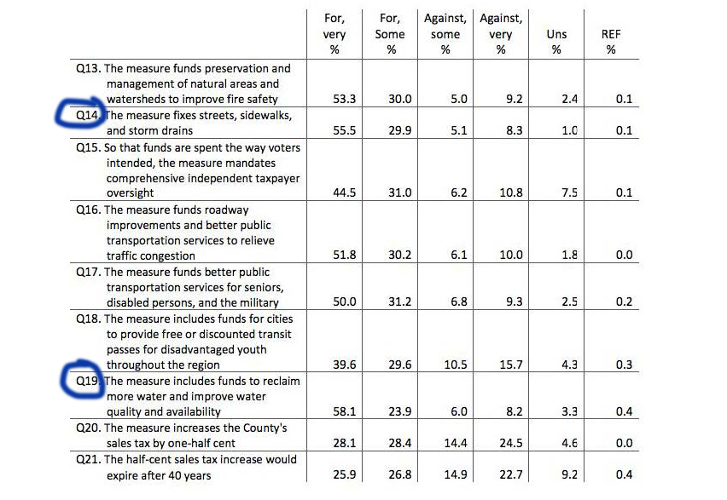
San diego water polling (2016)

Slide 51
audit committee and Ind. Budget Analyst recommendations
Develop a long-term funding strategy to meet its present and future capital and operational needs
Work with the City of San Diego’s Independent Budget Analyst to review long-term funding options, such as… increasing the storm water fee…

Slide 52
Hire a consultant to conduct an unbiased, statistically reliable survey of potential voters to estimate voter support for a variety of funding options
The consultant should educate stakeholders on specific storm water issues, including: flood prevention, the storm water funding gap, the deferred capital backlog, ongoing operational costs, and water quality regulations.
The consultant should then solicit voter opinions and include analysis regarding:

Slide 53
Importance of water quality and flood reduction to residents and businesses;
Whether, and how much residents or property owners are willing to pay for water quality measures, storm water infrastructure, and other SWD activities;
Funding mechanism structure options, such as tiered fee rates, fee rates that adjust annually by inflation, a sales tax measure, general obligation bonds, etc.;
Identify objections and strategies to overcome them; and
Whether the funding mechanism can be obtained by a simple majority or a two-thirds supermajority.

Slide 54
Next steps?
Support governments in efforts to educate public and stakeholders on importance of integrated water management investment
Work with cross-sector stakeholders and groups to determine and build support for public ballot measure to fund integrated water management
Work with electeds and identify a champion (or champions) to carry investment/funding measure

Slide 55



Matt O’Malley, Exec. Dir. &
Managing Attorney
matt@sdcoastkeeper.org
www.sdcoastkeeper.org
www.cacoastkeeper.org

