Slide 1
BIODIVERSITY &
SAN DIEGO REGIONAL HABITAT CONSERVATION PLANNING
Part 1

Slide 2
BIODIVERSITY & SAN DIEGO REGIONAL HABITAT CONSERVATION PLANNING
Global & local importance of biodiversity
Primer on San Diego regional habitat conservation planning
Preservation of biodiversity as a core progressive value

Slide 3
WHAT IS BIOLOGICAL DIVERSITY (“BIODIVERSITY”)?
The total variety of life on Earth

Slide 4
WHY DOES BIODIVERSITY MATTER?
Practical
Spiritual
Philosophical

Slide 5
WHAT ARE GLOBAL BIODIVERSITY HOTSPOTS?

Slide 6
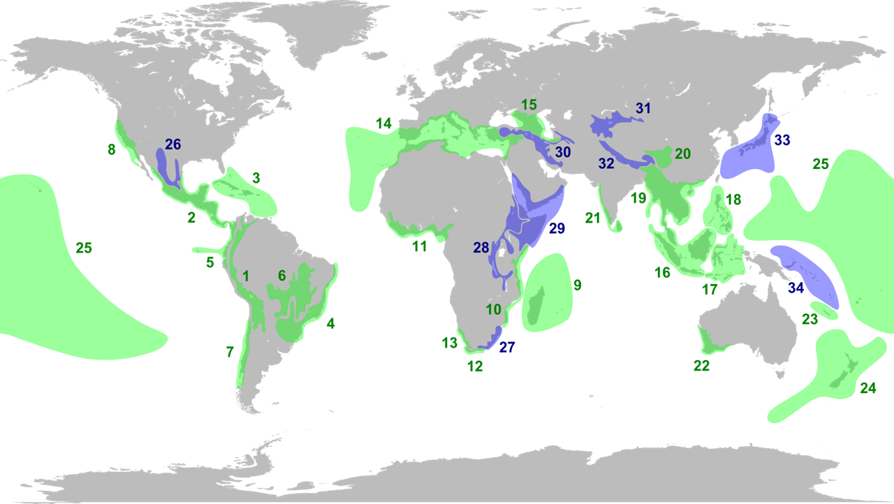

Slide 7
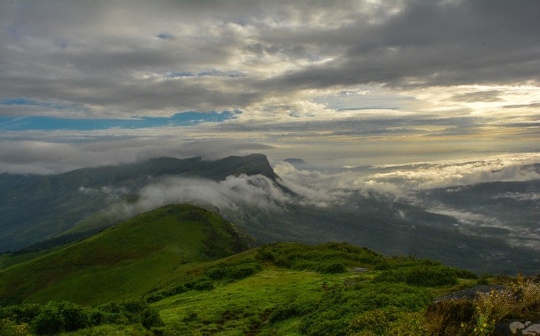
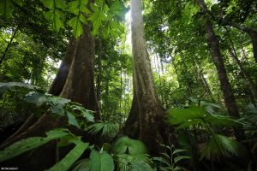
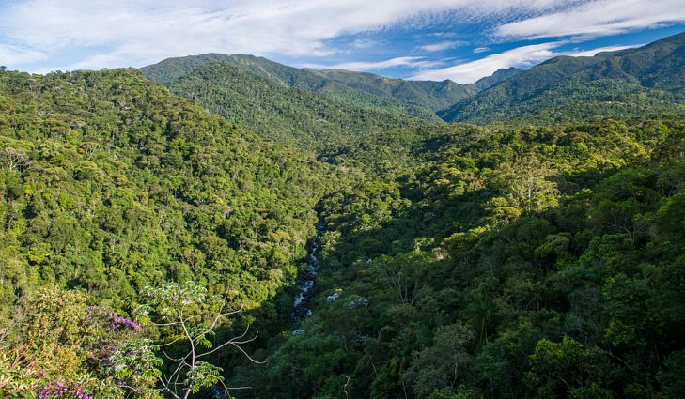
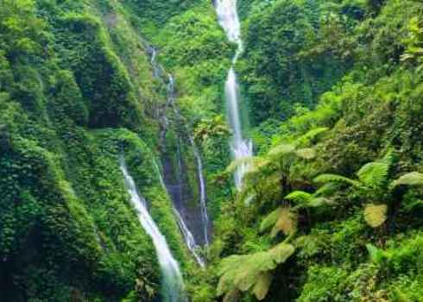

Slide 8
CONTEXT FOR GLOBAL &
LOCAL BIODIVERSITY CRISIS
Six major extinction events in history of life on Earth
Permian-Triassic extinction 252 million years ago was largest with loss of 96% of marine species and 70% of land animals

Slide 9
CONTEXT FOR GLOBAL &
LOCAL BIODIVERSITY CRISIS
United Nations study in May showed greater decline of animal and plant species than ever before in human history.
20% decline of land-based species, 40% decline of amphibian species, 33% decline of marine mammals and reef-forming corals
New study in Science

Slide 10
CONTEXT FOR GLOBAL &
LOCAL BIODIVERSITY CRISIS
Most of other five global extinction events have taken place over millions of years
Current “Anthropocene” extinction event over just 10,000 years with most extinctions in last 100 years, is predicted to eliminate at least 50% of all species and has been caused by a single species.

Slide 12
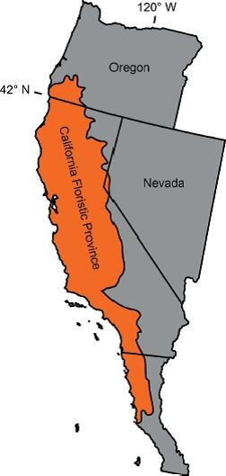

Slide 13
SAN DIEGO BIODIVERSITY

Slide 15
EPICENTER OF BIODIVERSITY LOSS IN SAN DIEGO COUNTY – COASTAL SAGE SCRUB

Slide 16
EPICENTER OF BIODIVERSITY LOSS IN SAN DIEGO COUNTY – COASTAL SAGE SCRUB

Slide 17
EPICENTER OF BIODIVERSITY LOSS IN SAN DIEGO COUNTY – VERNAL POOLS

Slide 20
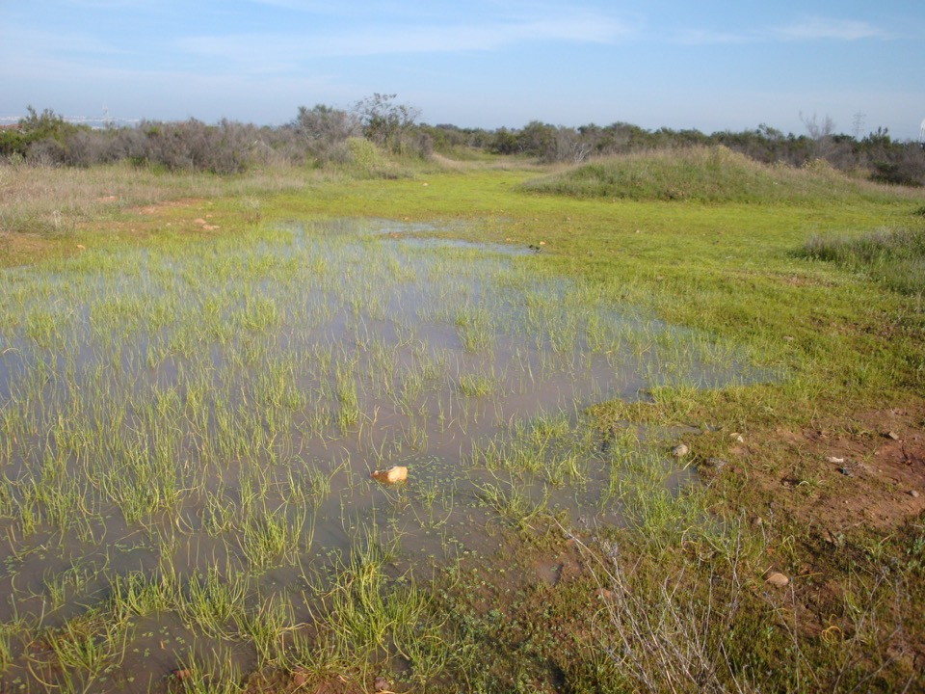

Slide 21
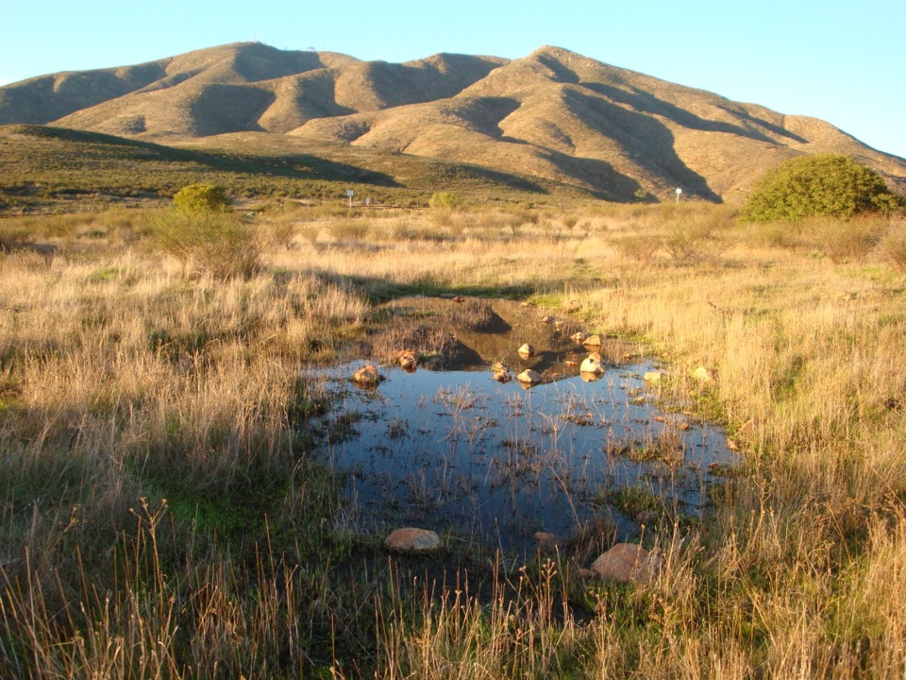

Slide 22
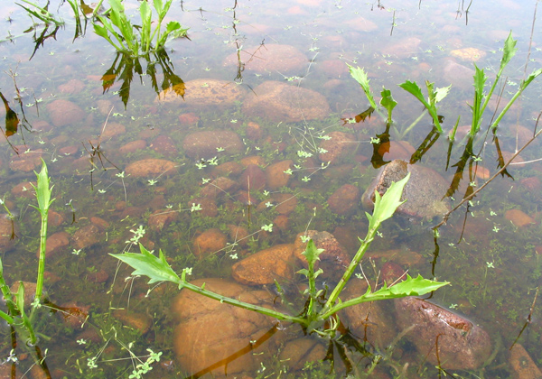

Slide 23
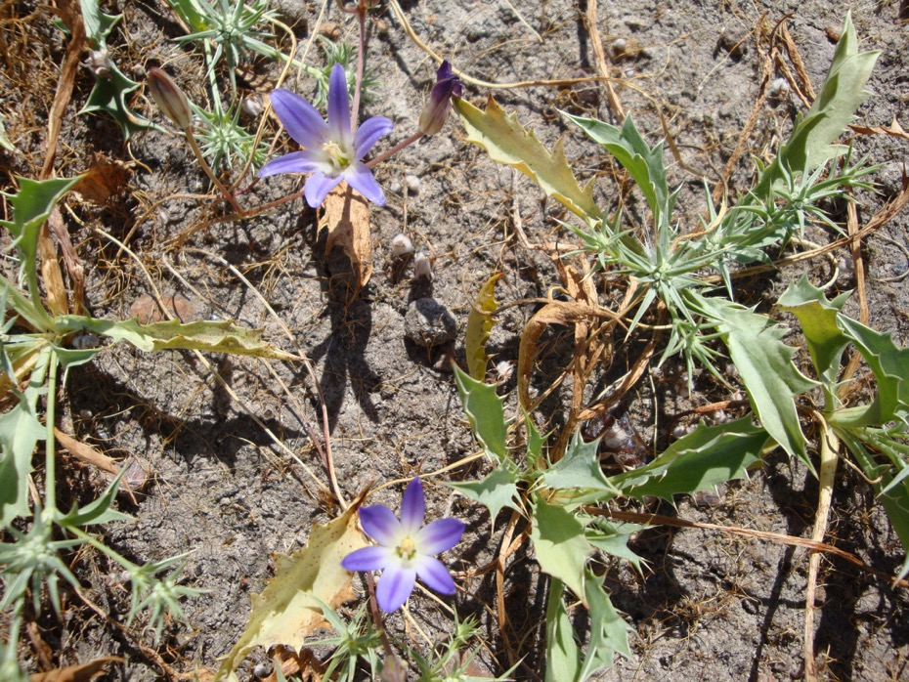

Slide 24
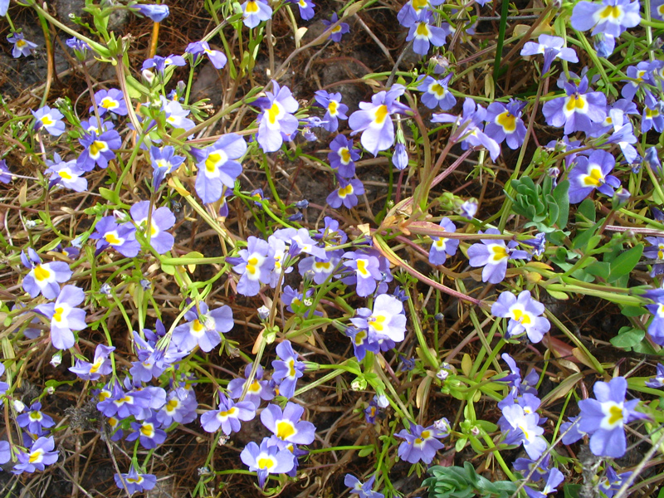

Slide 25
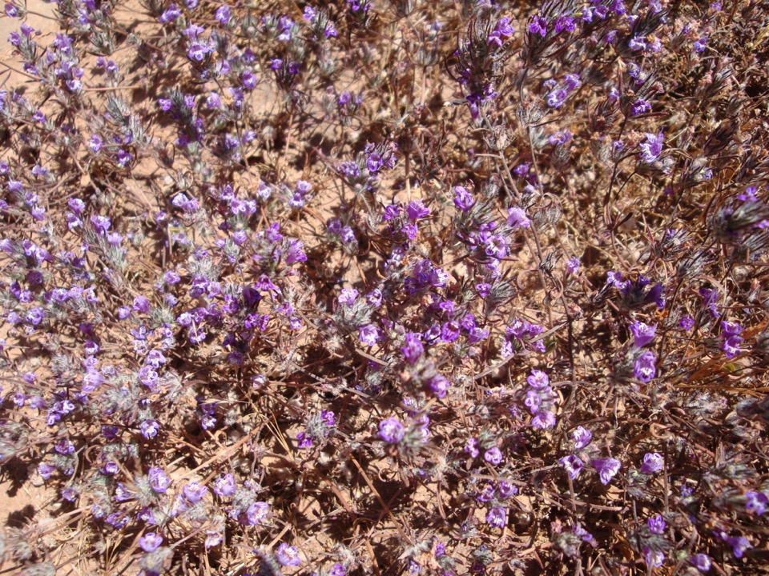

Slide 26
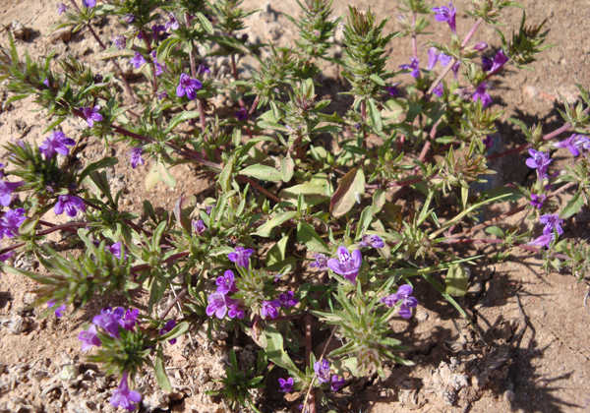

Slide 27
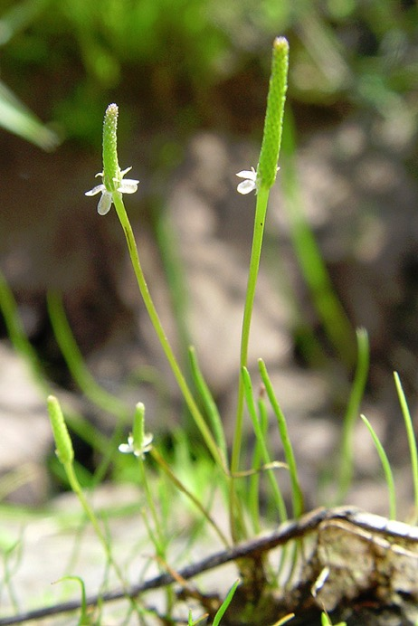

Slide 29
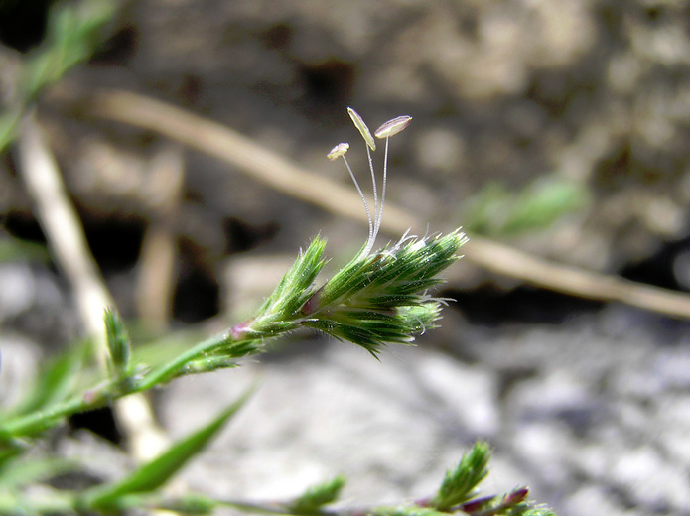

Slide 30
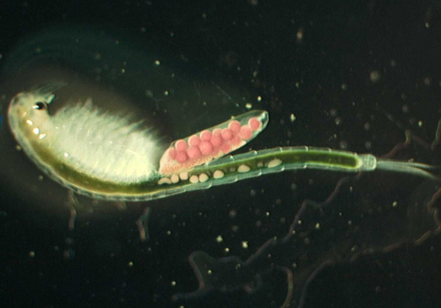

Slide 31
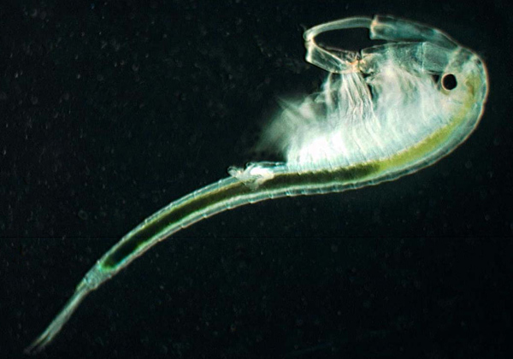

Slide 36
