Slide 1
BIODIVERSITY &
SAN DIEGO REGIONAL HABITAT CONSERVATION PLANNING
Part 2

Slide 2
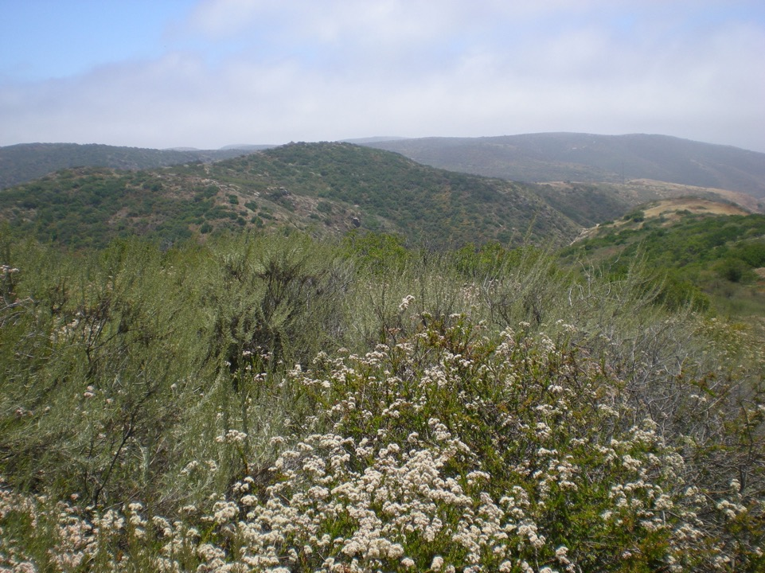
EPICENTER OF BIODIVERSITY LOSS IN SAN DIEGO COUNTY – COASTAL SAGE SCRUB

Slide 4
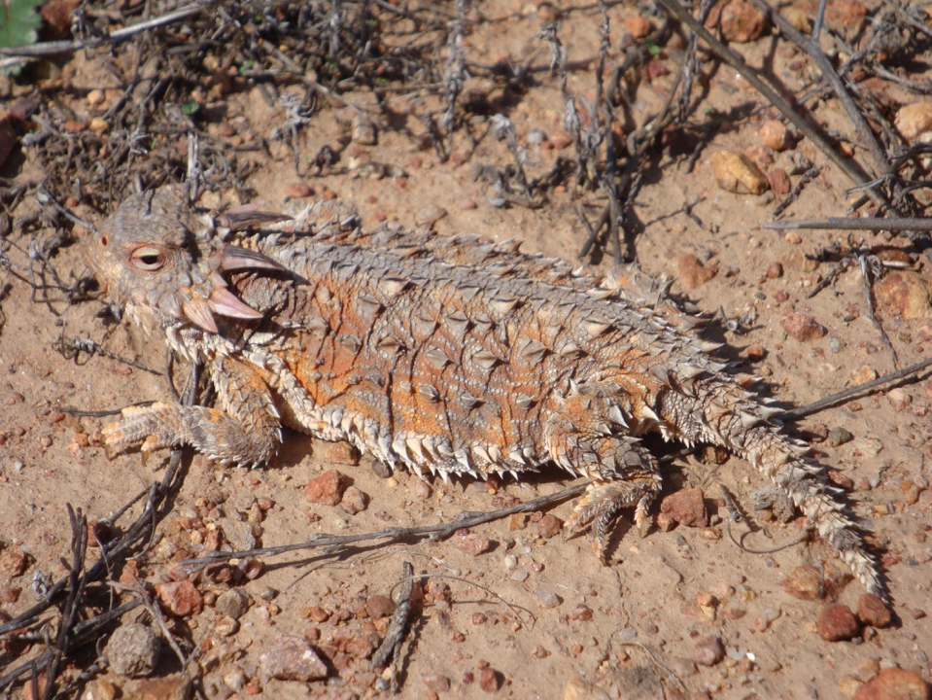

Slide 8
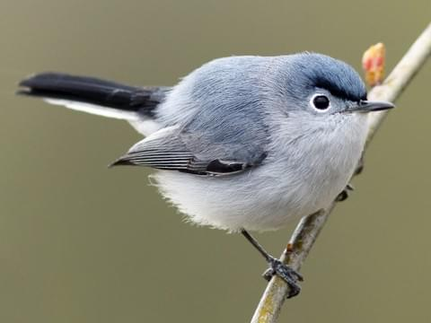

Slide 9
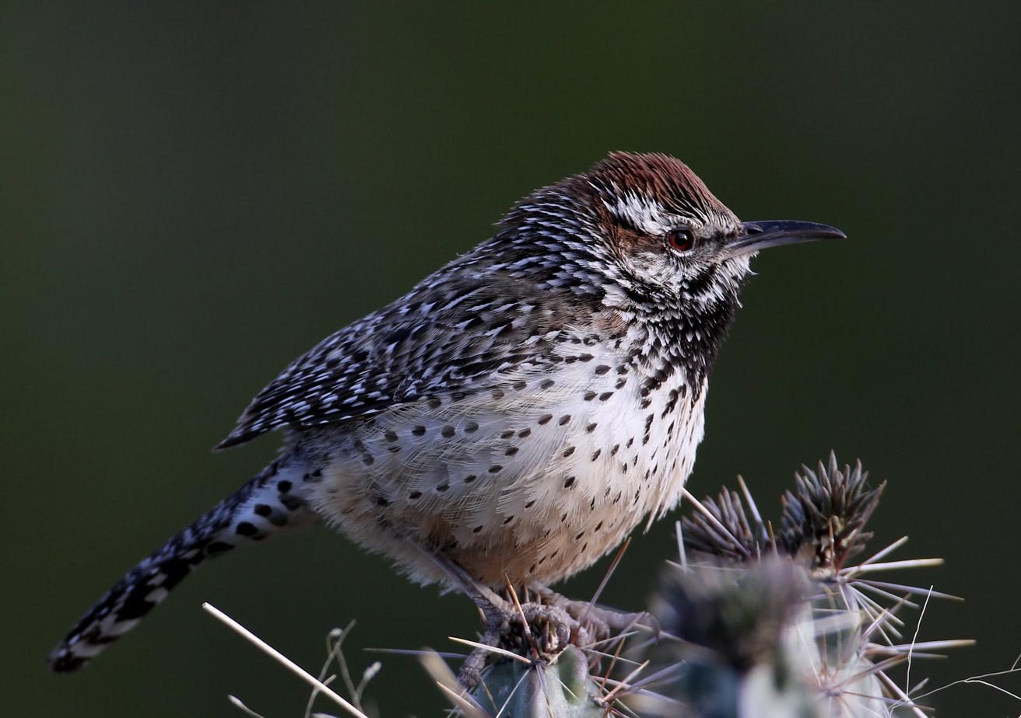

Slide 10
1991 CALIFORNIA NCCP ACT
“”Natural community conservation plan” … identifies and provides for the regional or statewide protection and perpetuation of natural wildlife diversity, while allowing compatible and appropriate development and growth.”

Slide 11
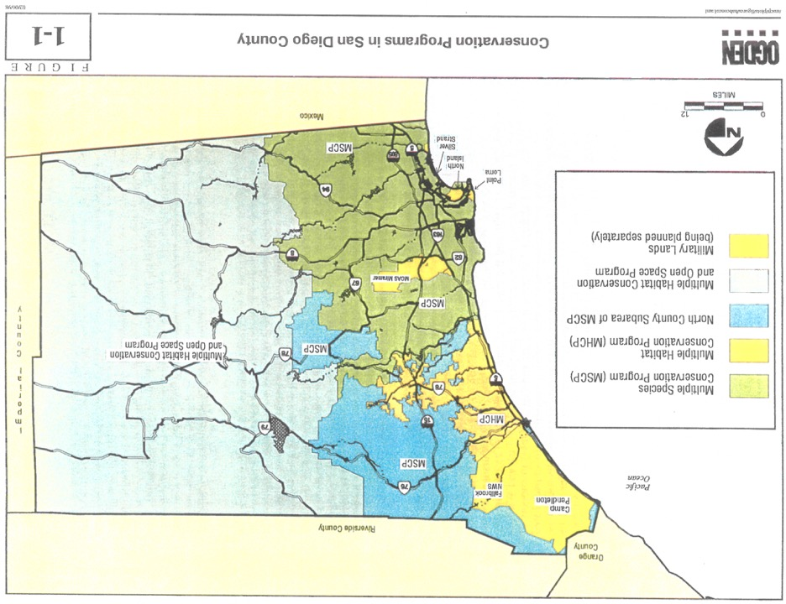

Slide 12
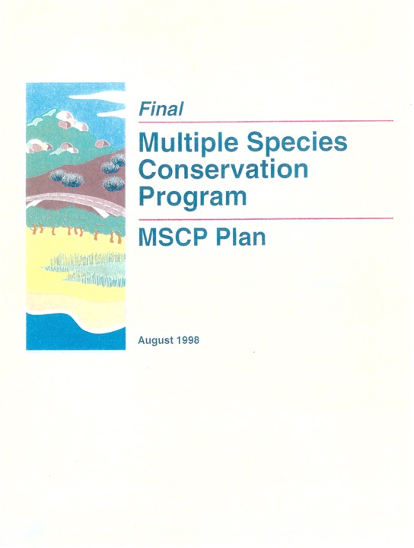

Slide 13
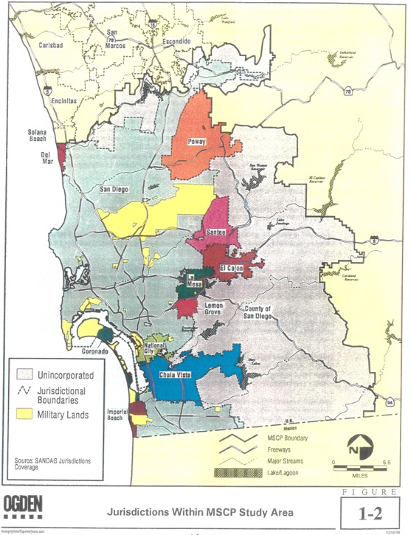

Slide 14
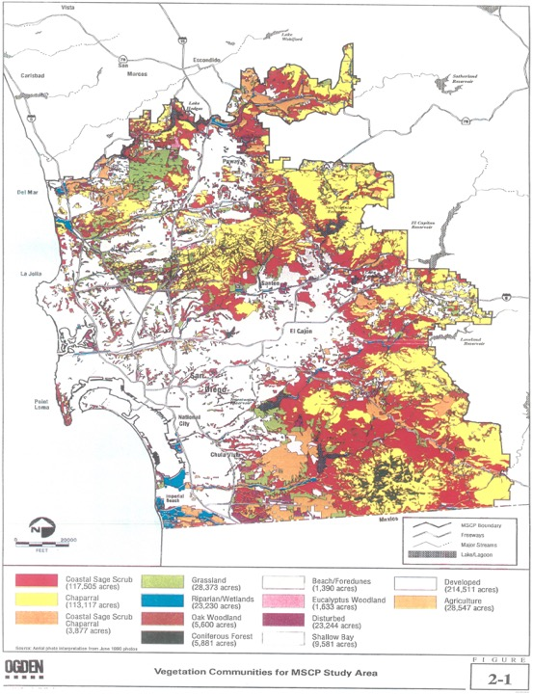

Slide 16
MSCP PROMISED HABITAT & SPECIES PRESERVATION FUNDING
“The City of San Diego and other Participating Local Jurisdictions will each be responsible for acquiring private lands with the [preserve], and for funding [preserve] management, monitoring and administrative costs. The MSCP Plan intends that funds to cover these local costs will be raised on a regional, County-wide, or MSCP Area-wide basis.”

Slide 17
MSCP PROMISED HABITAT & SPECIES PRESERVATION FUNDING
“Long-Term Regional Funding – Within [three years of July 1997], the City of San Diego intends to have a long-term regional funding source established. … If [no long-term regional funding source is in place] at the conclusion of the time allowed [above], then the City of San Diego shall establish and implement a funding source adequate to meet its share of MSCP… implementation costs, while it continues to pursue, with other Participating Local Jurisdictions, establishment of a regional funding source. ”

Slide 18
SUPPORT PRESERVATION OF BIODIVERSITY & REGIONAL HABITAT CONSERVATION PLANS
Support implementation of the existing San Diego MSCP and press for other planned NCCP/HCPs
Oppose sprawl into undeveloped natural lands as important progressive issue
Reject developers’ self-serving false choice of housing vs. preservation of nature

Slide 20
SUPPORT FUNDING FOR PRESERVATION OF BIODIVERSITY & REGIONAL HABITAT CONSERVATION PLANS
For acquisition of private land to add to preserves
For habitat and species restoration on damaged land
Mitigation for GHG emissions
Long-term stewardship management

Slide 21
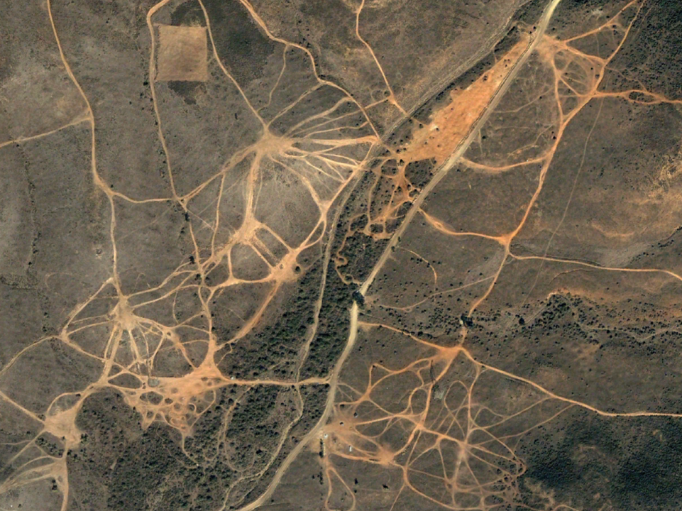

Slide 22
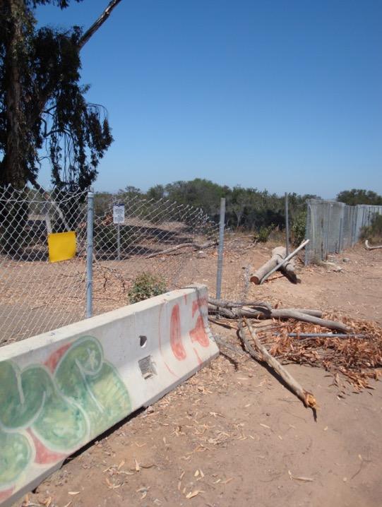

Slide 23
FUTURE POSSIBLE REGIONAL HABITAT CONSERVATION FUNDING
Another transportation and environment sales tax that values public and alternative transit over freeways
Environmental parcel tax
Environmental parcel transfer tax
Environmental benefit assessment districts

Slide 24
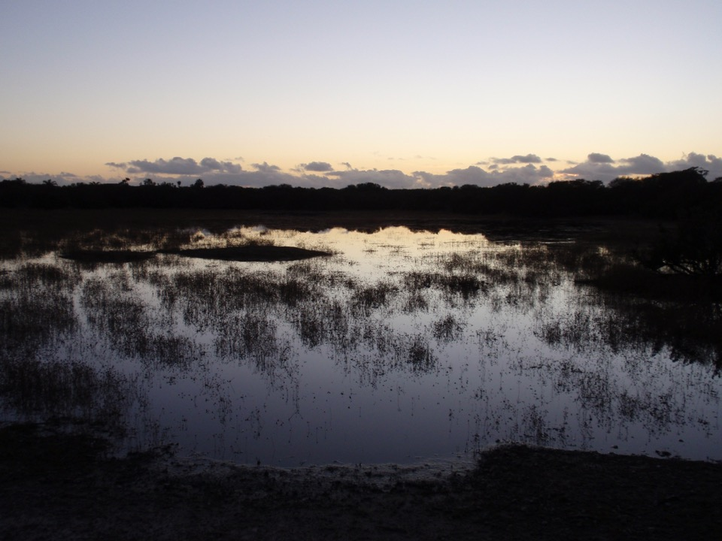

www.chaparralconservancy.org

