Slide 1
San Diego Forward: The Regional Plan and Sustainable Communities Strategy

Slide 2
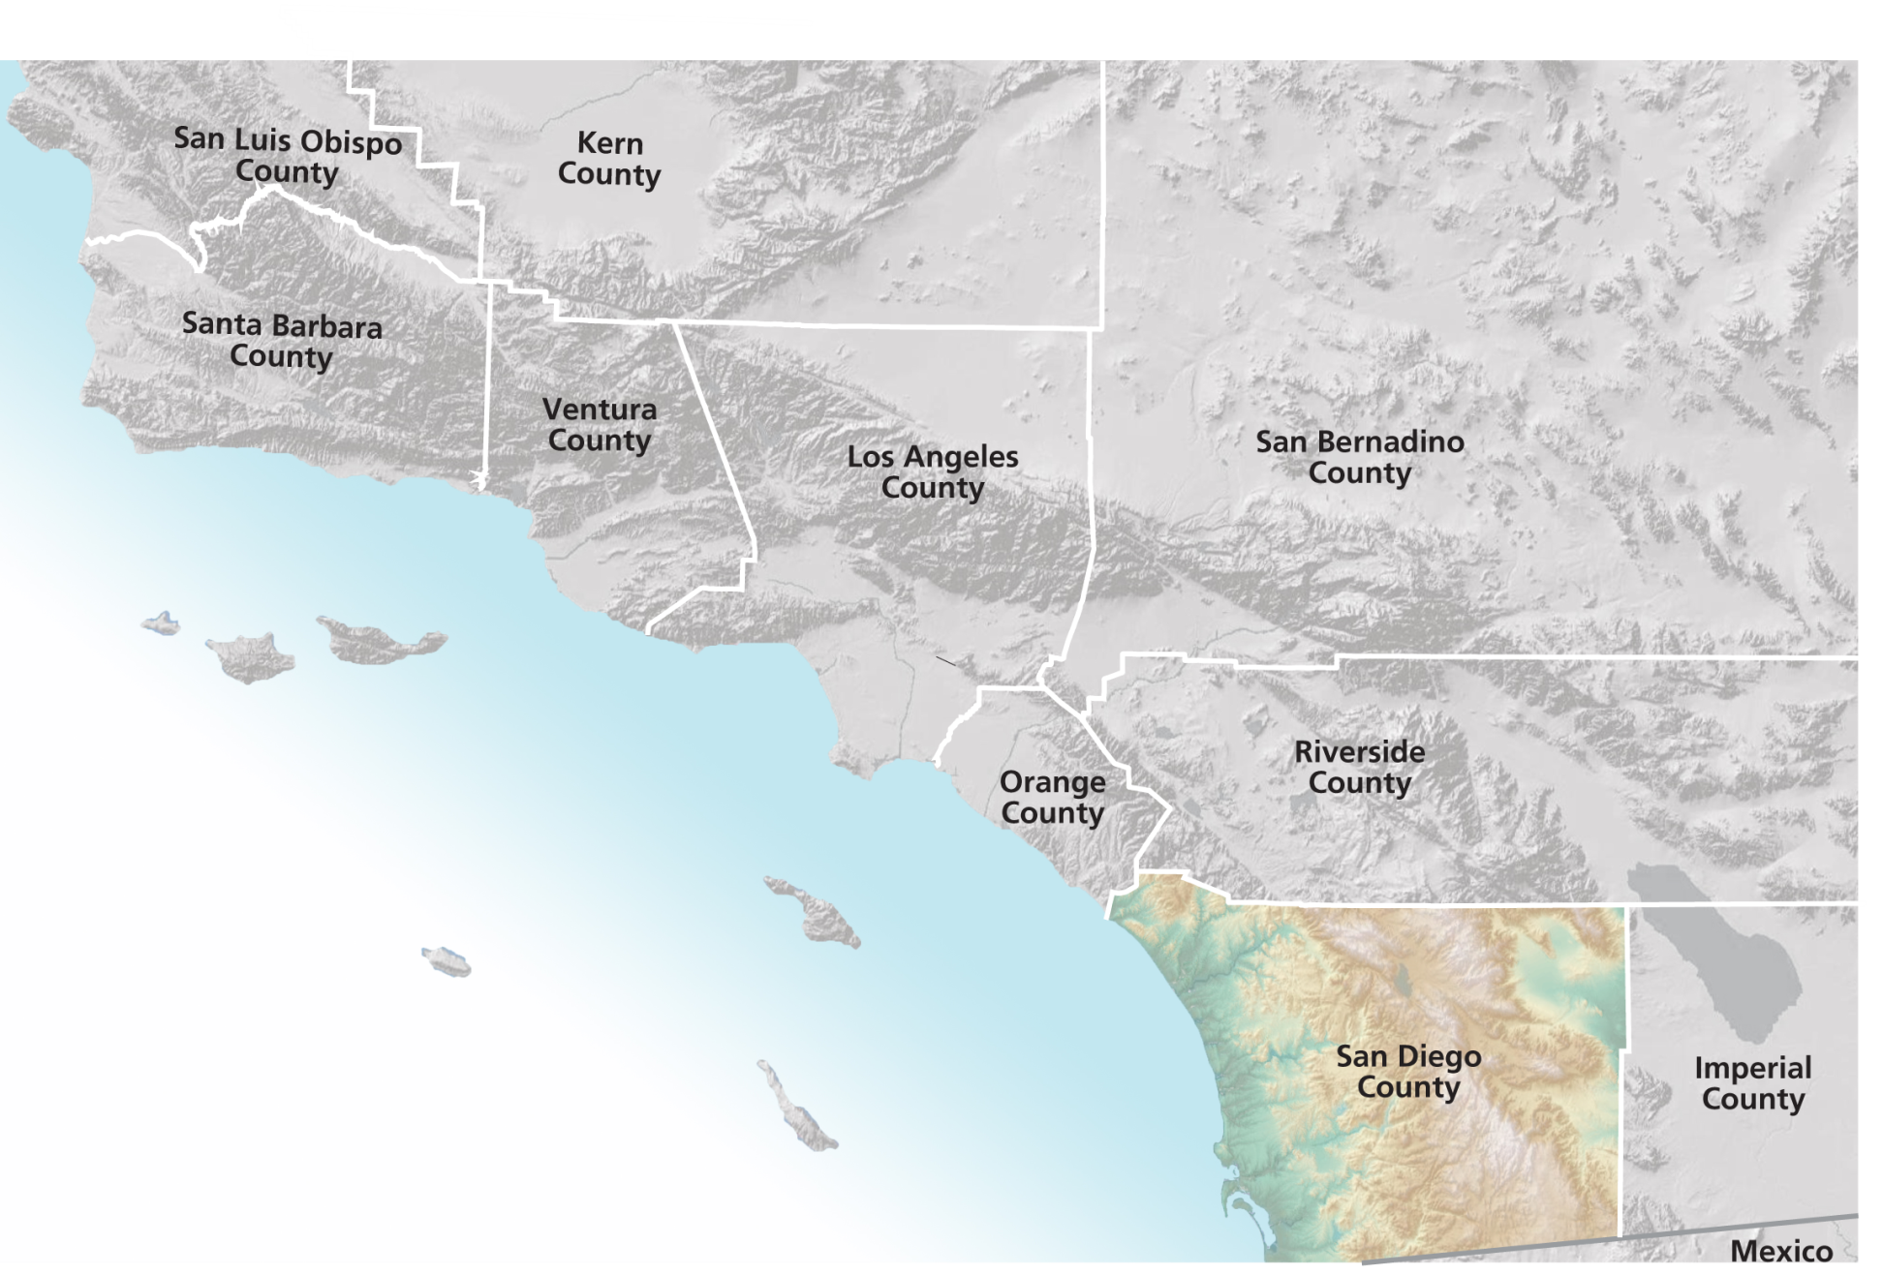
San Diego Region

Slide 3
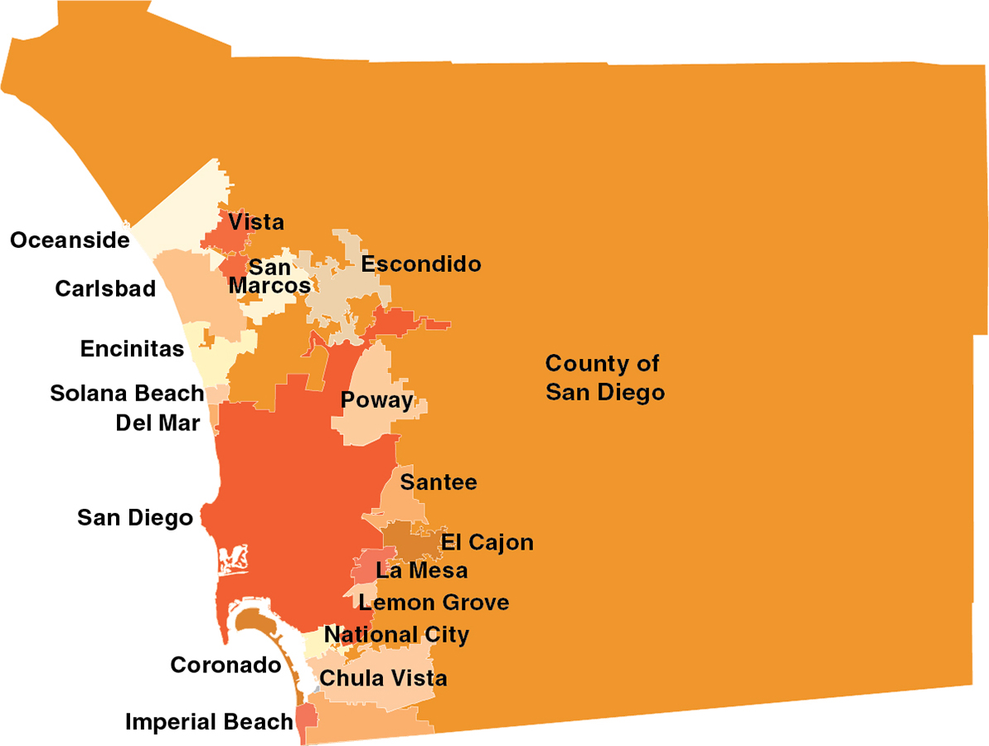
SANDAG Jurisdictions
Notes:
SANDAG is a council of governments tasked with making regional decisions and building consensus.

Slide 4
SANDAG Board of Directors
Mayors, Councilmembers, and Supervisors
Appointed by council/board to SANDAG
Meet in public meetings; twice/month
Notes:
Board Meetings are open to the public and generally take place on the 2nd and 4th Fridays of the month. A weighted voting system is used. In January 2007, the County will have a second seat on the Board, like the City of San Diego

Slide 5
Advisory Members
Imperial County
Caltrans
U.S. Department of Defense
San Diego Unified Port District
San Diego County Water Authority
Metropolitan Transit System (MTS)
North County Transit District (NCTD)
Southern California Tribal Chairmen’s Association
Republic of Mexico
Appointed
Officials
Notes:
The SANDAG Board is also made up of non-voting advisory members to make sure that it is truly a regional body.

Slide 6
SANDAG
Board of Directors
Makes regional public policy
Executive Committee
Sets agenda; oversight for budget and work program; reviews grant applications; makes recommendations on legislative proposals & agency policies
Transportation
Committee
Policy recommendations on planning and programming; strong focus & commitment to meet public transit needs
Public Safety Committee
Policy recommendations on public safety & Homeland Security related to ARJIS & Criminal Justice Research activities
Borders
Committee
Policy recommendations on interregional programs & projects
Regional Planning
Committee
Policy recommendations on Regional Plan development & implementation
Notes:
Five policy advisory committees discuss regional issues and plans, and make policy recommendations to the SANDAG Board. These are also public meetings.

Slide 7
SANDAG Mission
Forum for regional decision-making
Build consensus
Make strategic plans
Obtain and allocate resources
Plan, engineer, & build public transit
Provide information and technical assistance
Notes:
People often ask, “What does SANDAG do?” The better question is, “What doesn’t SANDAG do?” SANDAG has a very dynamic, multi-faceted mission.

Slide 8
Regional Work
Energy
Economic prosperity
Public safety
Binational planning
Shoreline preservation
Interregional planning
Population growth
Transportation
Transit construction
Habitat planning
Housing
Census
Notes:
SANDAG is involved is a variety of important regional issues that touch everyone in one way or another.

Slide 9
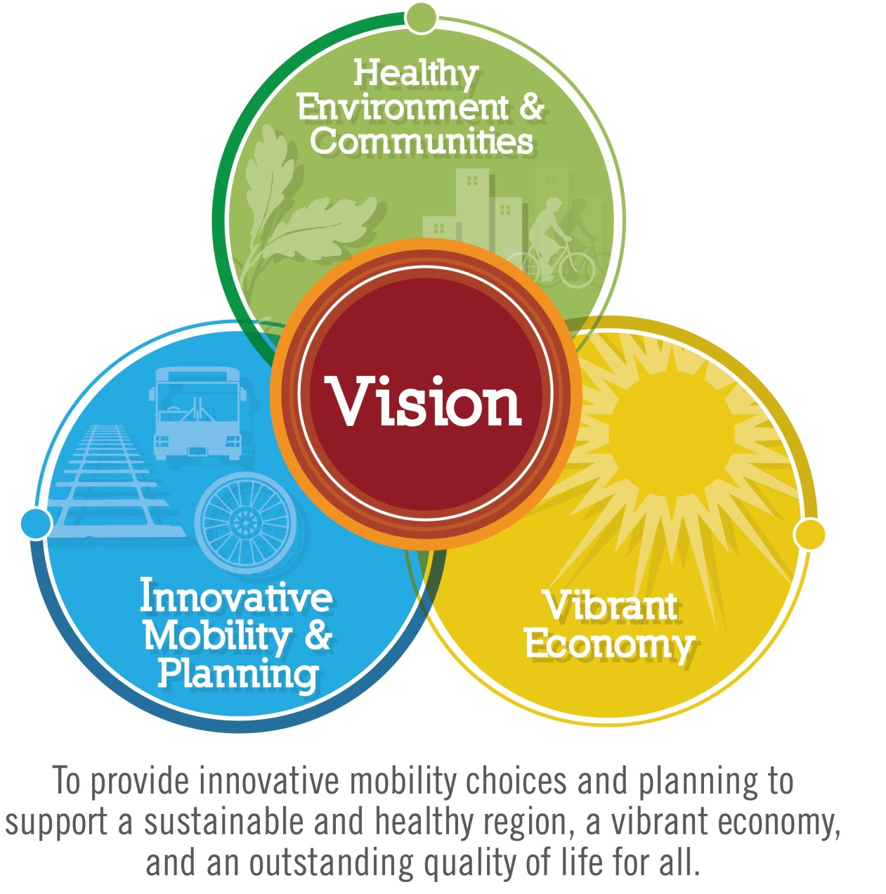
Aiming for a Vision that Works for All

Slide 10
The Region’s population grows 30 percent by 2050
By 2050, our population is projected to grow by nearly one million people.
The region’s growth will add about 460,000 more jobs.
The region will accommodate over 325,000 more housing units.
2050
+1,000,000 People
+460,000 Jobs
2012
+325,000 Housing Units
Each image represents 10,000 people, jobs or housing units

Slide 11
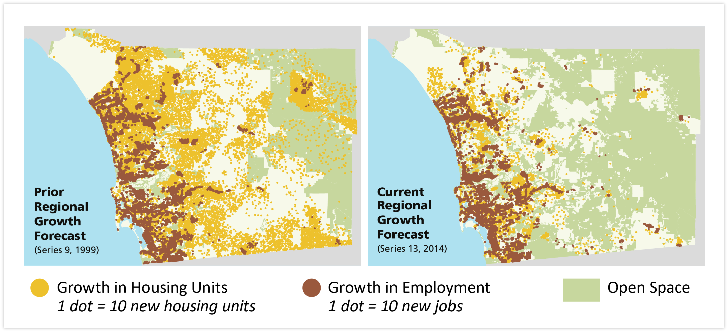
Our Changing Land Use Pattern
1999 Planned Land Use
2015
Planned Land Use

Slide 12
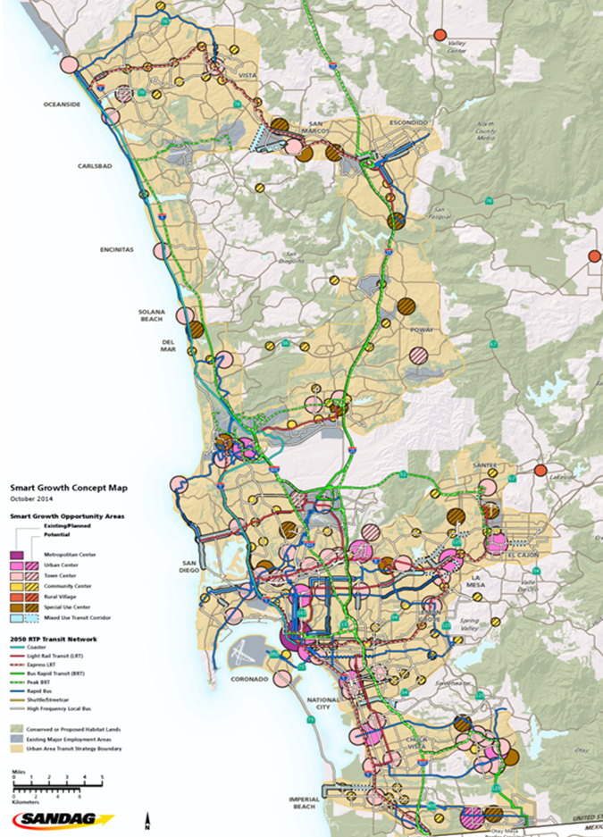
Planning for Sustainability
Preserving our environment
Creating vibrant communities
Providing more transportation choices
Addressing climate change

Slide 13
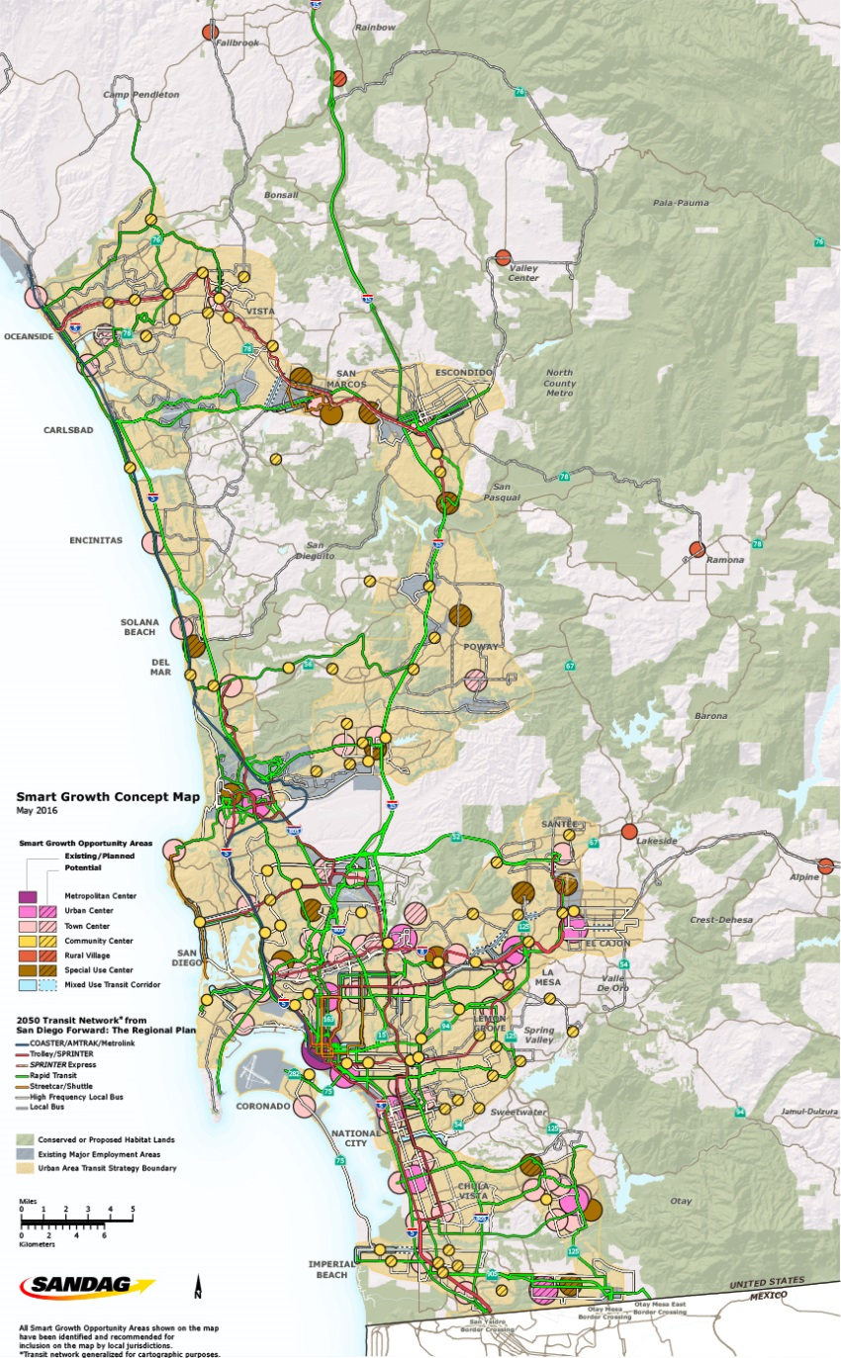
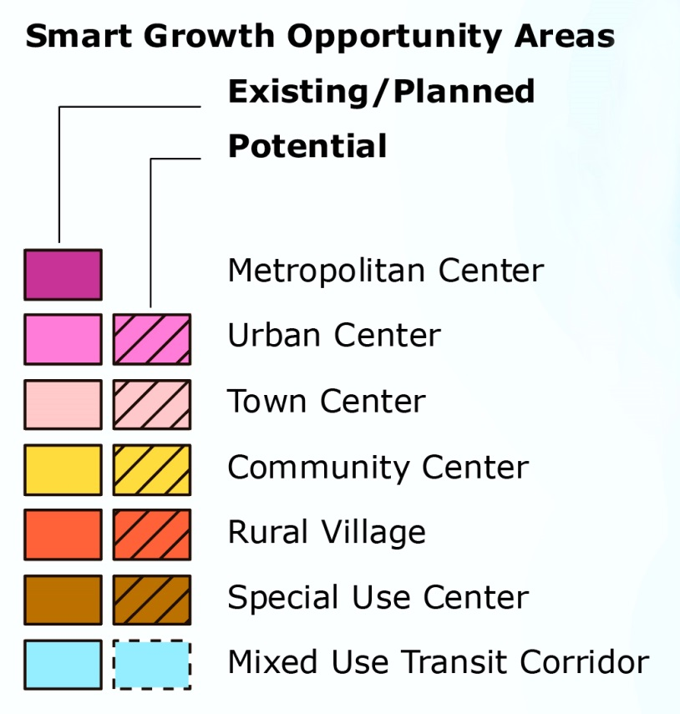
Smart Growth Concept Map - Regional Scale

Slide 14
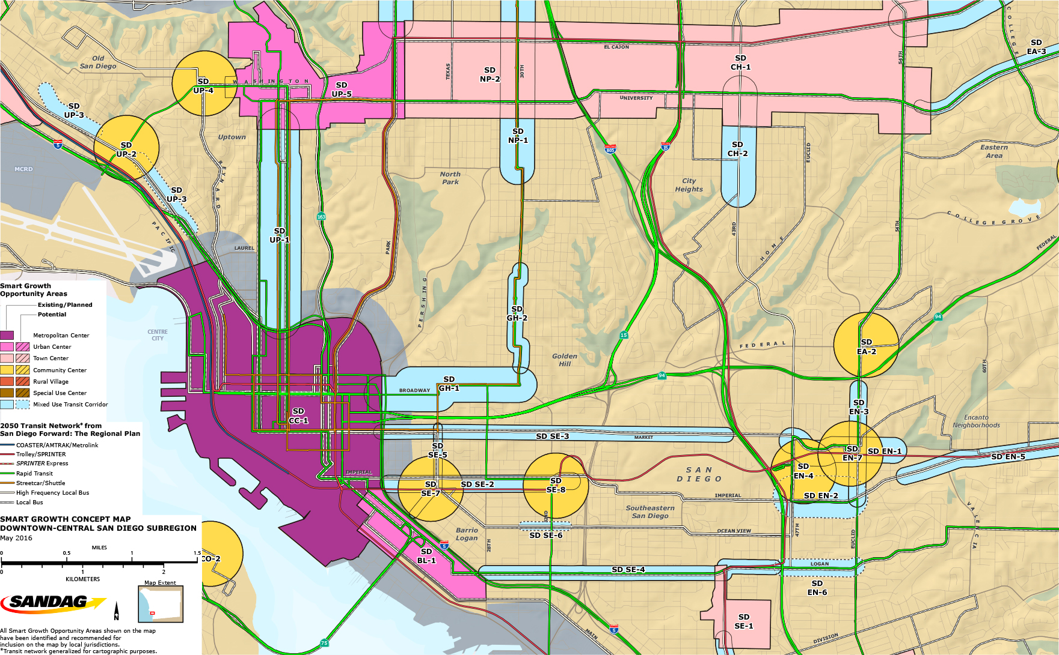
Downtown-Central San Diego Subregional Map

Slide 15
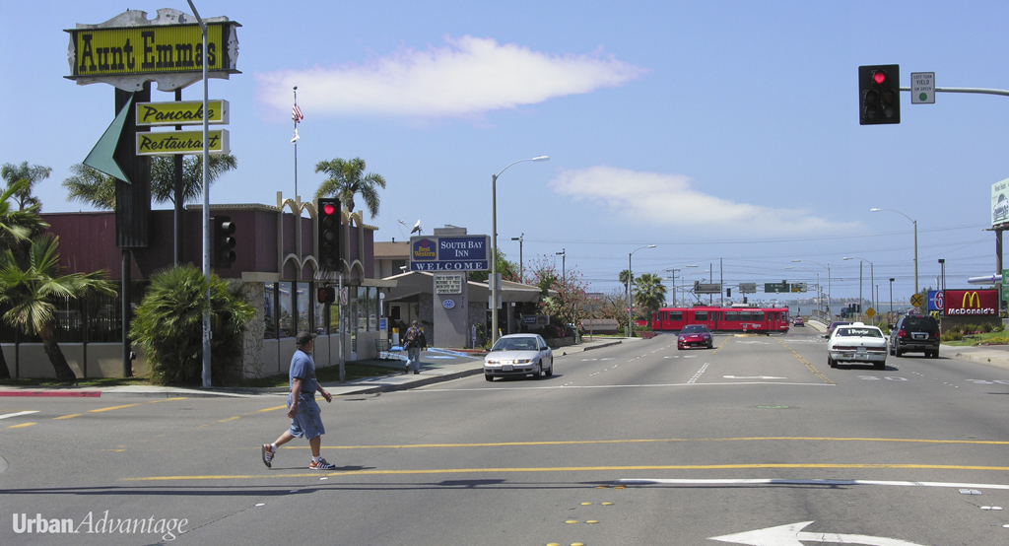
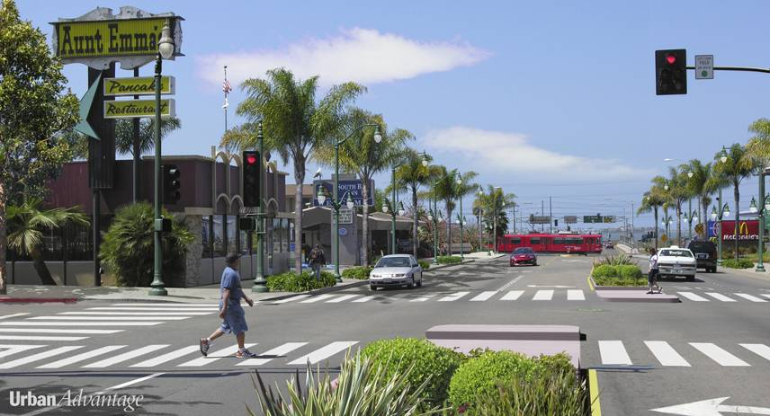
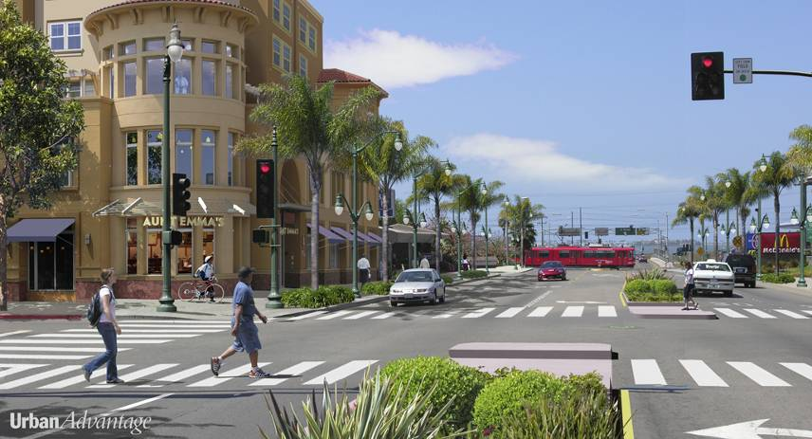
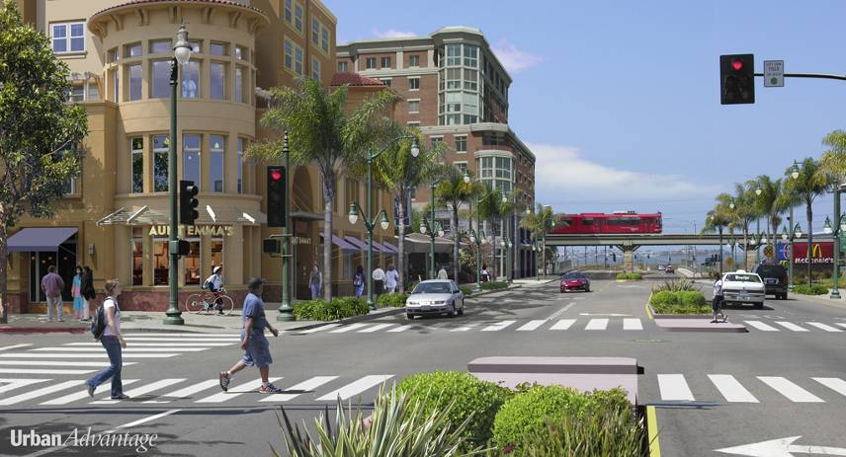
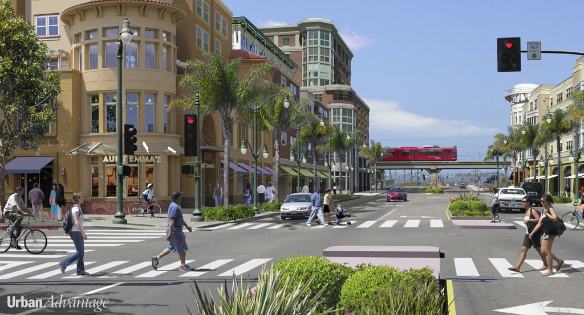
E Street near Bayfront / E Street Trolley Station Chula Vista, CA
Notes:
Existing Conditions:
Very wide auto-oriented street with two lanes in each direction and no on-street parking
In this image, the train platform is behind the buildings on the left
The Chula Vista Urban Core Specific Plan calls for high-density development (45-210 feet high) for parcels near the Trolley station.
Click 1:
Public street improvements:
Pedestrian refuges with landscaping, painted crosswalks
Wide sidewalks with plantings near curbs to separate pedestrians from auto travel lanes
Bi-level street lamps with lower lights for pedestrians
Click 2: Mixed-use development
Click 3: Increasing development focused on trolley station
Higher-density development (eight to ten stories)
Possible grade separation of trolley, going over E Street. (An overpass rather than an underpass is simulated here to keep the trolley visible and reinforce TOD identity for the area)
Click 4: Fill in both sides of street with buildings oriented toward street
Transit, architecture, and public spaces function together to compose and vitalize urban life

Slide 16
E Street near Bayfront / E Street Trolley Station Chula Vista, CA

Slide 17
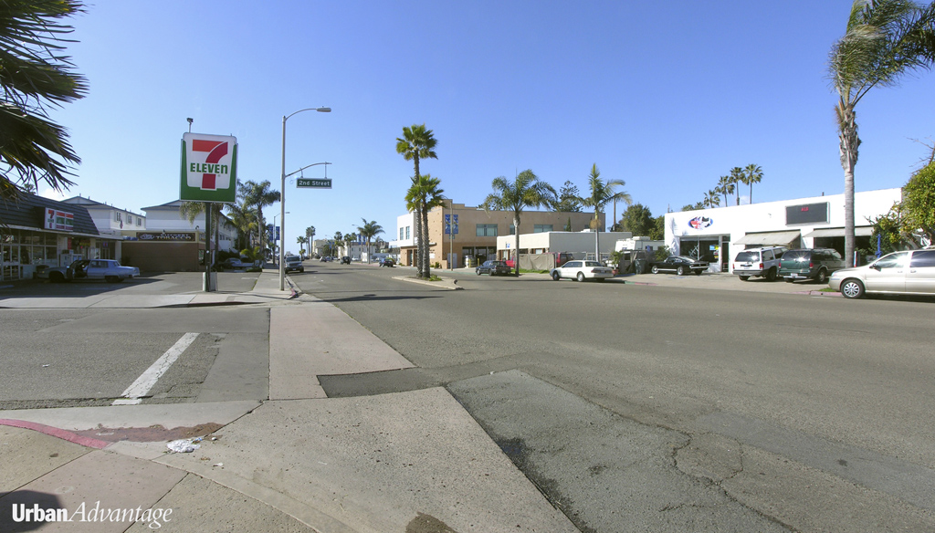
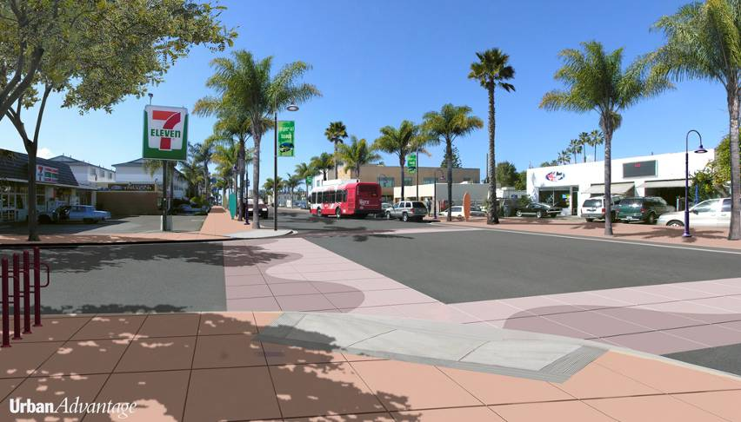
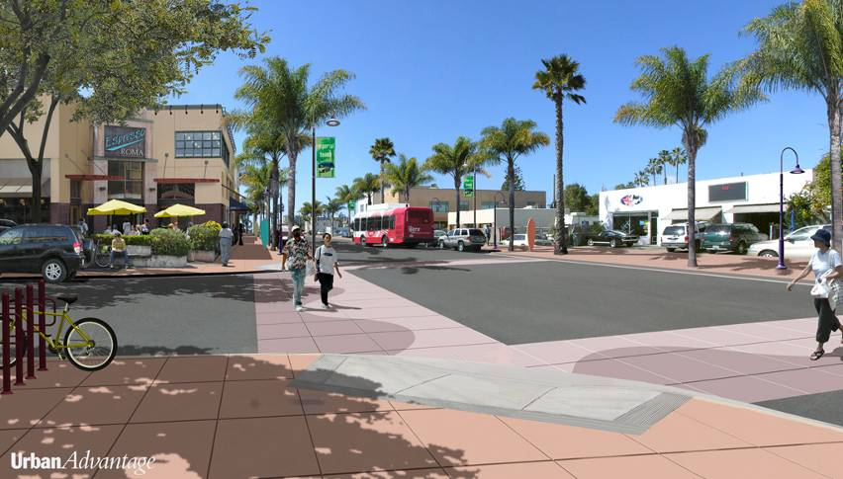
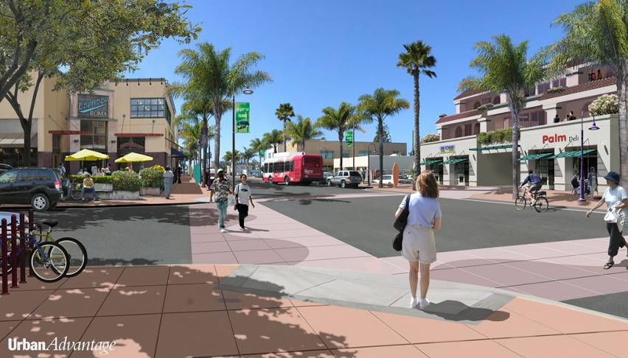
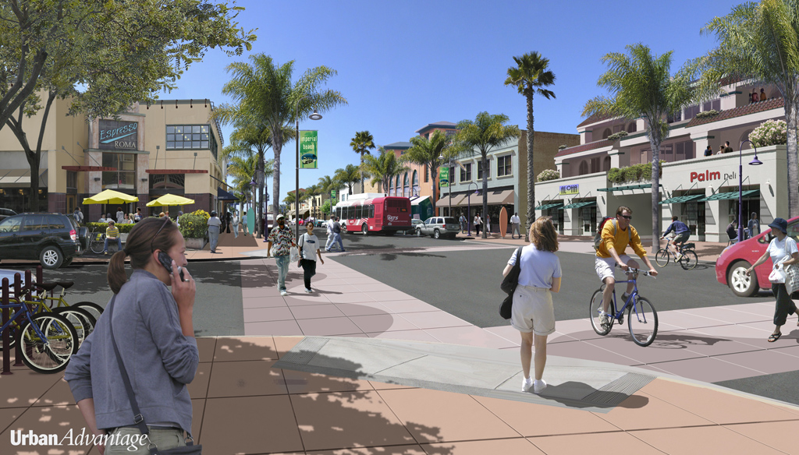
Old Palm Ave and Second Street Imperial Beach, CA
Notes:
Existing Conditions:
Numerous driveways reduce opportunity for on-street parking critical to main street shops.
Narrow sidewalks
No pedestrian scale lighting
Click 1:
Remove double-left turn lanes and curb cuts for driveways
Encourage on-street parking
Improve pedestrian crossings
Widen sidewalks and install bicycle stands
Plant street trees on curb side of sidewalks and install pedestrian-scale street lighting
Consider transit accessibility. Will development and public improvements make this an attractive and useful destination?
Click 2:
Bring in main street-type buildings – in this case, a tall one-story building to start to frame the street as a public space
Click 3:
Carefully bring in additional density. This three-story building is an owner-proposed project; note the driveway in the middle of the building. An occasional driveway may be acceptable, but should not be encouraged in a main street environment
Click 4:
Additional infill to produce a satisfying experience for the pedestrian walking down the street

Slide 18
Old Palm Ave and Second Street Imperial Beach, CA

Slide 19
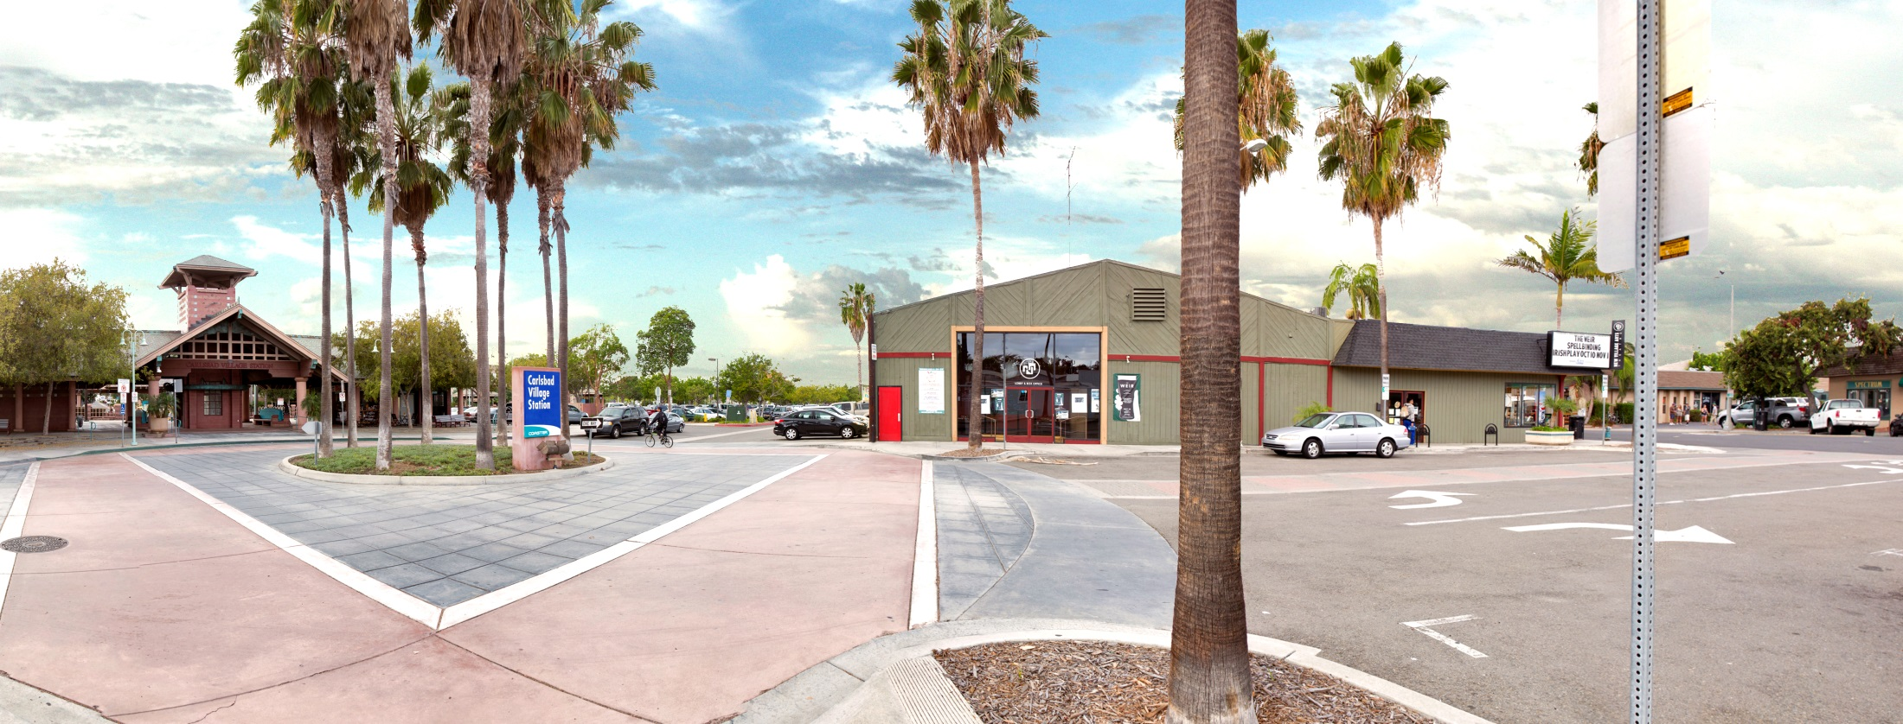
Carlsbad Village Coaster Station – Downtown Carlsbad, CA

Slide 20
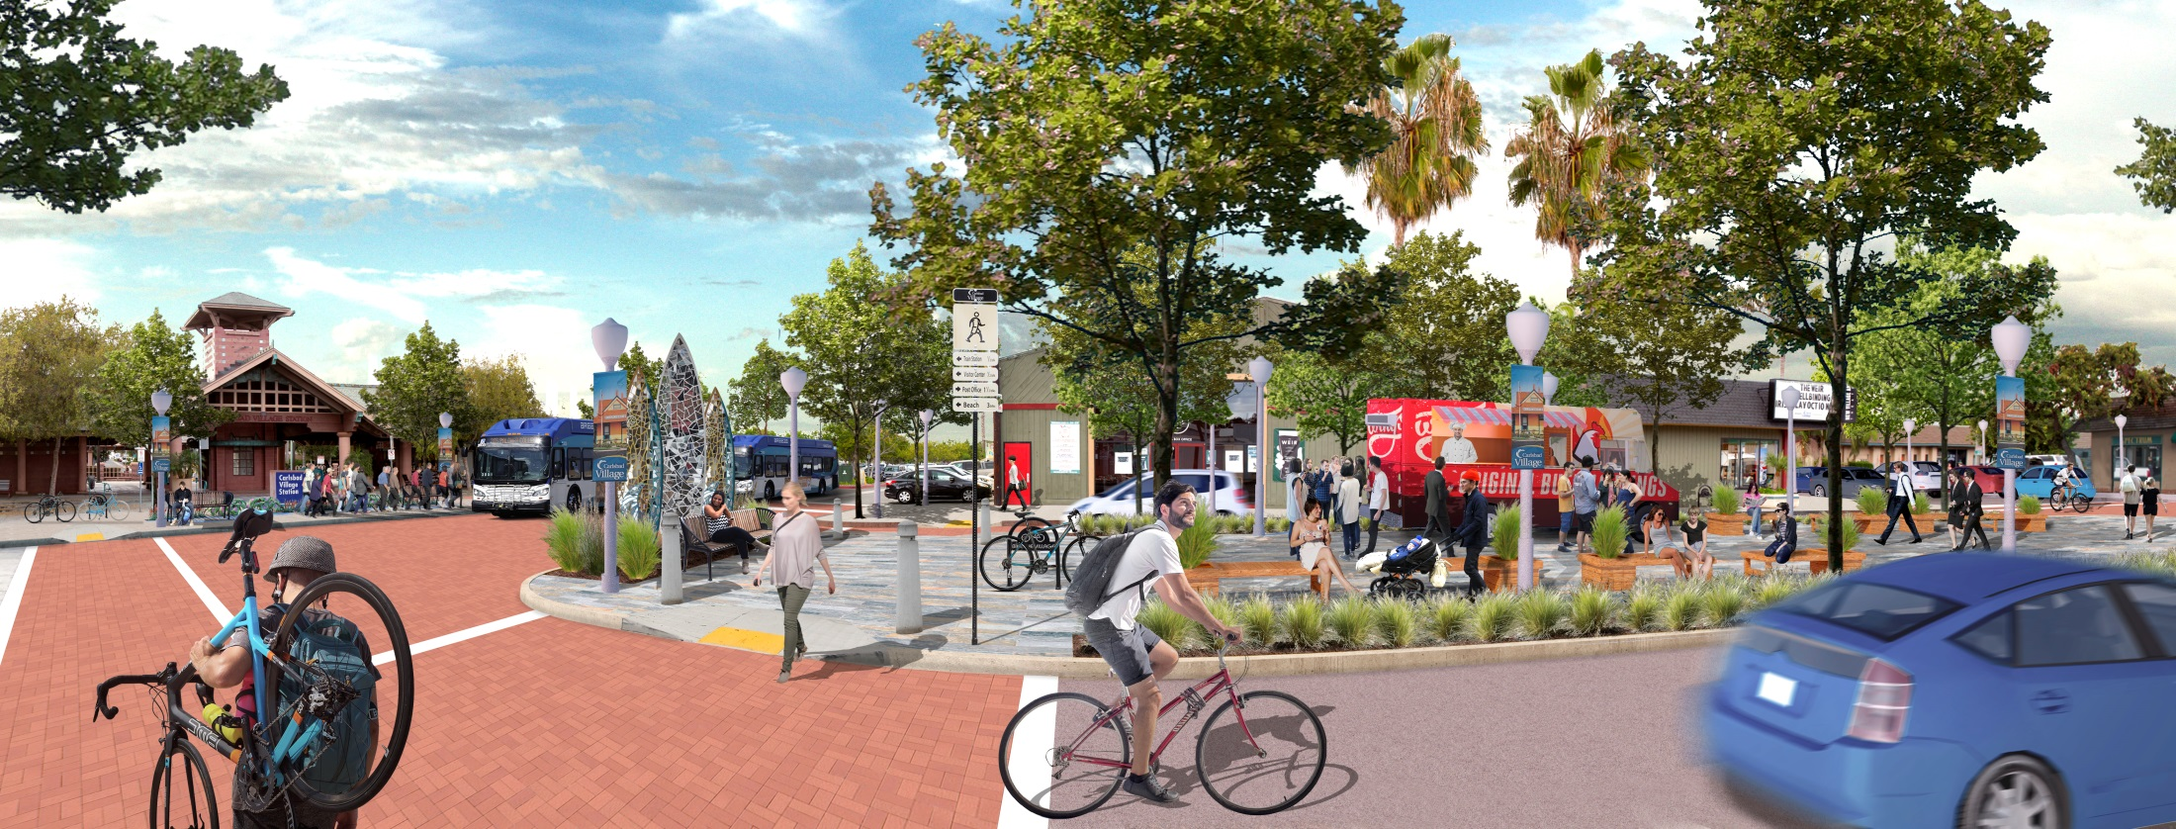
Carlsbad Village Coaster Station – Downtown Carlsbad, CA

Slide 21
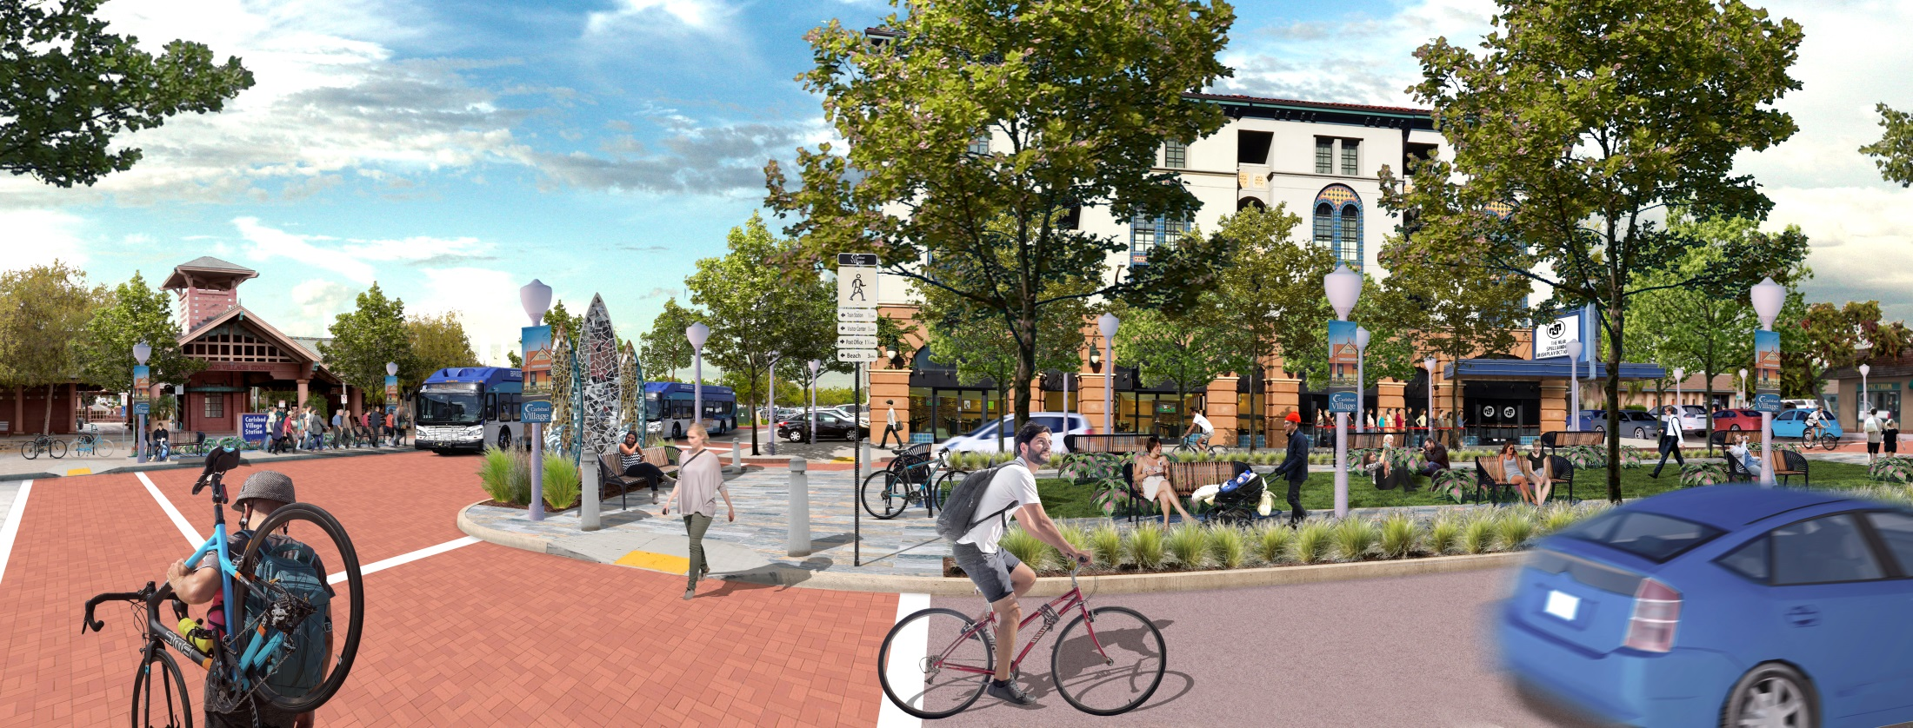
Carlsbad Village Coaster Station – Downtown Carlsbad, CA

Slide 22
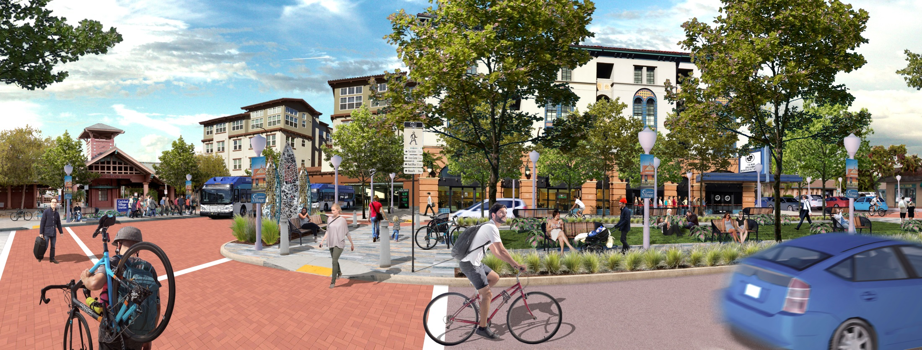
Carlsbad Village Coaster Station – Downtown Carlsbad, CA

Slide 23
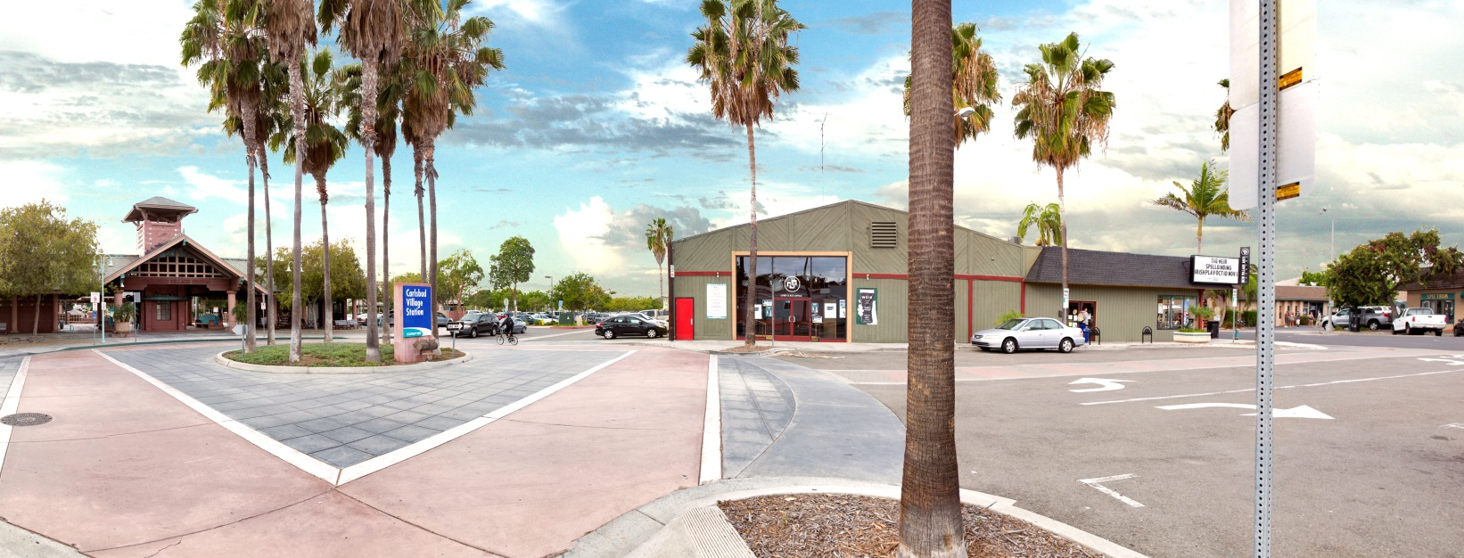
Carlsbad Village Coaster Station – Downtown Carlsbad, CA

Slide 24
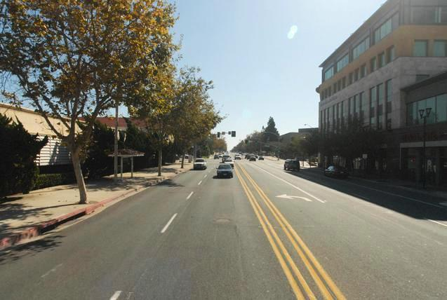
Chula Vista: Third Avenue – Before
Looking south towards H Street
COMPLETE STREETS IN THE CITY OF CHULA VISTA

Slide 25
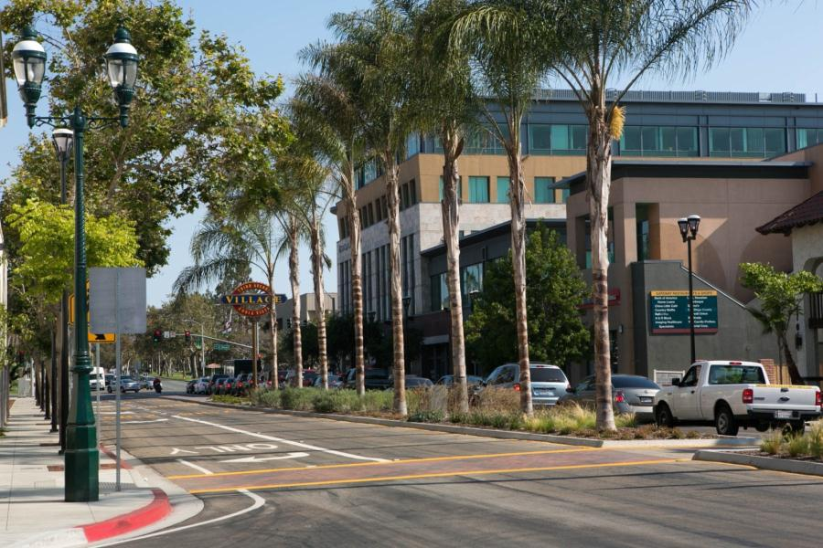
Chula Vista: Third Avenue – After
Before
COMPLETE STREETS IN THE CITY OF CHULA VISTA

Slide 26
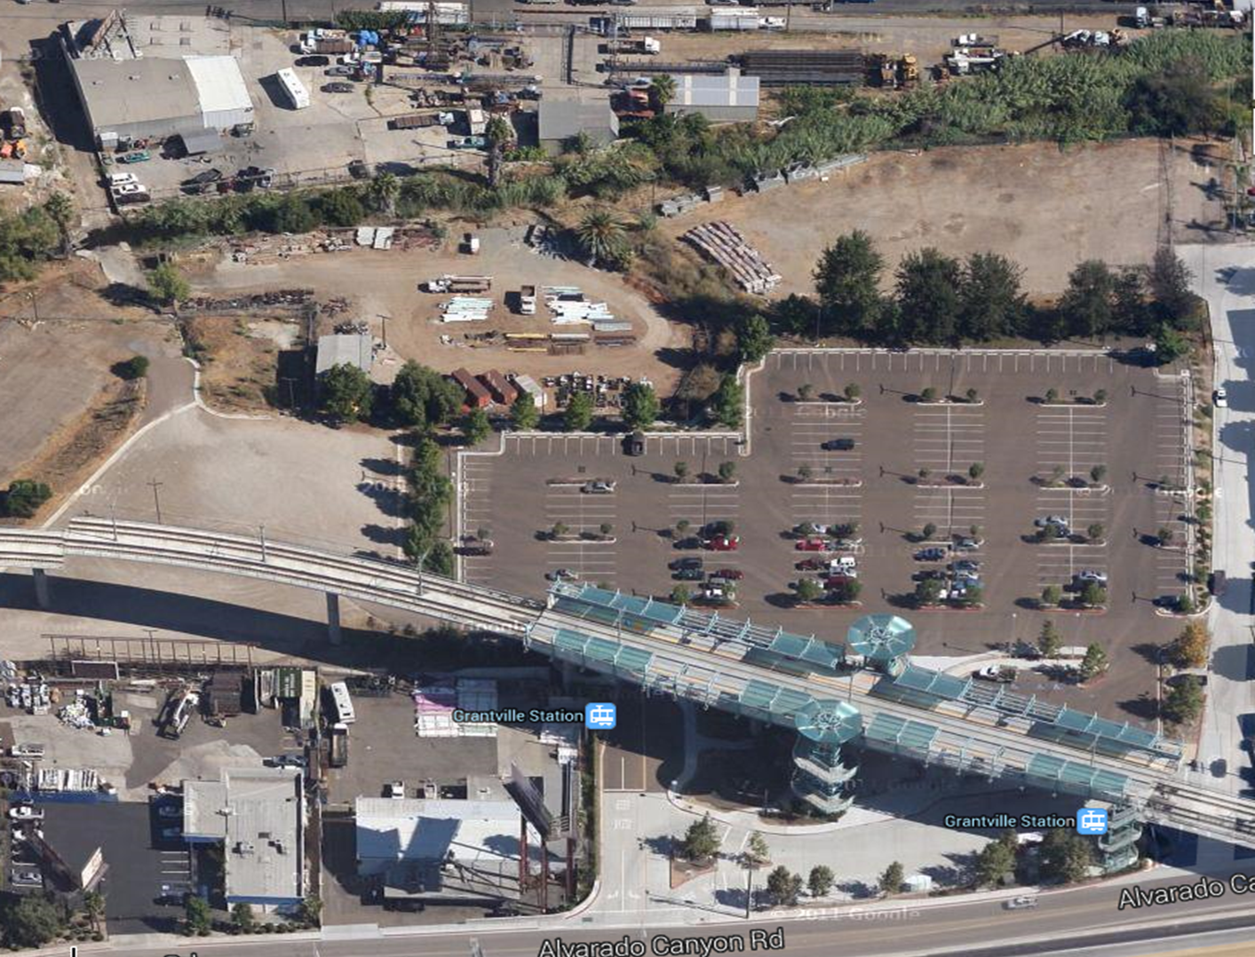
Grantville Trolley Station Area
Notes:
The overhead view of the trolley station shows the existing condition of the site. The area is surrounded by parking lots, auto-oriented development, and older industrial uses. Alvarado Creek is nearly inaccessible to the public and can barely be seen from above or on the ground.

Slide 27
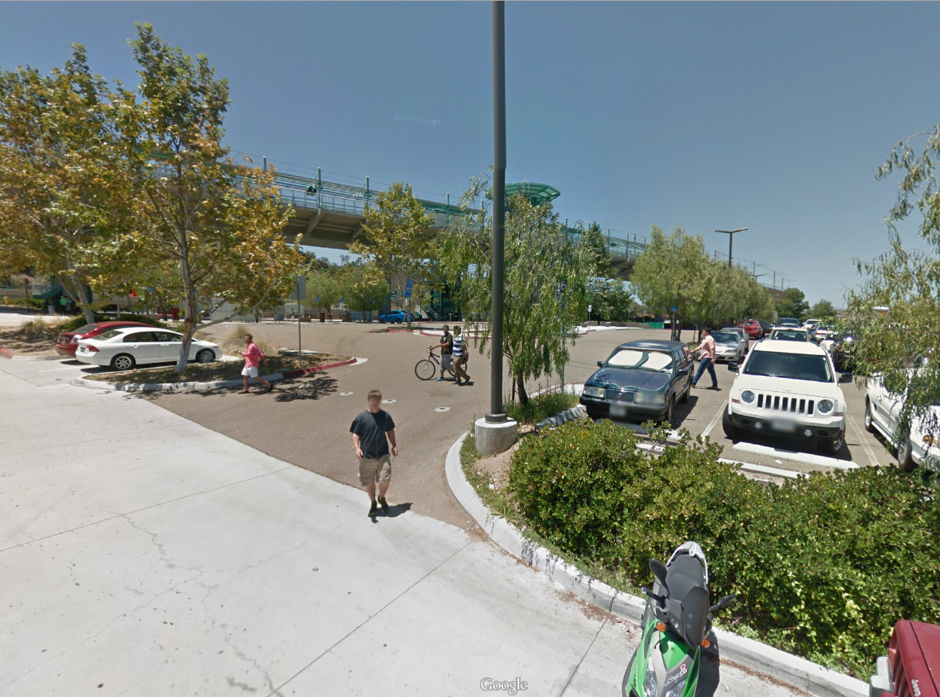
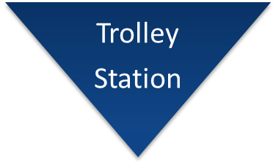
Grantville Trolley Station Area
Notes:
Google street view captured this perfect example of the need for change in Grantville. Just outside the trolley station, anyone walking or biking in the area has virtually no amenities like sidewalks or bike paths.

Slide 28
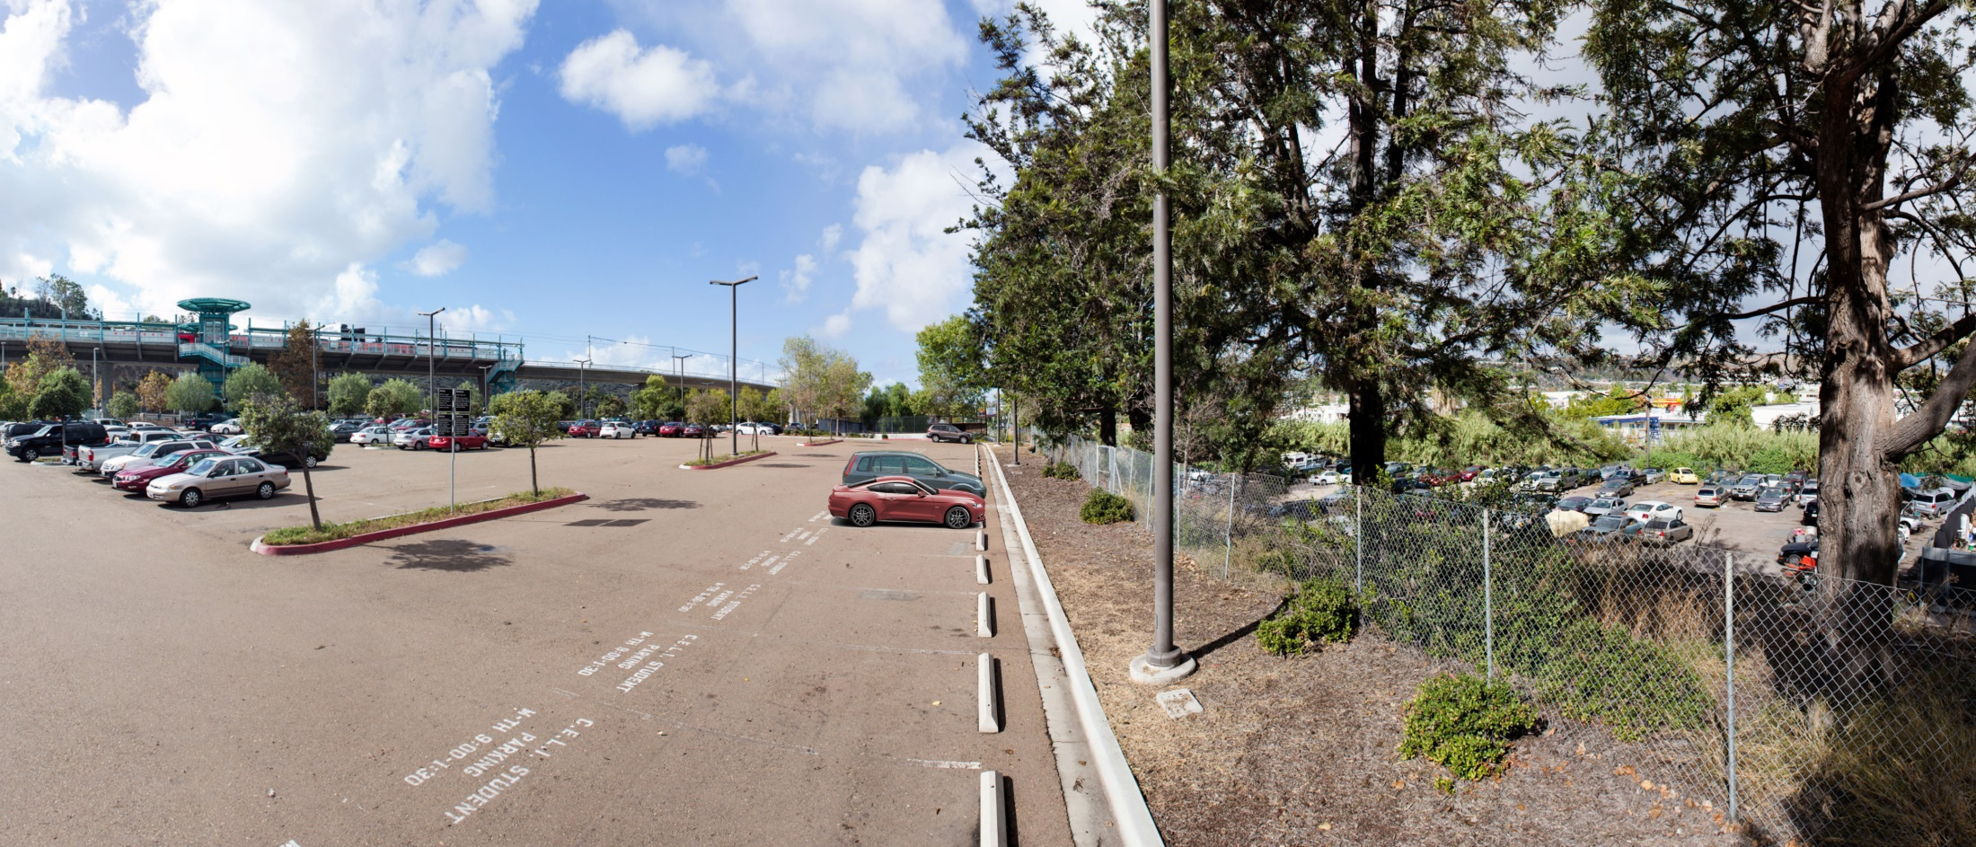
Grantville Trolley Station Area
Notes:
Our visual simulation captures a wide view of the trolley station on the left and Alvarado Creek on the right. The creek is nearly fully obstructed by plant growth and vehicle parking and a chain link fence separates the area from the trolley.

Slide 29
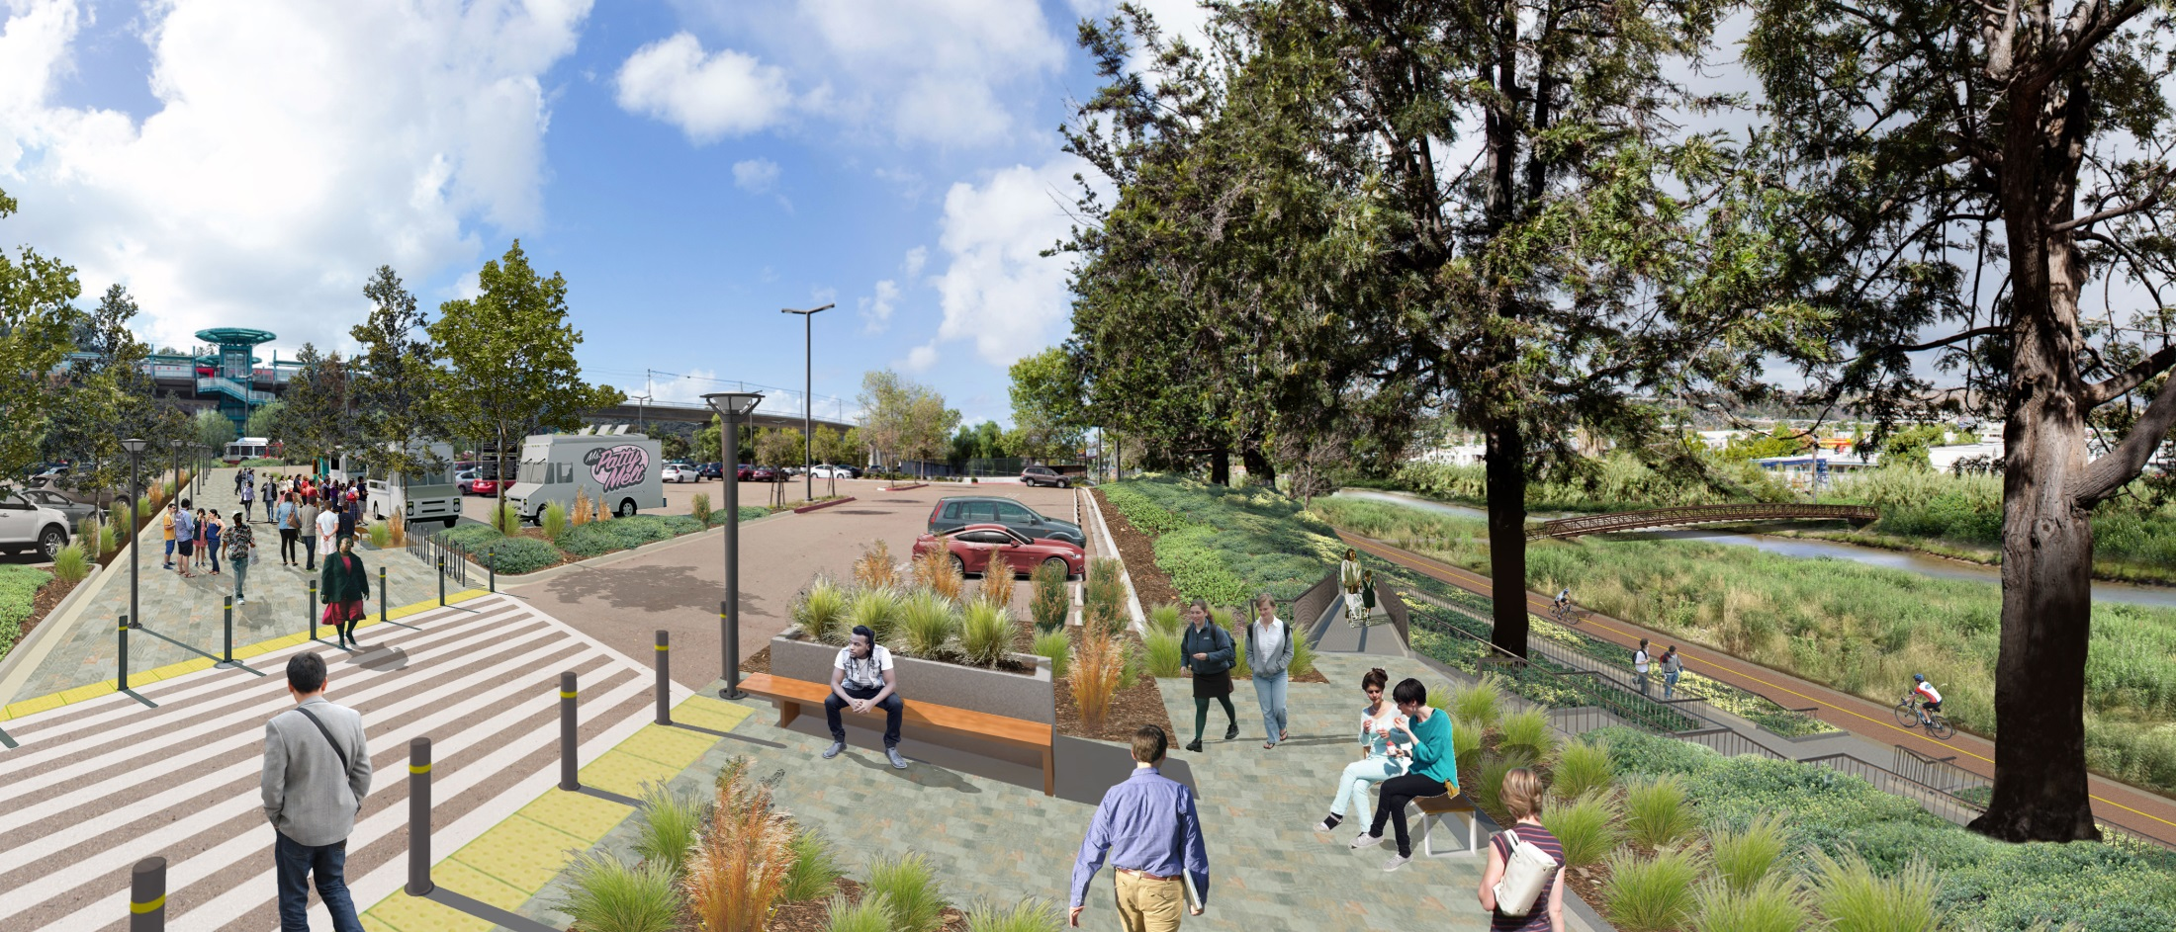
Grantville Trolley Station Area
Notes:
Through a SANDAG Smart Growth Incentive Program grant, the City is preparing a plan to improve Alvarado Creek. The plan will find solutions to the flooding, stormwater and water quality issues that occur periodically causing an impediment on future development. The plan will also identify how to create a pedestrian and bicycle circulation network along the creek, and provide opportunities for recreational amenities that connect residents to the creek. As you can see, the vision includes access to the trolley station for pedestrians and bicyclists, a walking and bike path along the creek, and a pedestrian bridge crossing to connect the trolley station to future development north of the creek. The creek becomes a visible, publicly accessible, open space enhancement rather than a hidden, channelized waterway prone to flooding during rainstorms. Pedestrian improvements are also shown near the trolley, removing the barriers to walking.

Slide 30
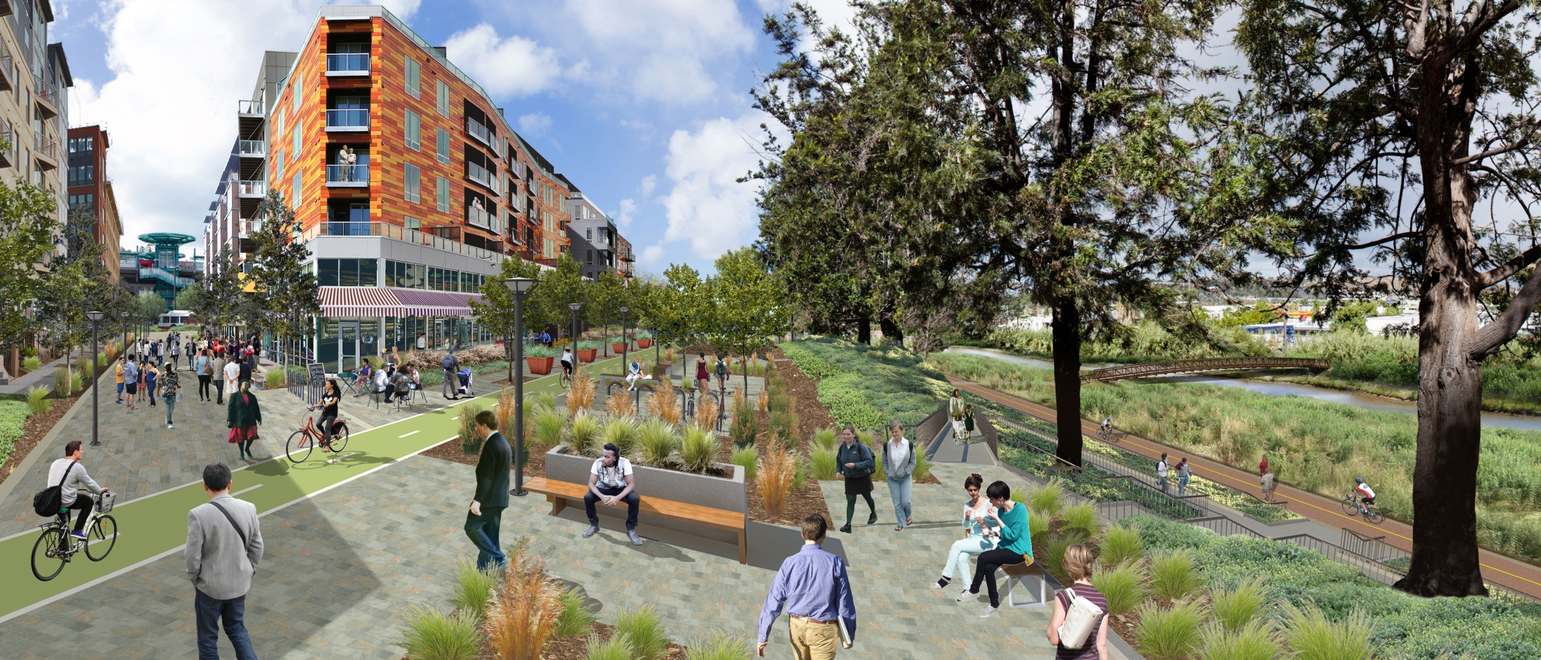
Grantville Trolley Station Area
Notes:
Once the amenities are in place, the vision for an Urban Village near the Grantville Trolley Station can come into form. The parking lot becomes an activity center for all users with ground floor commercial and residential units above it. The area becomes a place where residents are not reliant on a car as their only means of transportation. As one community resident stated upon the adoption of the Grantville Focused Plan Amendment, “Grantville can become the next Little Italy.”

Slide 31
Grantville Trolley Station Area
Notes:
So, in conclusion, this visual simulation demonstrates the implementation of the Grantville Focused Plan Amendment. By allowing transit oriented development, multi-modal transportation, new housing development, and improved access to Alvarado Creek, the neighborhood will be revitalized to become a destination for San Diegans and new example of an smart growth Urban Village for the entire region.

Slide 32
Tools, Programs, Near-Term Projects
Mobility Hub Implementation Strategy
http://www.sdforward.com/fwdAsp/mobilityhub.aspx
Bikeway, Grant, and Transit Projects
TransNet Story Map: KeepSanDiegoMoving.com
http://www.keepsandiegomoving.com/Home.aspx
Data Surfer
http://www.sandag.org/
http://www.sandag.org/index.asp?classid=26&fuseaction=home.classhome
Info Bulletins
Smart Growth / TOD Visual Simulations
http://www.sandag.org/index.asp?classid=12&projectid=335&fuseaction=projects.detail

