Slide 1
Transportation
David Grubb, Transportation Chair, San Diego Chapter, Sierra Club
Some slides and photos courtesy of Darrell Clarke, Transportation Chair, Angeles Chapter, Sierra Club

Slide 2
Why does the Sierra Club Care about Transportation
It is the largest source of Greenhouse Gas (GHG) emissions.
It has a big impact on land use and habitat.
It is a major source of pollution, including CO, NO2, and particulates.
It kills a lot of people (Crashes killed 3602 in Ca for 2017, 37,133 in US).

Slide 3
Particulates

Slide 4
US GHG Emissions by Sector

Slide 5
California GHG Emissions by Sector

Slide 6
Policies and Positions
Sierra Club Policy - https://www.sierraclub.org/policy#
Transportation - https://www.sierraclub.org/policy/transportation
Urban Infill Development Policy (New) - http://sandiegosierraclub.org/wp-content/uploads/Urban-Infill-Policy.pdf
Overview of Transportation Issues - https://www.sierraclub.org/transportation

Slide 7
What are we doing about it?
Litigation, Legislation, and Agitation
SANDAC - San Diego Activist Citizens
Quality of Life Coalition
Wildlife and Habitat Coalition
Clean Transportation For All Campaign

Slide 9
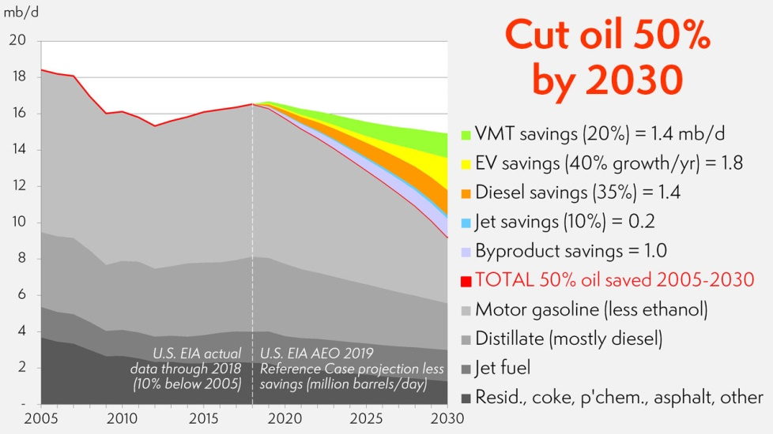
A model of campaign actions

Slide 10
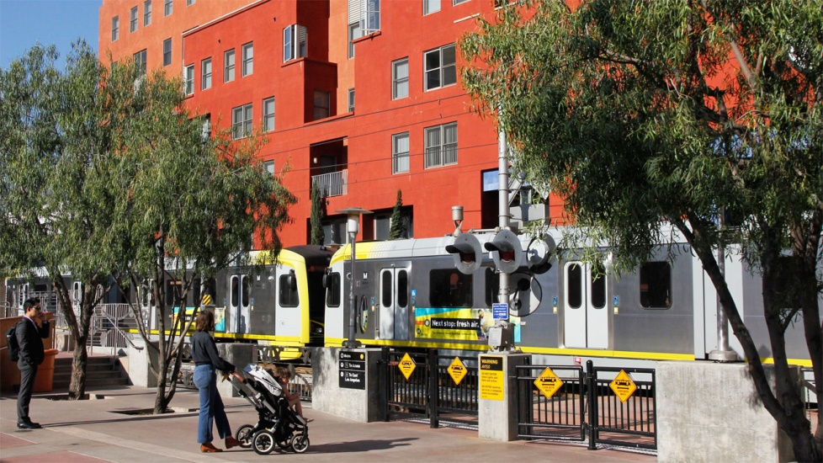
1. Drive less: 1a. Dense infill
Notes:
Green wedge in model

Slide 11
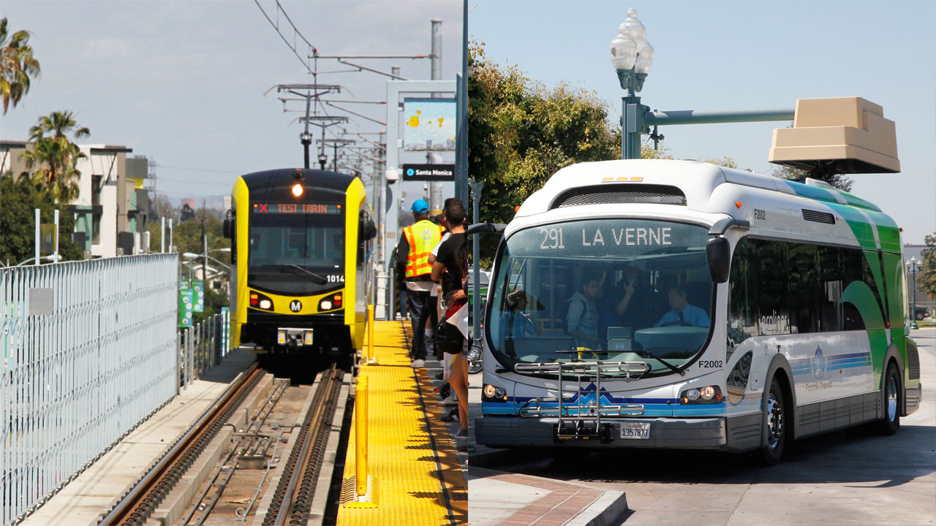
1b. Expand transit, create good regional plans

Slide 12
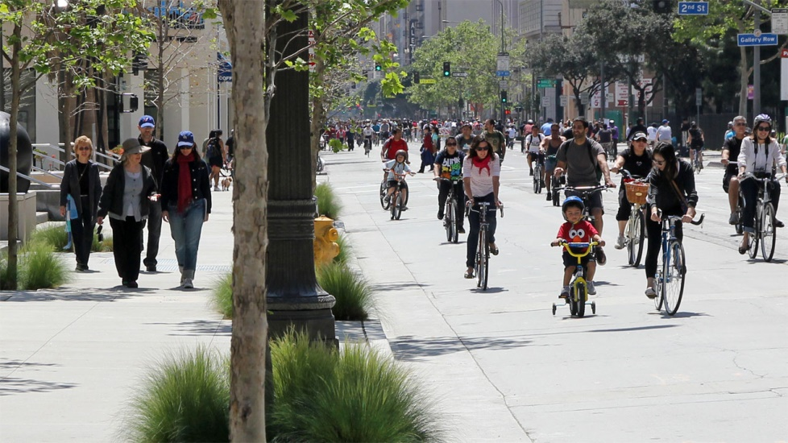
1c. Safe streets for walking, biking, scooting

Slide 13
1d. Parking pricing & other incentives to not drive alone

Slide 14
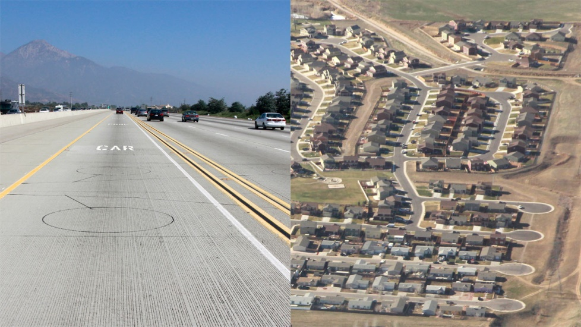
1e. Shift funding from highways & sprawl to solutions for less driving
Notes:
SB 375 requirements for Metropolital Planning Organizations’ (e.g. SCAG) Sustainable Community Strategies

Slide 15
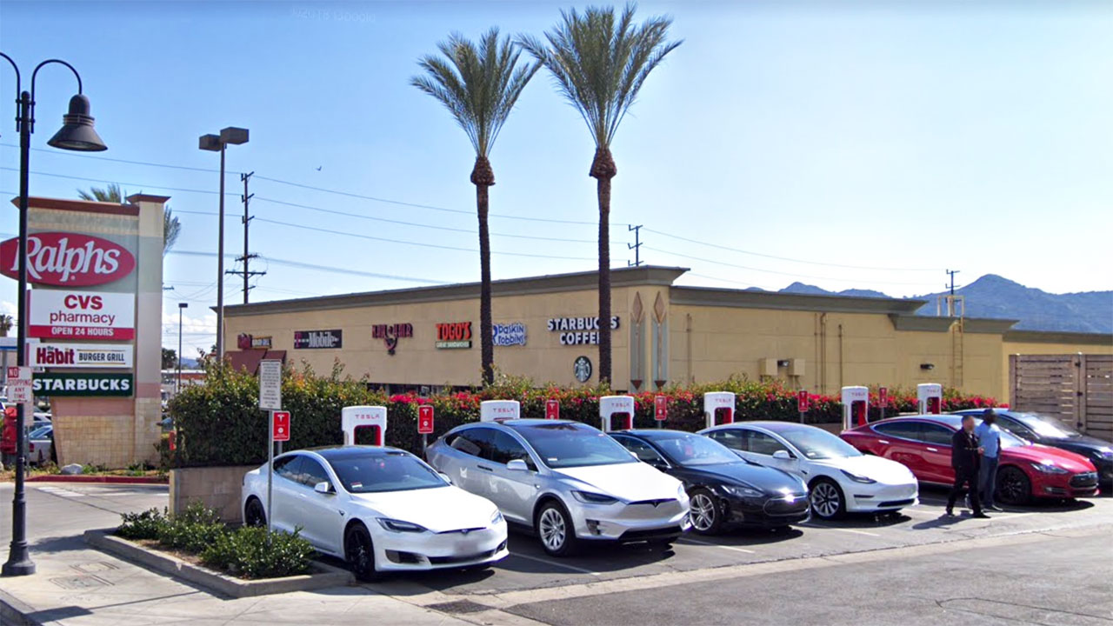
2. Electrify: 2a. Rapidly expand electric cars and charging
Notes:
Yellow wedge in model

Slide 16
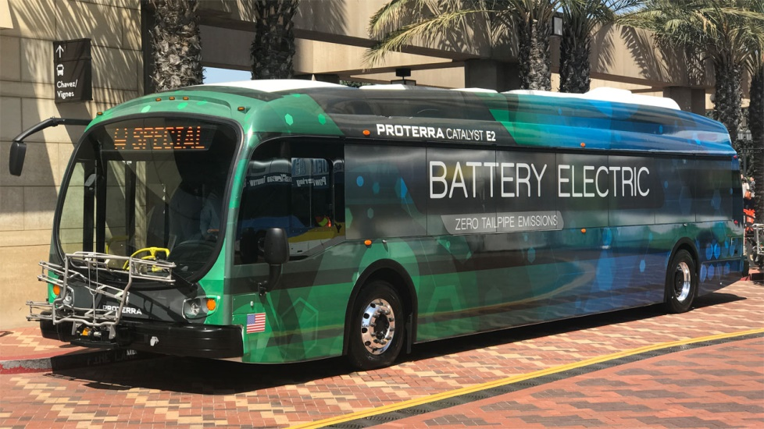
2b. Electric buses

Slide 17
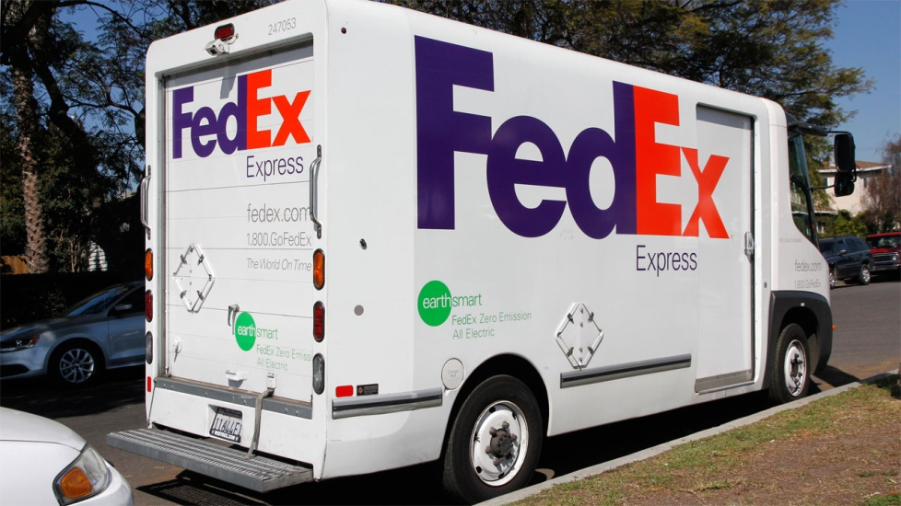
2c. Electric local & long-distance trucks
Notes:
Orange wedge in model

Slide 18
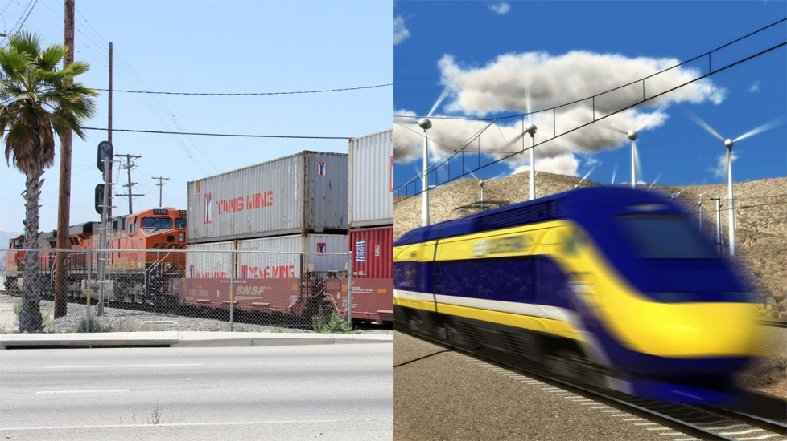
2d. Freight and passengers to rail and electrify
CHSRA image

Slide 19
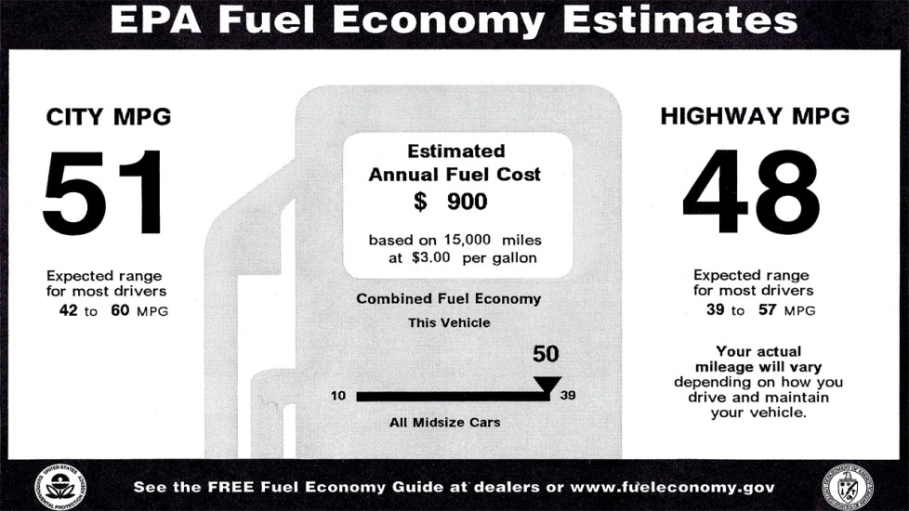
3. Defend MPG standards

Slide 20
San Diego Chapter Positions
We support the 5 Big Moves, but...
We opposed the Transnet Extension in 2004, and we still oppose it.
We support good Climate Action Plans with enforceable measures to reduce GHG emissions.
We oppose bad Climate Action Plans, and we sued the County twice over theirs.

Slide 21
Points to Remember
Expanding highways does not fix congestion, it just promotes more driving.
There is no such thing as free parking, but there is plenty of subsidized parking.
Every car trip starts and ends at a parking space.
More people telecommute than ride transit.

Slide 22
Reduce GHG Emissions Starting Now!
Mandatory Transportation Demand Management.
Promote Telecommuting.
Impose a “Congestion Abatement Fee” on every parking space.

